Slide 1
MARKETING DEVELOPMENT & PERFORMANCE REPORT
Prepared for:
RCCA
07-01-16 to 09-30-16

Slide 2
INTERNET
Search Engine Optimization
Website Executive Summary
Website Unique Calls 105
SEO Executive Summary
Overall Monthly Visibility | 40%
Keywords Ranked 1st | 47
Keywords in Top 3 | 79
Keywords in Top 10 | 121
Summary
Regional Cancer Care Associates’ overall monthly visibility for the keywords is up 40% since our first time tracking this website.
The website currently has an additional 47 keywords ranked in the #1 spot, 79 additional keywords ranked in the Top 3 and an additional 121 keywords ranked in the Top 10 on Google, Google Mobile, Yahoo and Bing.

Slide 3
INTERNET
Social Media & Reputation
Social Media Executive Summary
New Facebook Fans | 5
New Twitter Followers | -
Impressions | 5,379
Summary
RCCA had a steady quarter in terms of social media. They gained 5 organic likes and had no unlikes.
They also had several successful posts during that quarter that reached a large majority of their followers.
We continue to try to share content that is interesting to followers and encourages engagement.

Slide 4
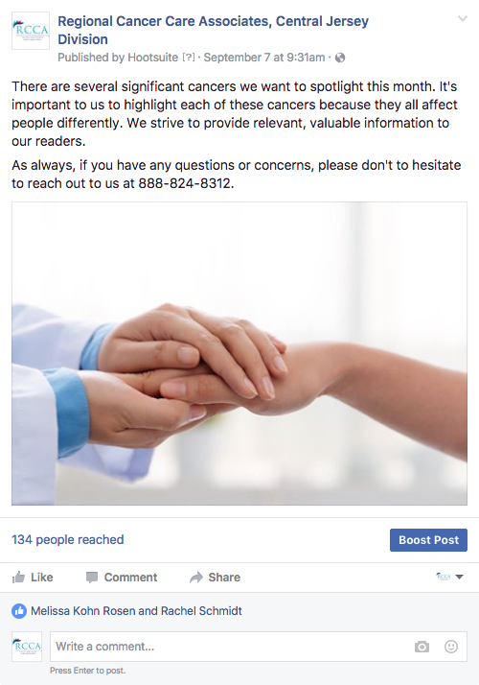
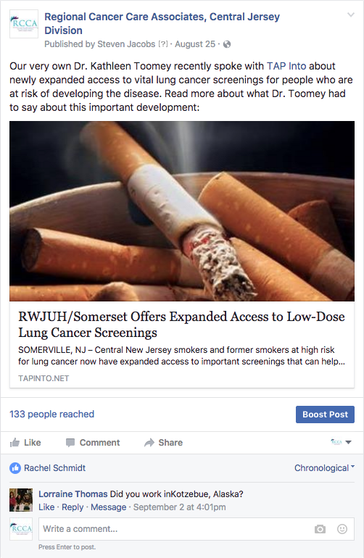
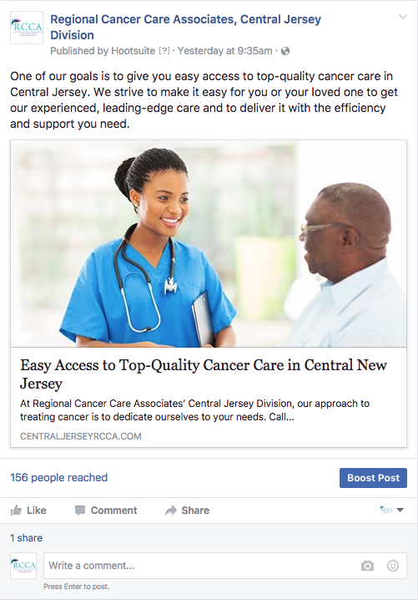
INTERNET
Social Media & Reputation
Top Performing Social Media Posts

Slide 5
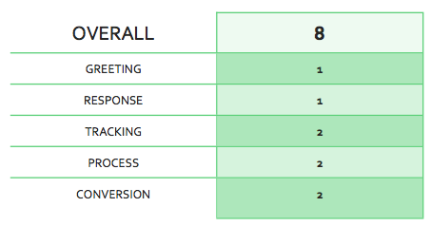
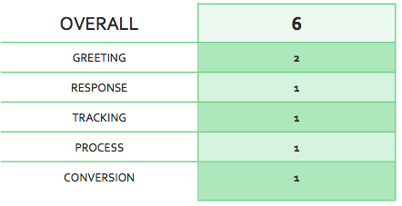
PERFORMANCE & TRAINING
Summary
The staff is doing better on the calls. There is still long wait time, however phone skills and leadership training will be performed to focus on continued improvement.
Monthly progress reports and suggestions will be ongoing.
Progress Report Summary
August

Slide 6
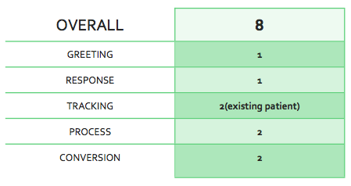
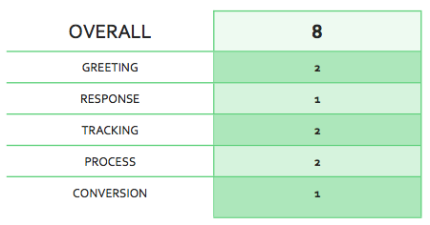
PERFORMANCE & TRAINING
September

