Slide 1

MARKETING DEVELOPMENT
& PERFORMANCE REPORT
Prepared for:
RCCA
10-01-16 to 12-31-16

Slide 2
INTERNET
Search Engine Optimization
Website Executive Summary
Website Unique Calls 116
SEO Executive Summary
Overall Monthly Visibility | 50%
Keywords Ranked 1st | 62
Keywords in Top 3 | 145
Keywords in Top 10 | 242
Summary
Regional Cancer Care Associates’ overall monthly visibility for the keywords is up 50% since our first time tracking this website.
The website currently has an additional 48 keywords ranked in the #1 spot, 112 additional keywords ranked in the Top 3 and an additional 164 keywords ranked in the Top 10 on Google, Google Mobile, Yahoo and Bing.

Slide 3
INTERNET
Social Media & Reputation
Social Media Executive Summary
New Facebook Fans | 5
New Twitter Followers | 7
Impressions | 17,600
Summary
RCCA had a steady quarter in terms of social media.
Key Facebook Results:
4 paid likes
9 organic likes
5 unlikes
Audience growth increase of 2.1%

Slide 4
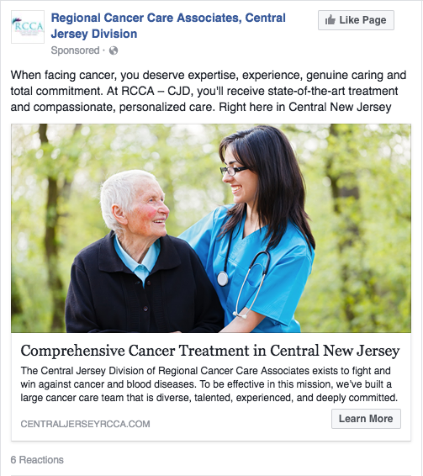
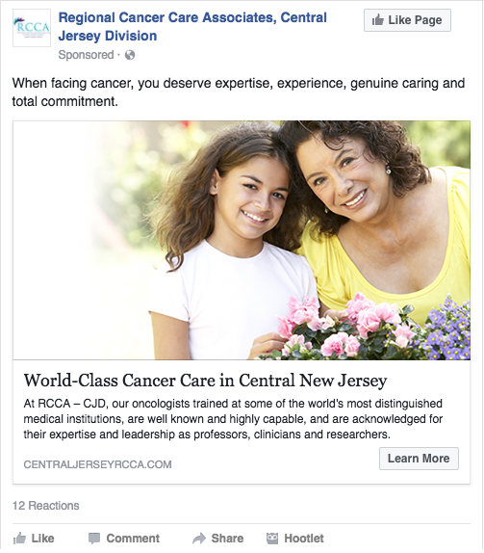
INTERNET
Social Media & Reputation
Facebook Ads
We started running 2 ads in mid-December. So far the ads have resulted in:
  435 clicks
Average CPC of $0.29
Average CTR of 3.42%
Reached 7,400 people

