Slide 1
MARKETING DEVELOPMENT & PERFORMANCE REPORT
Prepared for:
RCCA
01-01-17 to 03-31-17

Slide 2
Online & Offline Media
Online & Offline Media Executive Summary
Online Media Spend $0.00 | Online Media Leads 0 | Online Media CPL $0.00
Est. Offline Media Spend $1,784.70 | Offline Media Leads 8 | Offline Media CPL $223.09
Website Executive Summary
Website Unique Calls 158

Slide 3
Online & Offline Media
Offline Media Summary
Offline Media Summary
Source | Unique Calls
Homer News Tribune | 8
Total: | 8

Slide 4
INTERNET
Search Engine Optimization
SEO Executive Summary
Overall Monthly Visibility Increase | 42%
Additional Keywords Ranked 1st | 53
Additional Keywords in Top 3 | 138
Additional Keywords in Top 10 | 214
Summary
Central Jersey RCCA’s overall monthly visibility for the keywords is up 42% on Search Engines since we’ve began to monitor the website.
The website currently has an additional 53 keywords ranked in the #1 spot, 138 additional keywords ranked in the Top 3 and an additional 214 keywords ranked in the Top 10 on Google, Google Mobile, Yahoo and Bing.

Slide 5
INTERNET
Social Media & Reputation
Facebook Executive Summary
New Fans | 39
Total Fans | 280
Impressions | 116,200
Summary
They had a strong quarter: 39 Net new likes, which is a 16.2% increase from the previous quarter.
17 Paid likes
26 Organic likes
4 Unlikes
48 Clicks to the website
2,116 Organic impressions
We had a few posts that did very well. (see attached screenshots: Video, Breast cancer seminar, & what's new in lung cancer)

Slide 6
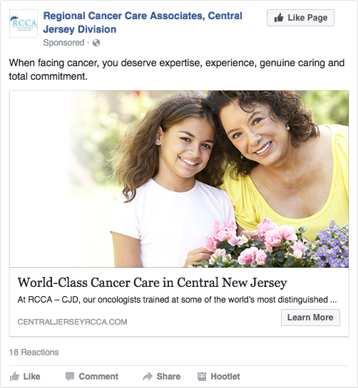
INTERNET
Social Media & Reputation
Facebook Ads:
All Ads:
2,791 clicks to the website
Average CPC: $0.20
Average CTR: 2.86%
Woman with Nurse Ad:
671 Clicks to the website
CPC: $0.07
CTR: 2.93%
Mother/Daughter Ad:
485 Clicks to the website
CPC: $0.13
CTR: 2.83%

Slide 7
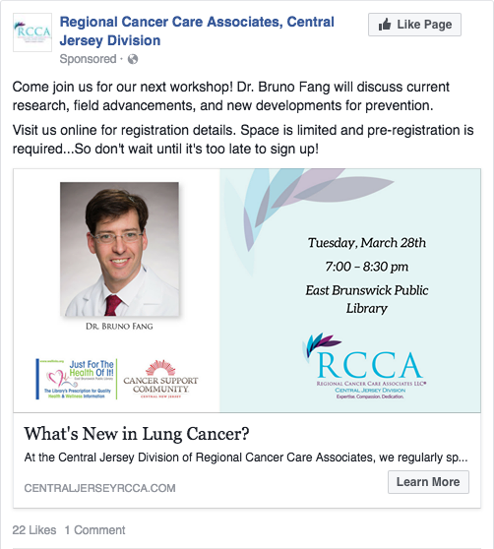
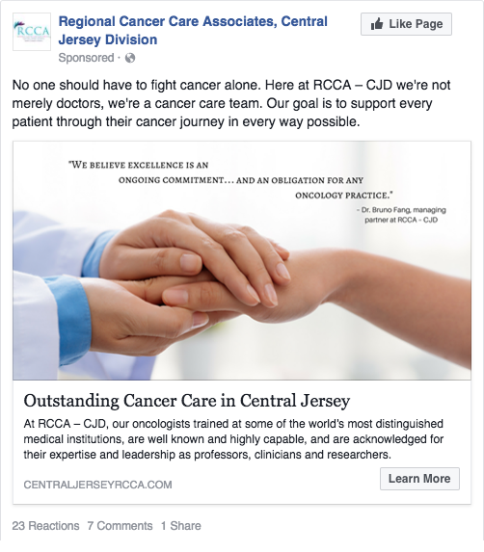
INTERNET
Social Media & Reputation
Facebook Ads:
Coping with Cancer in the Kitchen Ad:
158 Clicks to the website
CPC: $0.63
CTR: 3.12%
Dr. Fang Seminar Ad:
316 Clicks to the website
CPC: $0.32
CTR: 2.03%
Holding Hands Ad:
1,161 Clicks to the website
CPC: $0.22
CTR: 3.1%
Ad received extra audience engagement, including some very nice comments about Dr. Fang

