Slide 1

Where Orthopedic Stem Cell Injections were Invented
Insert your practice and name

Slide 2

In 2005, we were the first clinic on earth to begin treating orthopedic conditions using precise stem cell injections…

Slide 3
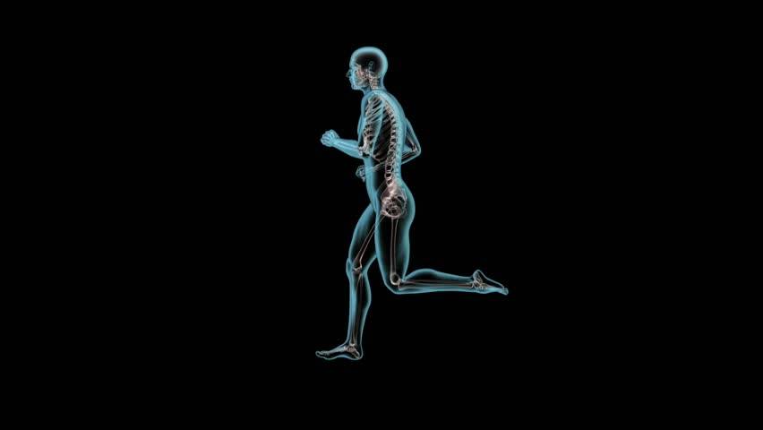
All of this represents a new medical specialty: Interventional Orthopedics…

Slide 4
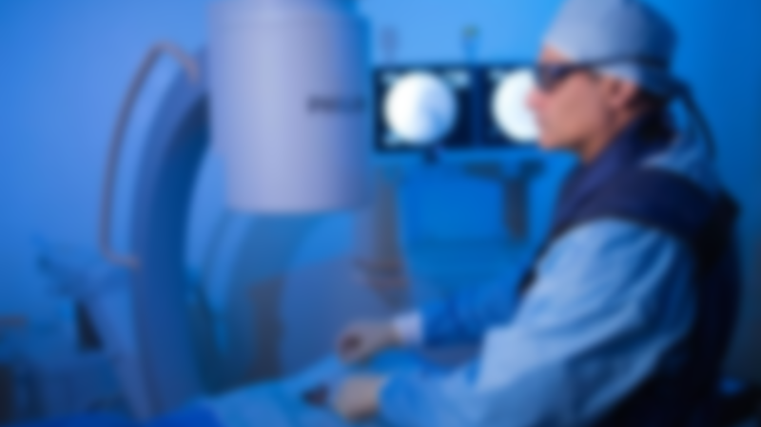
What is Interventional Orthopedics?
The core tenants of this new medical specialty are:
Injectates that can facilitate healing of bone, tendon, ligament, muscle, or cartilage
Precise placement of those injectates into damaged structures using imaging guidance
The development of new tools to facilitate percutaneous tissue manipulation

Slide 5
What is Interventional Orthopedics?
Quadriceps
Tendon
Inside the Femur Bone
ACL
PCL
Inside the Patella Bone
Simple Inside the Joint (Intra-articular) Injection
LCL
Patello-femoral Joint
Lateral Hamstrings Insertion
Simple Inside the Joint (Intra-articular) Injection
Patellar Tendon
Meniscus
Tib-Fib Joint
Inside the Socket Bone
Inside the Femur Bone
Pes Anserine
Rotator Cuff Tendons (Supraspinatus, Infraspinatus, Subscapularis, Teres)
AC Joint
AC Ligament
Labrum
Suprascapular Nerve Block
Ligaments
Psoas Tendon
ITB
SGHL
Advanced Inside the Joint (Intra-articular) Injection
Superior Labral Anchor
Adductor Tendon
Simple Intra-articular
Inside the Humerus Bone
MGHL
Inside the Socket Bone
Simple Inside the Joint (Intra-articular) Injection
Hamstrings Tendon
Biceps Tendon
Labrum
IGHL
Simple
Injections
Interventional
Orthopedics
Surgery
4% of US Physicians
1% of US Physicians
95% of US Physicians

Slide 6
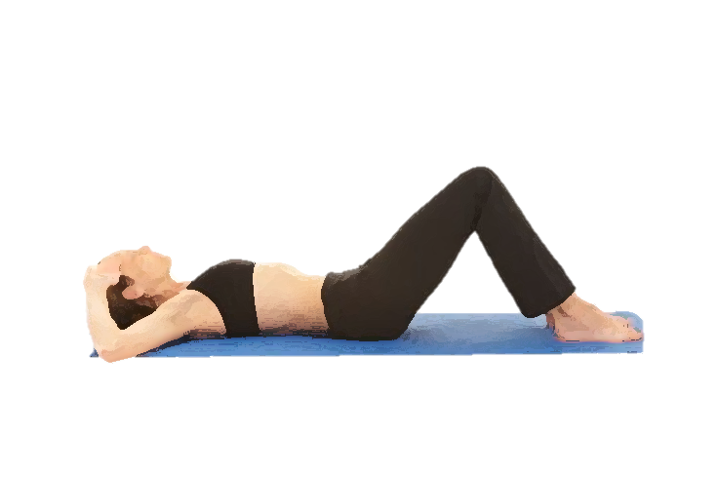
We perform precise image guided stem cell and platelet procedures to treat:
Neck pain
Headaches
Upper back pain
Shoulder arthritis, rotator cuff tears, and labral tears
Wrist TFCC and thumb arthritis, elbow
Low back pain, sciatica, facet syndrome, disc herniations, bulges, and stenosis
Hip arthritis and labral tears
Knee arthritis, meniscus tears, ACL tears
Ankle arthritis, ligament and tendon tears

Slide 7
We are very different than any other “stem cell” clinic:
Highly trained physicians
1
All injections performed using fluoroscopy or US or both
2
Your cells custom processed in a clean room facility and not a simple bedside machine
3
Multi-million dollar lab and clinical research facility on site
4
Fellowship program
5
World headquarters for 60+ sites world-wide
6

Slide 8
Examples of Interventional Orthopedics

Slide 9
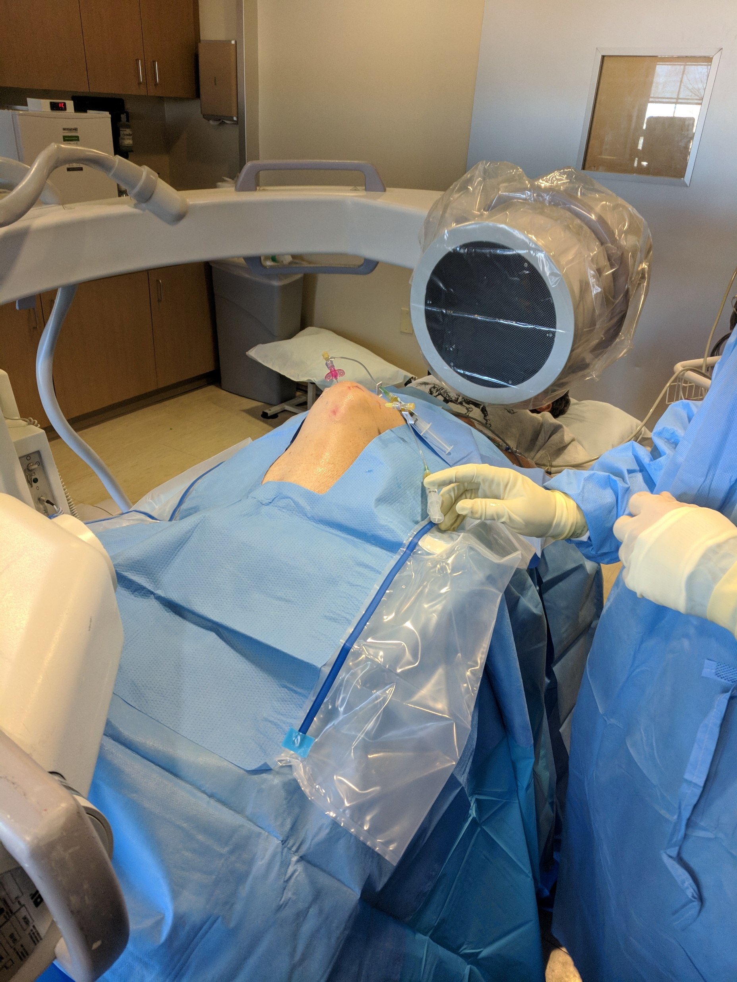
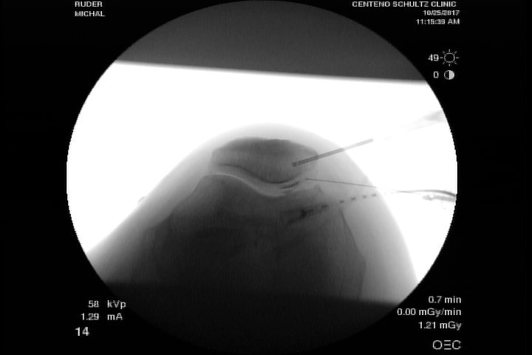
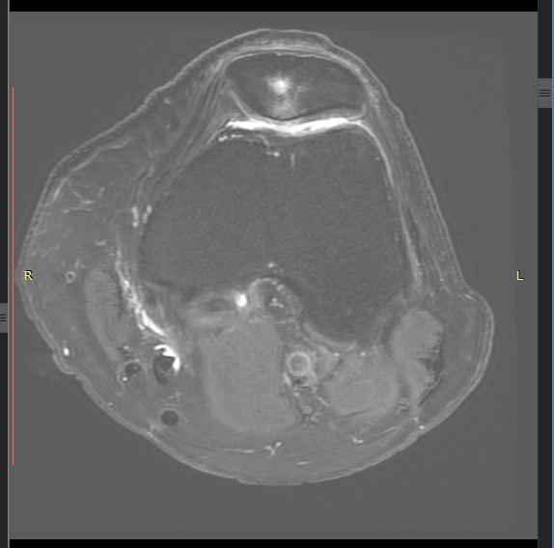

Slide 10
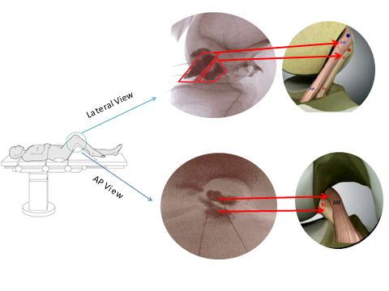
Injecting the ACL bands (AM and PL) under fluoro because US doesn’t show the origin…

Slide 11
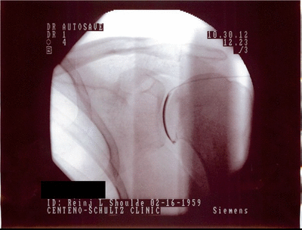
Shoulder SLA

Slide 12
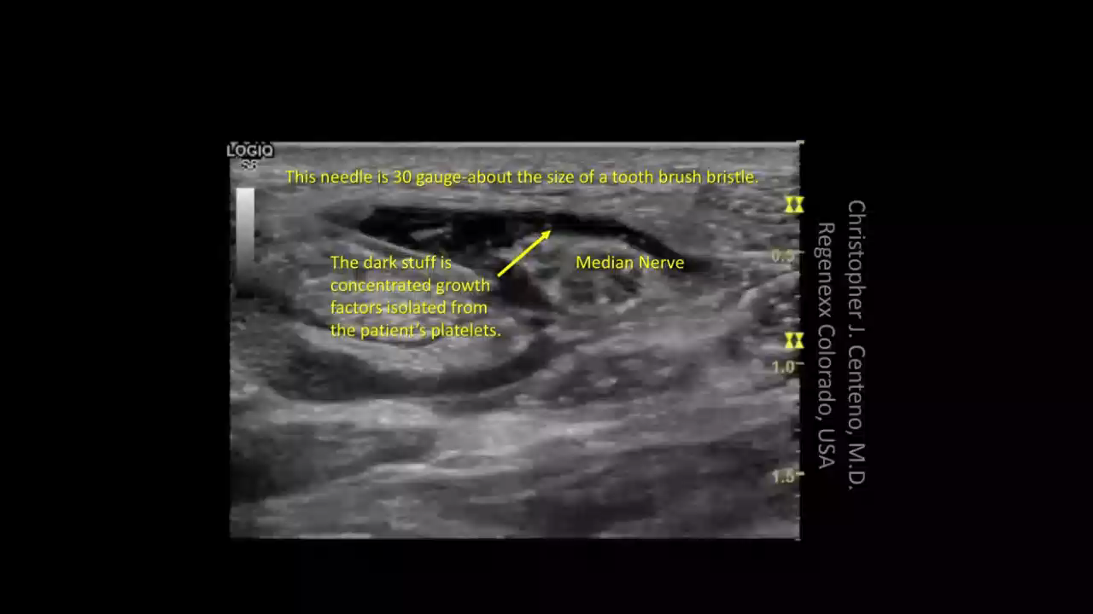
Injecting platelet derived growth factors around the median nerve with a 30 gauge needle:

Slide 13
Why will Interventional Orthopedics replace elective orthopedic surgery?
Less Invasive
Quicker recovery
Preservation of Biomechanics

Slide 14
What do we inject?
Orthobiologics
Growth Factor Enriched Serums
Bone Marrow
Stem Cells
Cytokine Enriched
Serums
Concentrated Platelets

Slide 15




Growth Factors vs. Cytokines vs. Stem Cells
Growth factors are like espresso shots for the local repair cells to kick start healing
Cytokines are natural chemical messengers that tell cells to do things or clean up other bad chemicals. For example, A2M is a cytokine that gets rid of inflammatory chemicals that destroy cartilage.
Stem cells are like general contractors that can direct other cells to repair tissue damage and then at the end of the day turn into the bricks and mortar.

Slide 16
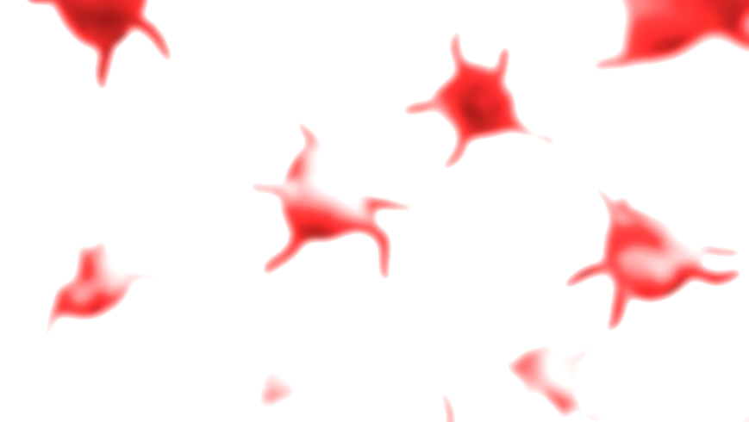
Concentrated Platelets
Platelet Rich Plasma (PRP) is using your own concentrated platelets to help heal your body
Platelets do this through the release of growth factors
We can concentrate PRP many times higher with our state of the art lab than can be achieved with simple bedside machines used by almost all other physicians
This procedure works well for mild arthritis and small tendon and ligament tears

Slide 17
Growth Factor Enrighed Serum
(Platelet Lysate)
Platelet lysate is created by isolating the growth factors
Based on extensive experience, we use this mixture around nerves rather than PRP as it’s more anti-inflammtory and has growth factors that can help in nerve repair and establishing new blood supply
We use this extensively to treat spine conditions and compressed nerves like carpal tunnel

Slide 18
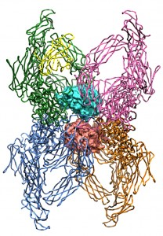
Cytokine Enriched
Serums
We can concentrate A2M, which is an anti-inflammatory cytokine
It gets rid of inflammatory chemicals in the joint that breakdown cartilage so it’s believed that this therapy may help reduce cartilage breakdown and advancement of arthritis

Slide 19
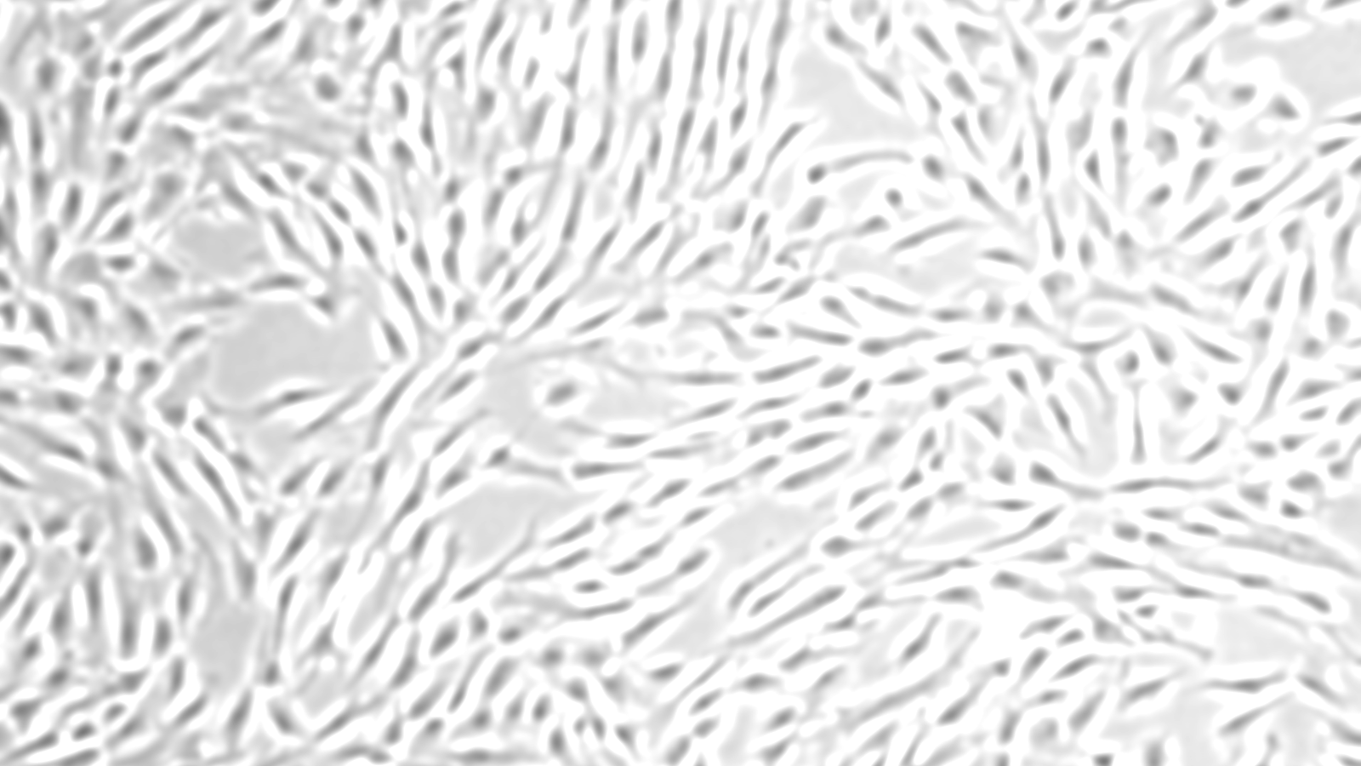
Stem Cells
We isolate and concentrate these stem cells from bone marrow aspirate
These can help repair tissue
We can concentrate these to much higher levels in our lab than can be achieved by the simple bedside centrifuges used by almost all physicians

Slide 20
Let’s focus on these just 3 of the many body areas we treat.
Knee
Knee arthritis patients requiring knee replacement
Shoulder
Shoulder rotator cuff tears
Knee
Knee ACL tears

Slide 21
Knee Arthritis: Avoiding Knee Replacement

Slide 22

30,000 foot view…
We’re able to help many patients with:
  Severe arthritis avoid a knee replacement
    This doesn’t work by growing you a new knee
    It works by making the toxic chemical environment in your knee healthier
  Mild arthritis prevent it from getting worse
  Knee meniscus tears
  Arthritis due to prior surgeries

Slide 23
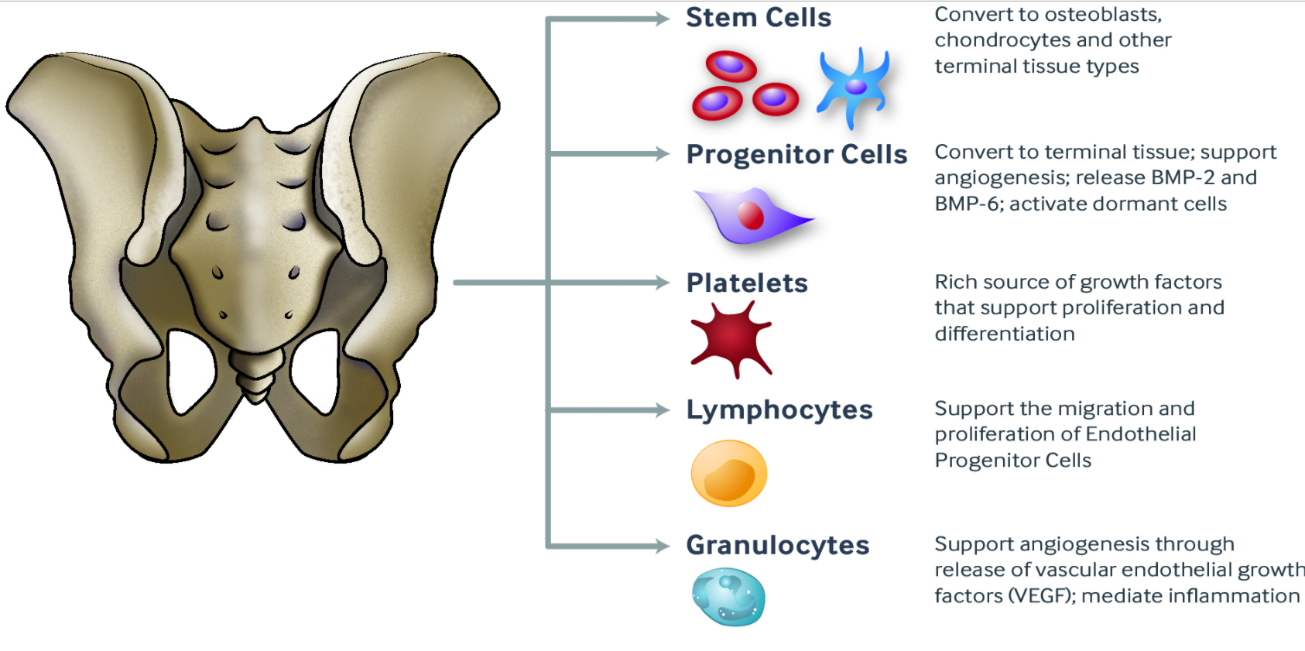
All reported outcomes discussed here used High Dose Bone Marrow Concentrate containing Live Stem Cells
Buffy coat removed manually and reinjected in the same surgical procedure. Peripheral blood drawn to isolate LP-PRP.

Slide 24
Helping Patients Avoid Knee Replacement:
We are tracking 5,852 knee procedures going back to 2005 as of 3/1/17
01
3,450 have knee OA as primary diagnosis-2/3rds TKA candidates
02
TKA rate despite treatment at 1-2 years is 12.7%*
03
*100 patient sample (135 knees) used to achieve 100% follow-up and then chart review for TKA candidacy and progression to TKA.

Slide 25
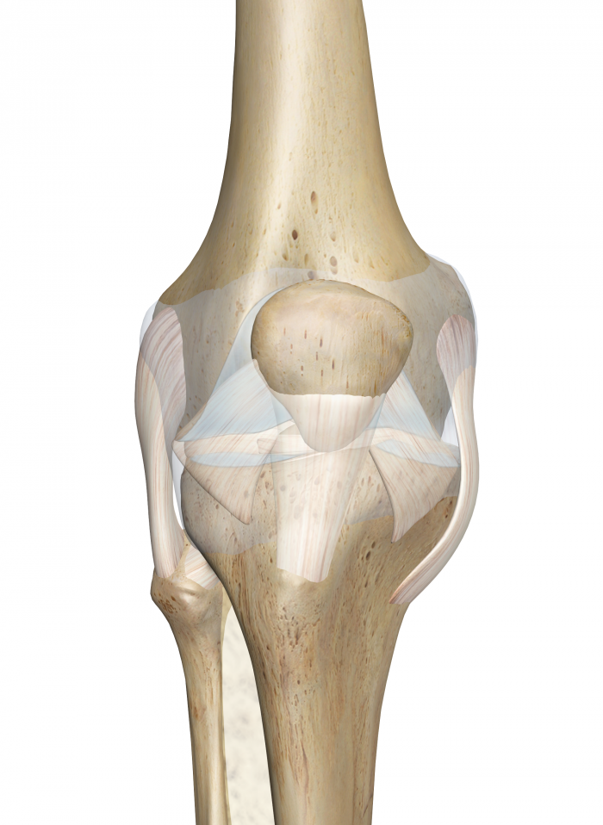
Published and Ongoing Knee OA Research
Positive outcomes reported in large case series-n=840
  Biomed Res Int. 2014
Registry based dosing study established that min 400M TNC required per knee.
  BMC Musculoskelet Disord. 2015 Sep 18;16:258
Knee OA RCT

Slide 26
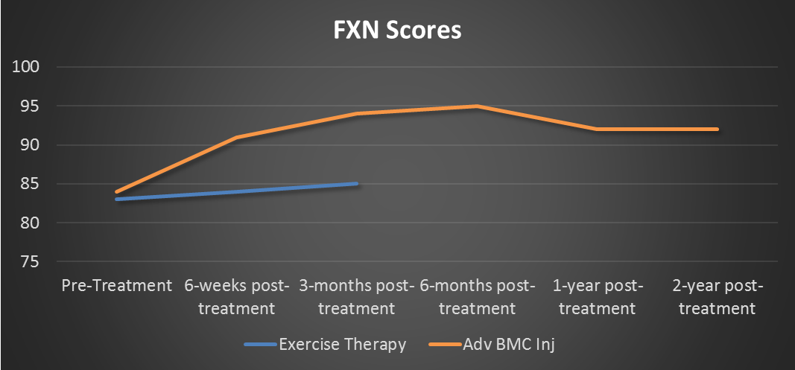
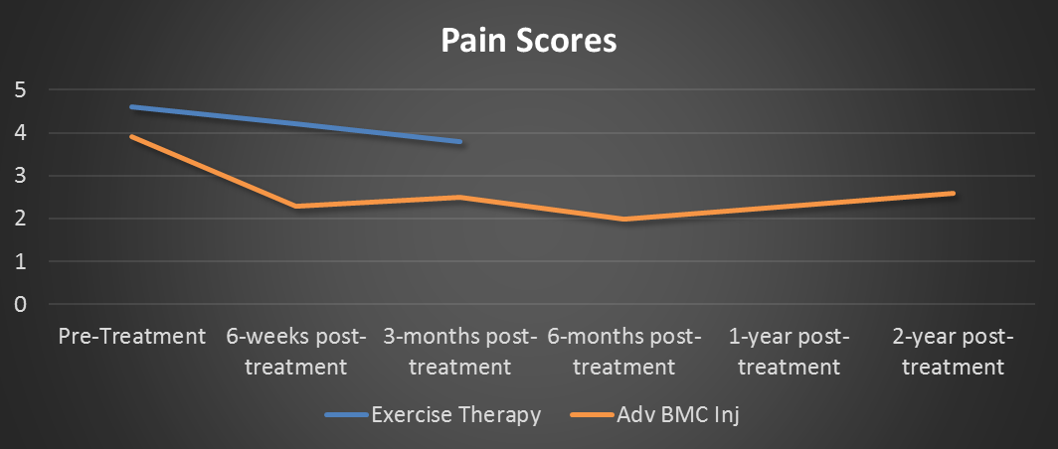
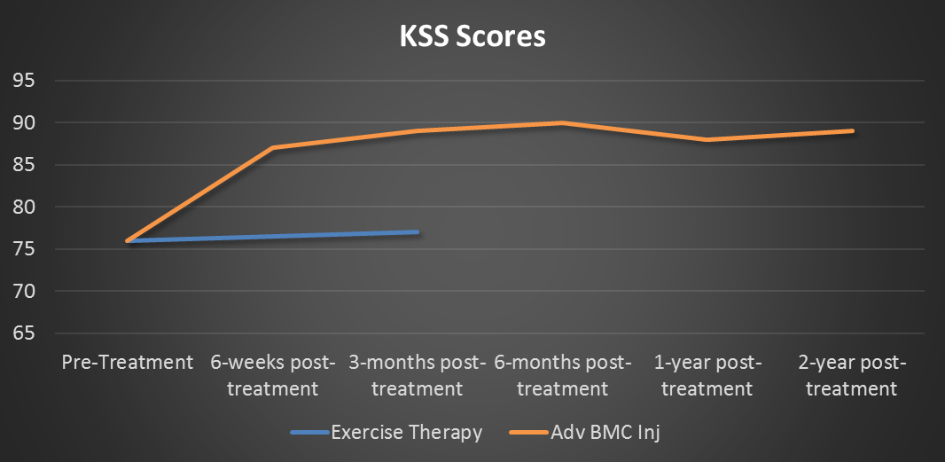
Knee OA RCT
KL grades 3-4
N=48, 3 month crossover with PT
1:1 allocation
Stat sig differences between groups in functional, exam, and pre-op pain scores
Significant improvements in pain and function over control group
Data collection completed, being submitted now for publication

Slide 27
Rotator Cuff Repair

Slide 28
30,000 foot view…
We’re able to help many patients with:
  Severe shoulder arthritis avoid a joint replacement
  Rotator cuff tears
  Shoulder labral tears

Slide 29
Instead of surgery, we inject high dose stem cells precisely into the tears using ultrasound guidance.

Slide 30
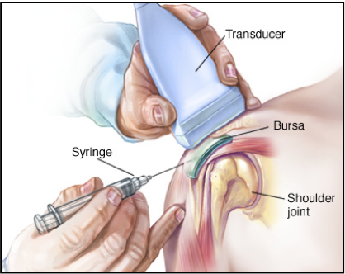
Percutaneous Rotator Cuff Repair
Large case series showing positive outcomes
  Journal of Pain Research 2015:8 269–276
RCT underway

Slide 31
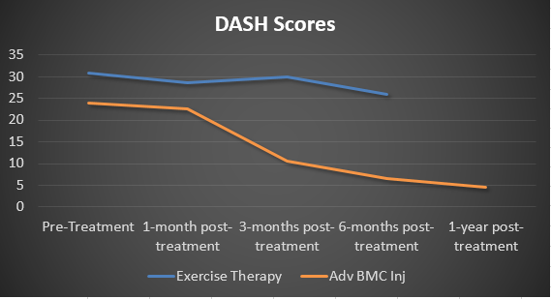
Regenexx-Percutaneous Rotator Cuff Repair
Partial and complete non-retracted tears
N=50, 28 recruited
Cross-over at 6 months with PT
1:1 allocation

Slide 32
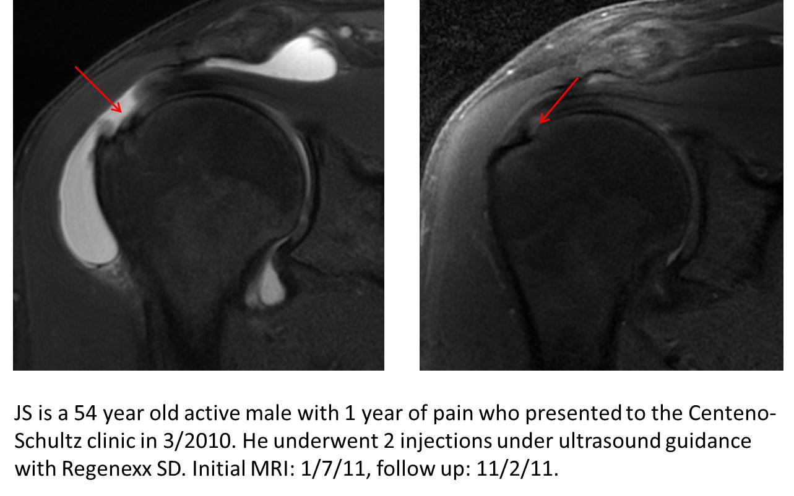

Slide 33
Knee ACL Tear

Slide 34
30,000 foot view…
We’re able to help many patients with:
  ACL tears
  Other knee or joint ligament tears

Slide 35
We can treat these types of ACL tears:
Partial
01
Full Thickness non-retracted
02
Full Thickness retracted
03

Slide 36
This is a precise, fluoro guided ACL injection into the origin and insertion of both bundles…

Slide 37
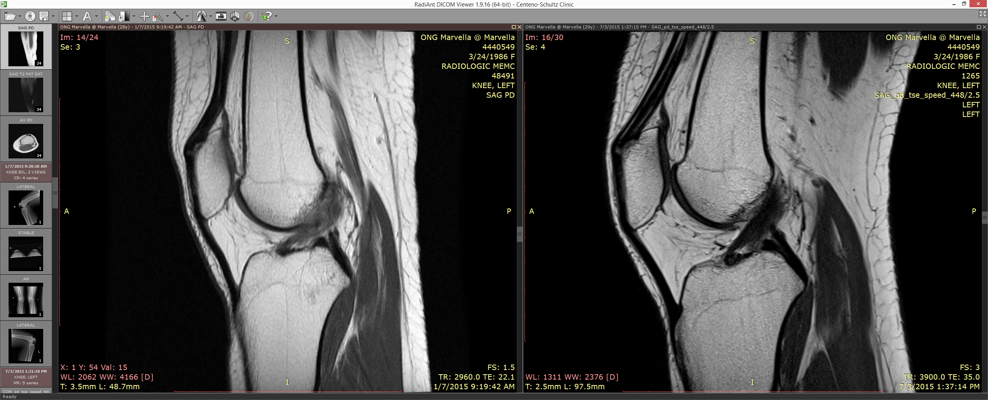

Slide 38
Stem Cell Hype

Slide 39
The three phases of procedural adoption:
This is magic and it helps everybody
This is great and it helps almost everybody
Let’s figure out who is a good candidate

Slide 40

We are the only practice doing this that is in phase III…everyone else is still pretending this is magic.

Slide 41
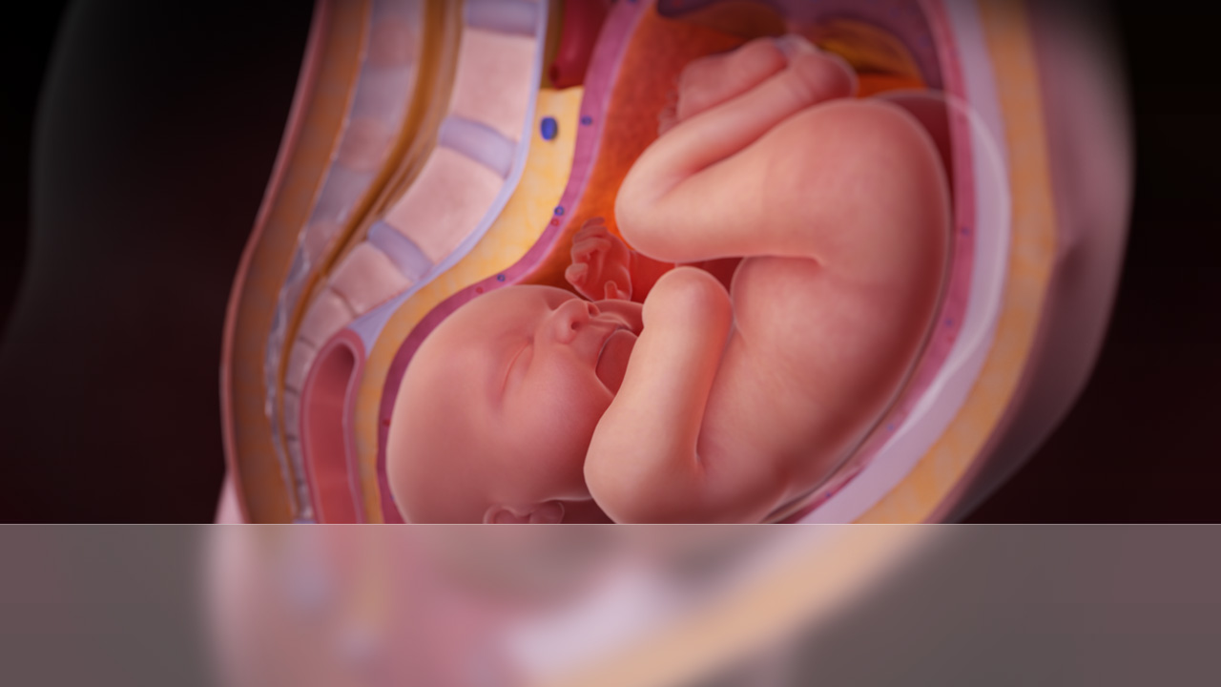
As the inventors of these procedures, the biggest abuse we see is amniotic, placental, or cord “stem cell” injections.

Slide 42
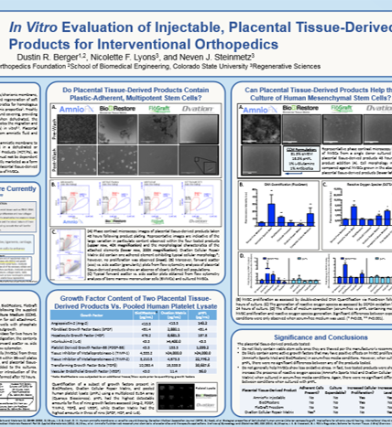
Our lab extensively tested these products and found them to be dead tissue with no viable cells…

Slide 43
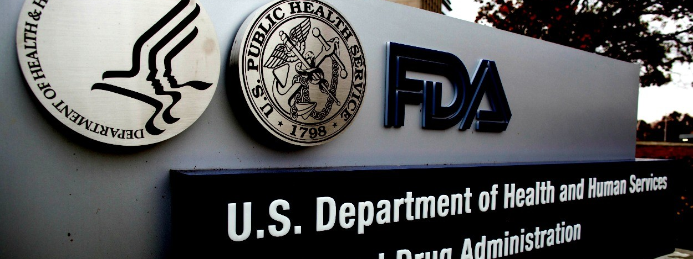
They are also regulated by FDA as dead tissue products.

Slide 44

How do they work? They are a growth factor shot like concentrating blood platelets (PRP). Hence, any claims that these are “stem cell” shots is consumer fraud.

Slide 45
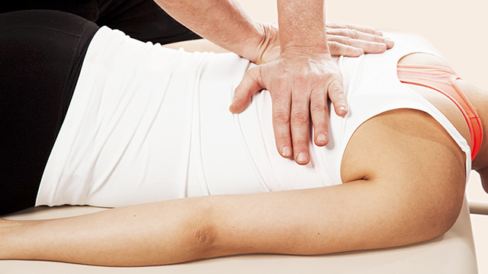
These are also performed in a chiropractic office:
Usually no guidance
By a PA or nurse
These are dead cell products
The costs are often higher than having them performed by the world’s experts in this field

Slide 46
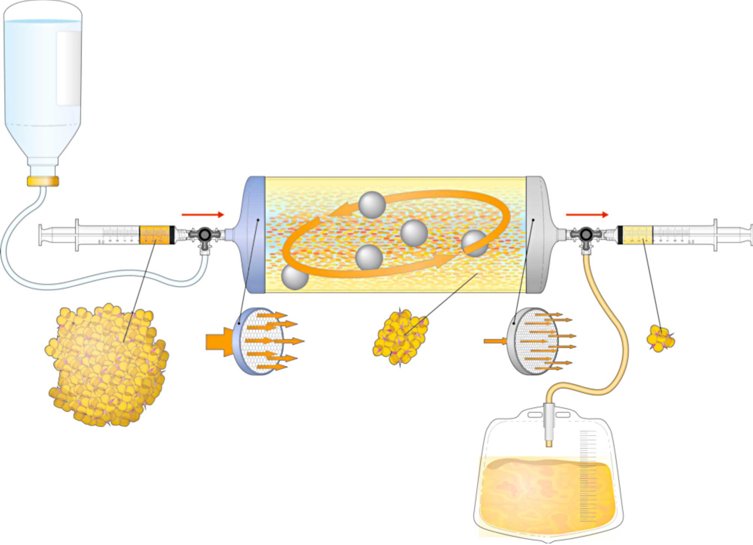
How about orthopedic surgeons using Lipogems?
This is not a stem cell procedure, but a fat graft
There are no viable stem cells that can act on tissues in these injections
May aide in healing

Slide 47


Slide 48
Let’s take a tour of our facility and then we’ll take questions:
Advanced stem cell and orthobiologics research facility
Clinical research team
Large cGMP class clean room for cell processing
Advanced procedure rooms

