Slide 1
Sales Training
Plastic Surgery Studios
Jan. 27 2020
Jon Pack
J

Slide 2
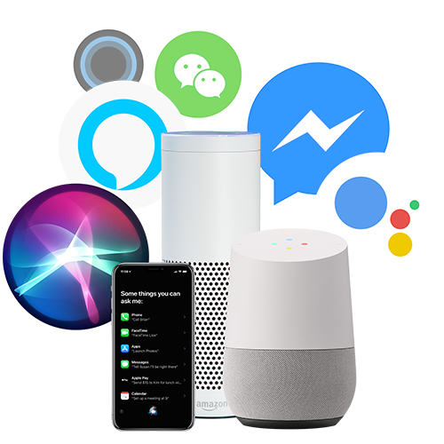
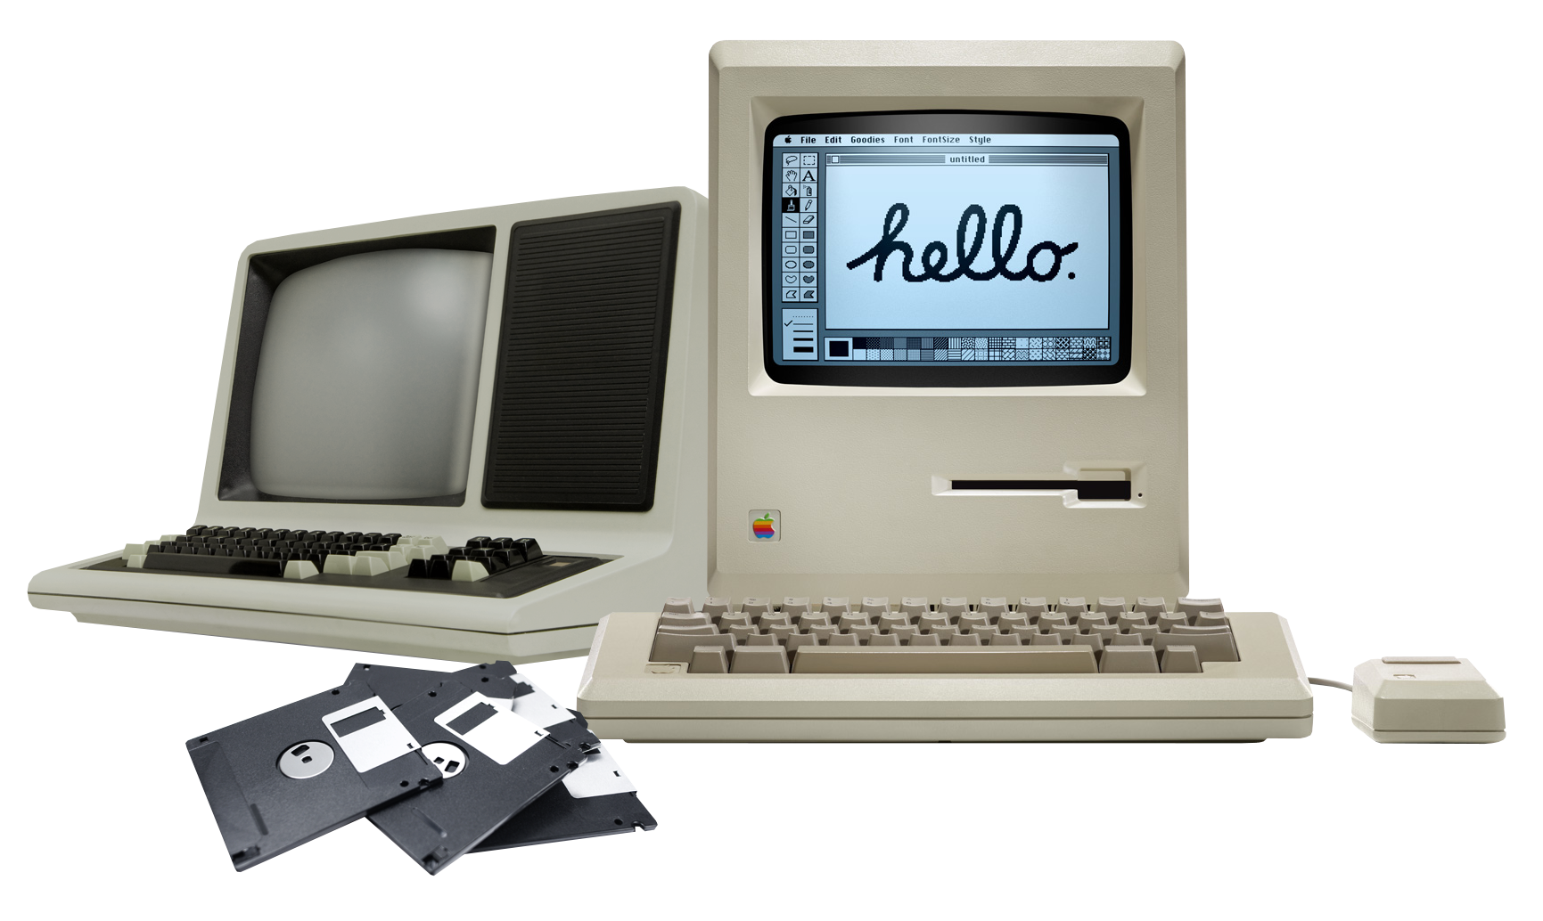
’80s / ’90s: PCs
’90s / ’00s: Internet
’00s / ’10s: Mobile, Cloud
NOW: Conversation & AI
Notes:
---
Gartner quote is from “Conversational AI to Shake Up Your Technical and Business Worlds” report, 30 September 2016.
Gartner link: https://www.gartner.com/doc/3463317/conversational-ai-shake-technical-business
PDF accessible at: http://torquex.com.au/wp-content/uploads/2017/02/Conversational-AI-to-Shake-Up-Your-Technical-and-Business-Worlds.pdf

Slide 3
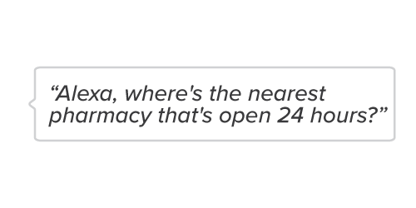
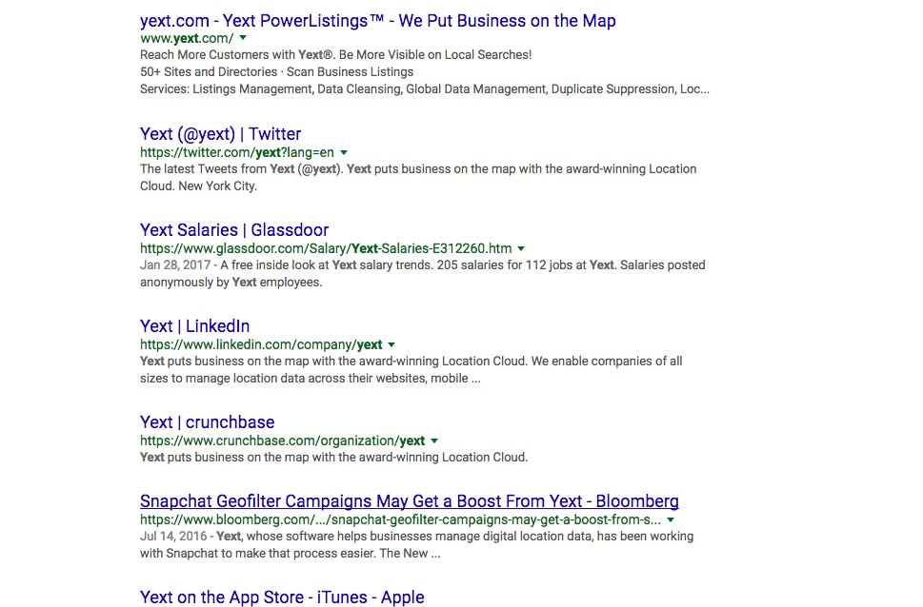
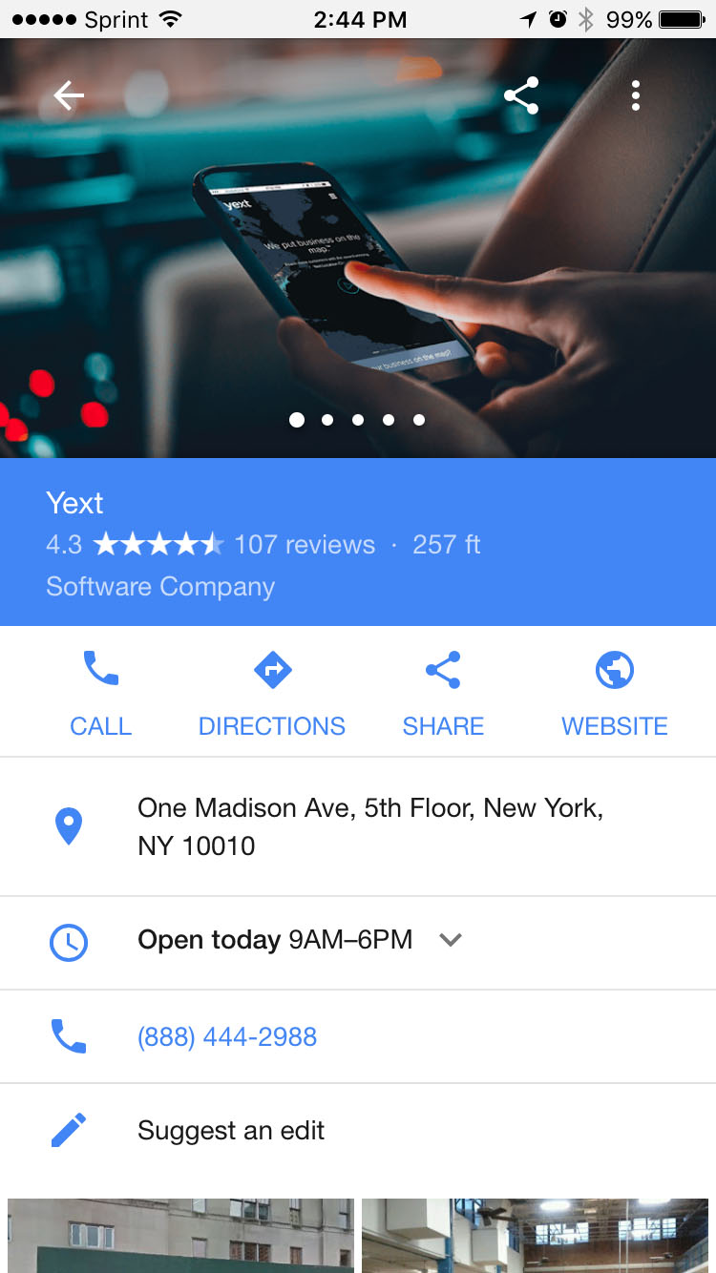
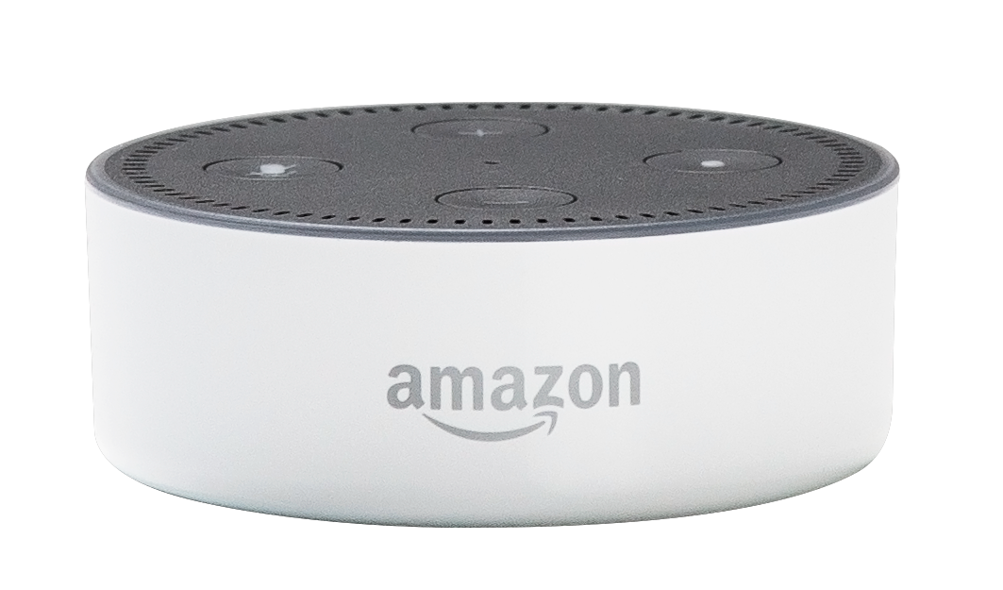
AI services provide structured answers
Blue Links
Notes:
It used to be that when you searched for something, you got 10 blue links on a page. But now, they just give you an answer. [CLICK]

Slide 4
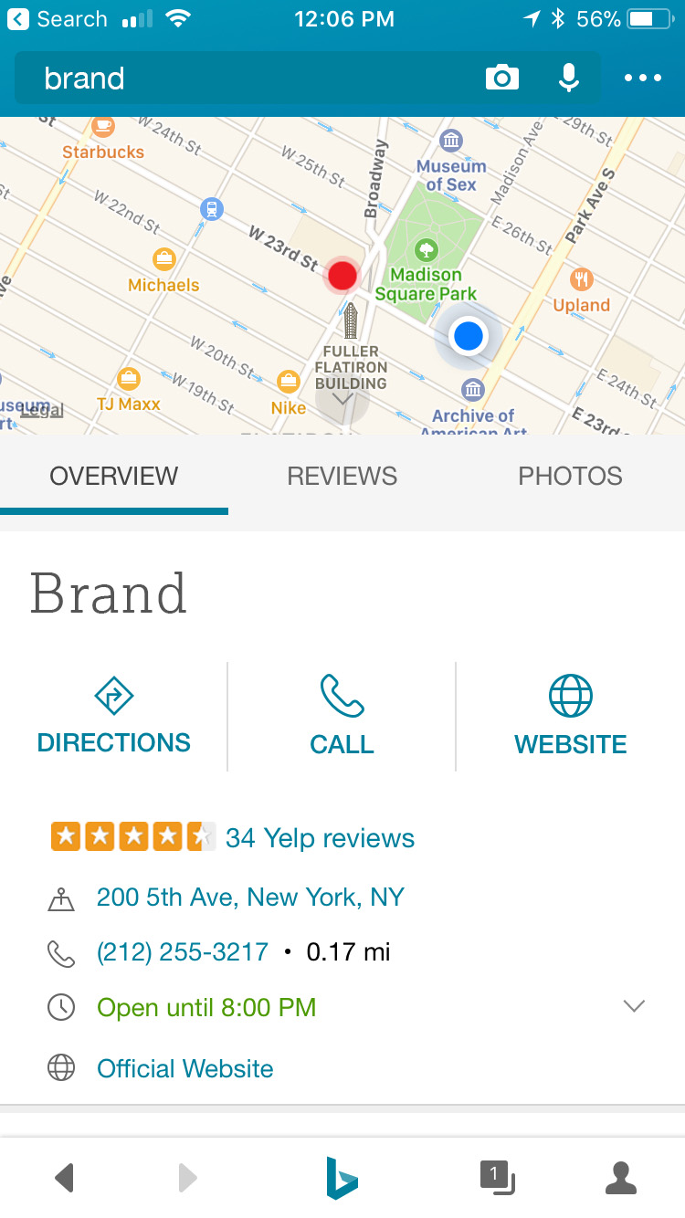
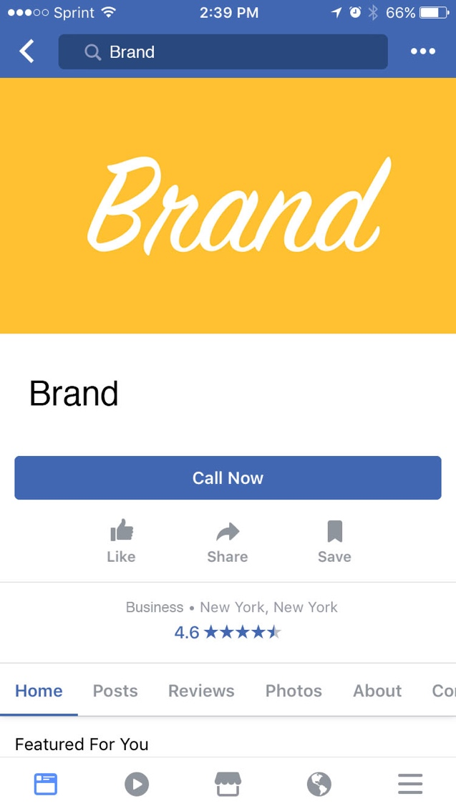
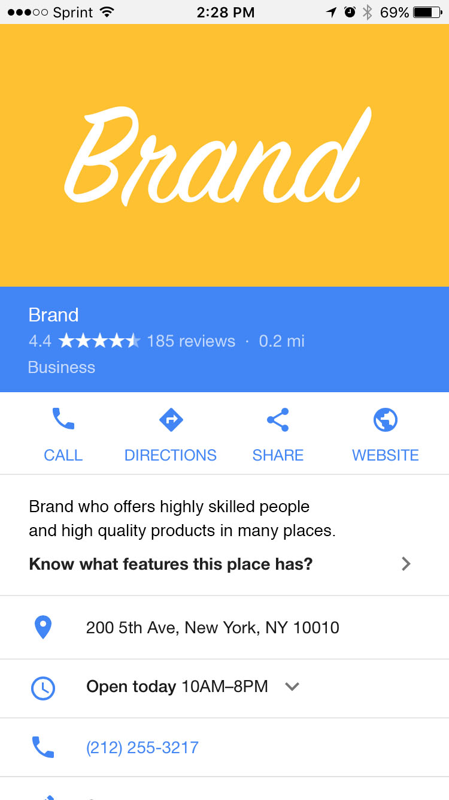
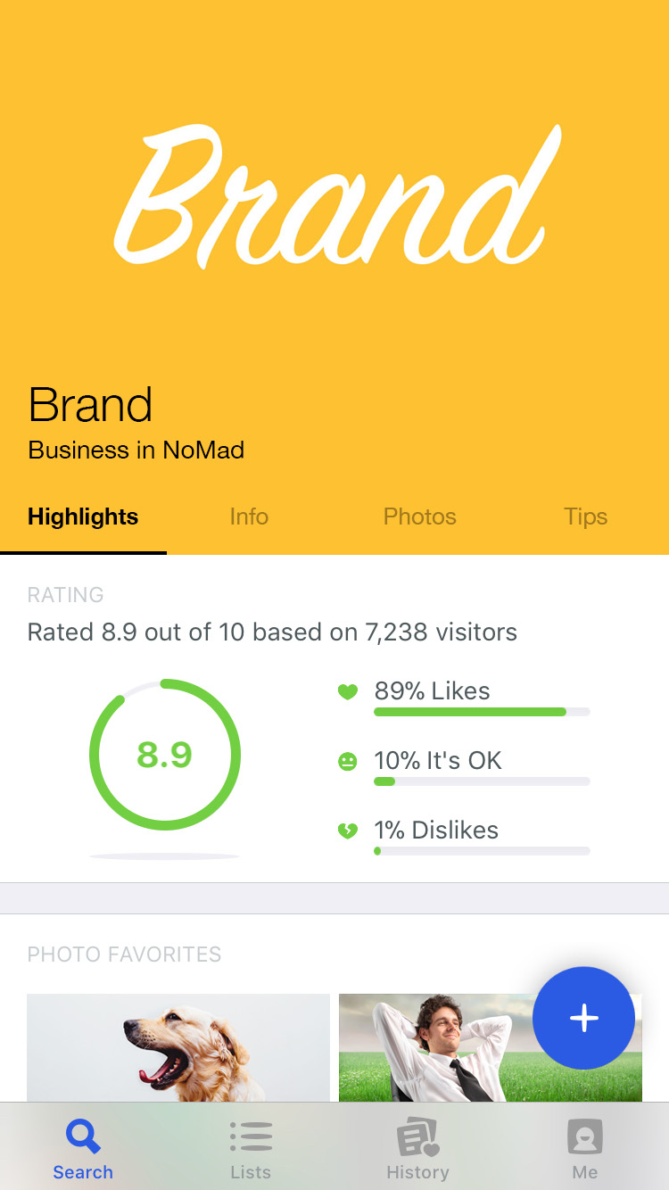
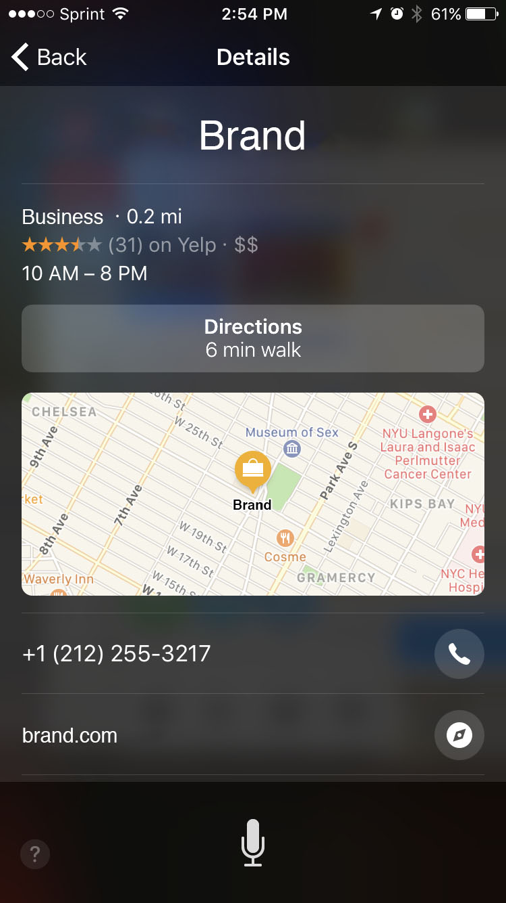
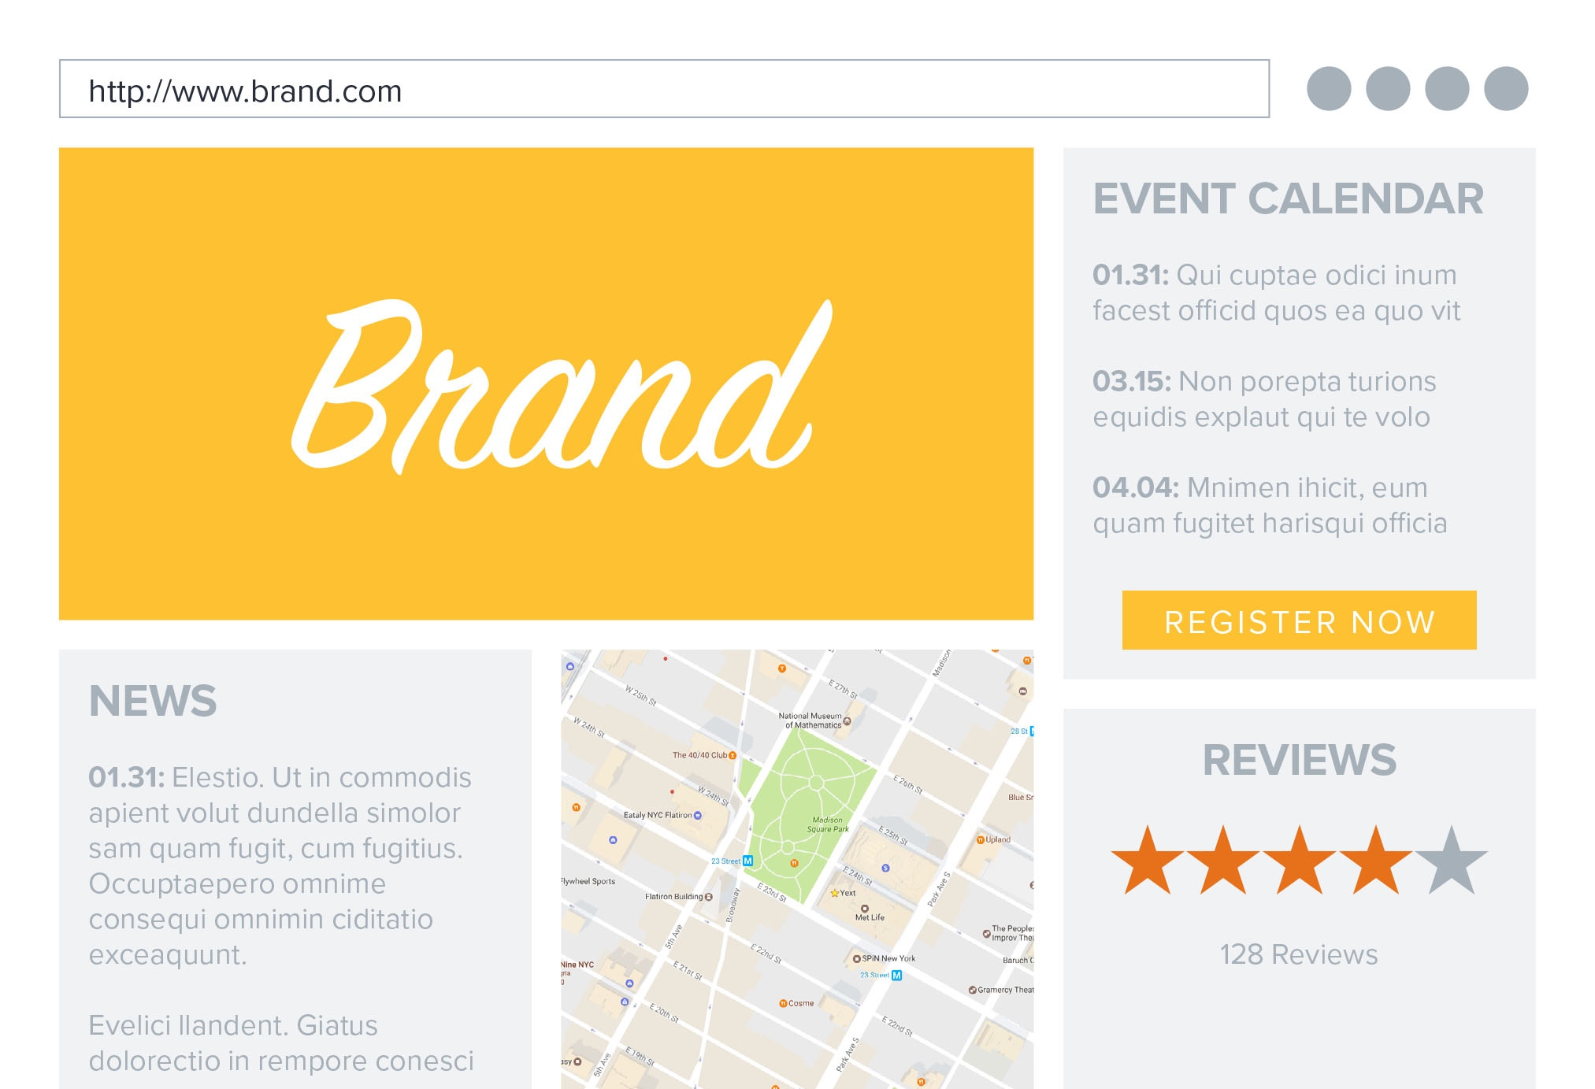
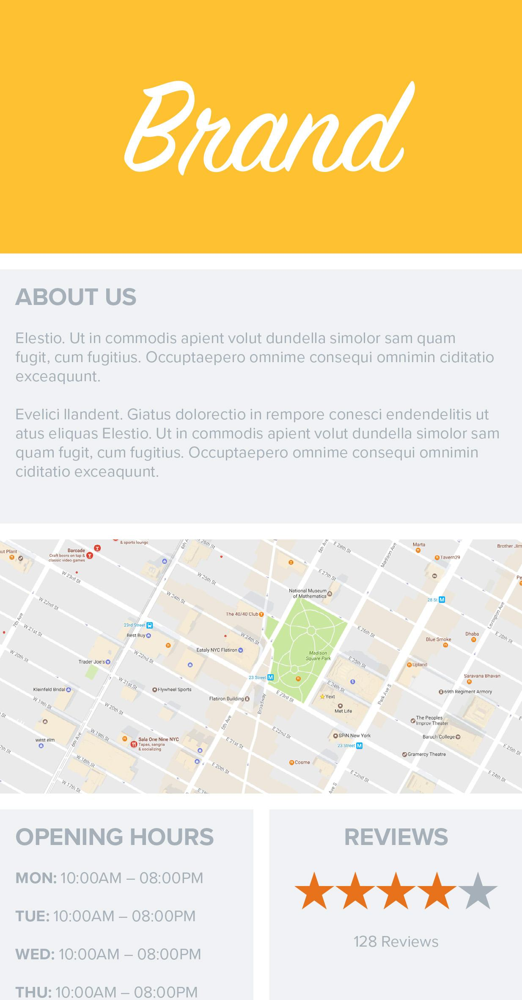
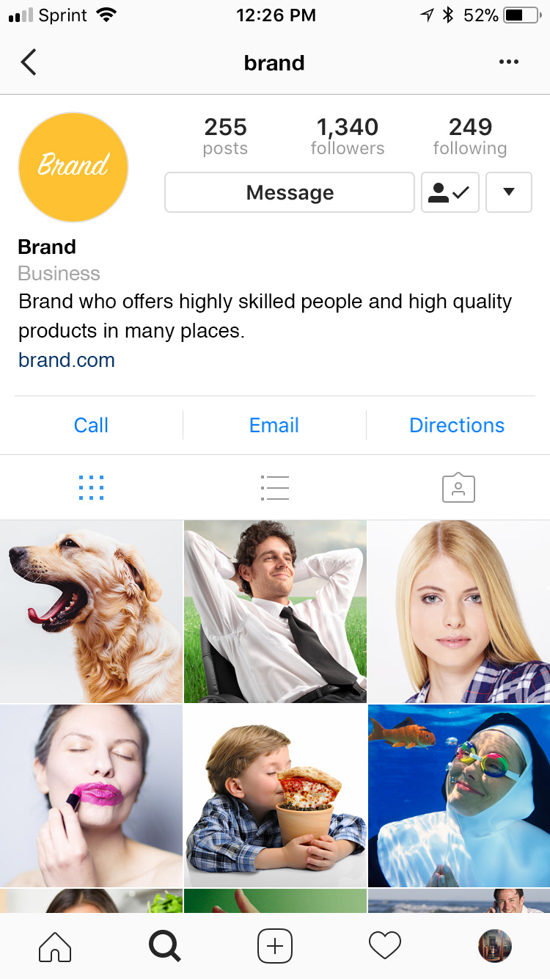
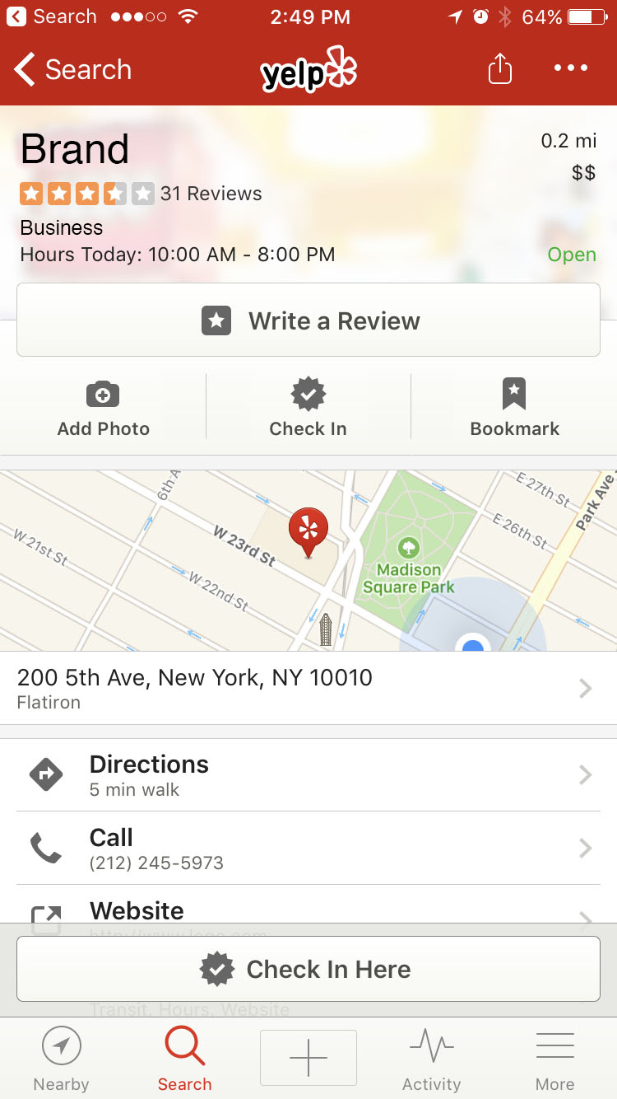
A new channel for customer engagement
Website & Mobile Website
Search, Maps, Directories, Voice, Chat
73% of high-intent traffic
is going to new services
Study of 20,107 business locations conducted by Yext in February 2017. “High-intent traffic” represents mobile searches for nearby businesses.
Notes:
For 20 years, your website was the centerpiece of your digital experience — [CLICK] but now 73% of high-intent traffic is happening off your website.
Search engines, maps, directories, voice, and chat interfaces have created a new channel where customers can engage with your business.
And now, it’s just as important to manage these services as your own website!
-------
Stat is from a Yext proprietary study, February 2017, https://www.entrepreneur.com/article/293806. ”High-intent traffic” represents mobile searches for nearby businesses, since 76% of people who search for something nearby on their smartphone visit a related business within a day (Google, 2016: https://www.thinkwithgoogle.com/data-gallery/detail/mobile-near-me-searches/).
-------
DISCOVERY QUESTIONS:
Tell me about how your website traffic is doing these days.
Tell me about where your online traffic comes from. What’s the breakdown on your website and other sites? How are you taking a consolidated view of all your traffic today?
How are you allocating resources to your website today? What about to other online channels?
What if I told you there was an entirely new organic channel out there? What would that mean for your business?
What are you doing today to manage this organic channel?
What decisions would you make or change if you knew that 70% of your traffic was happening off your website?
How are you measuring customer engagement on this new channel today?

Slide 5
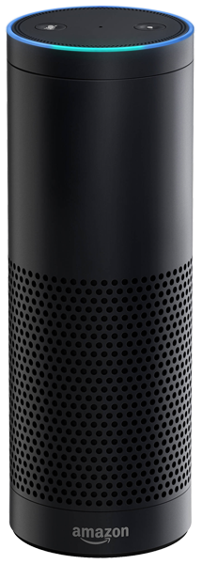
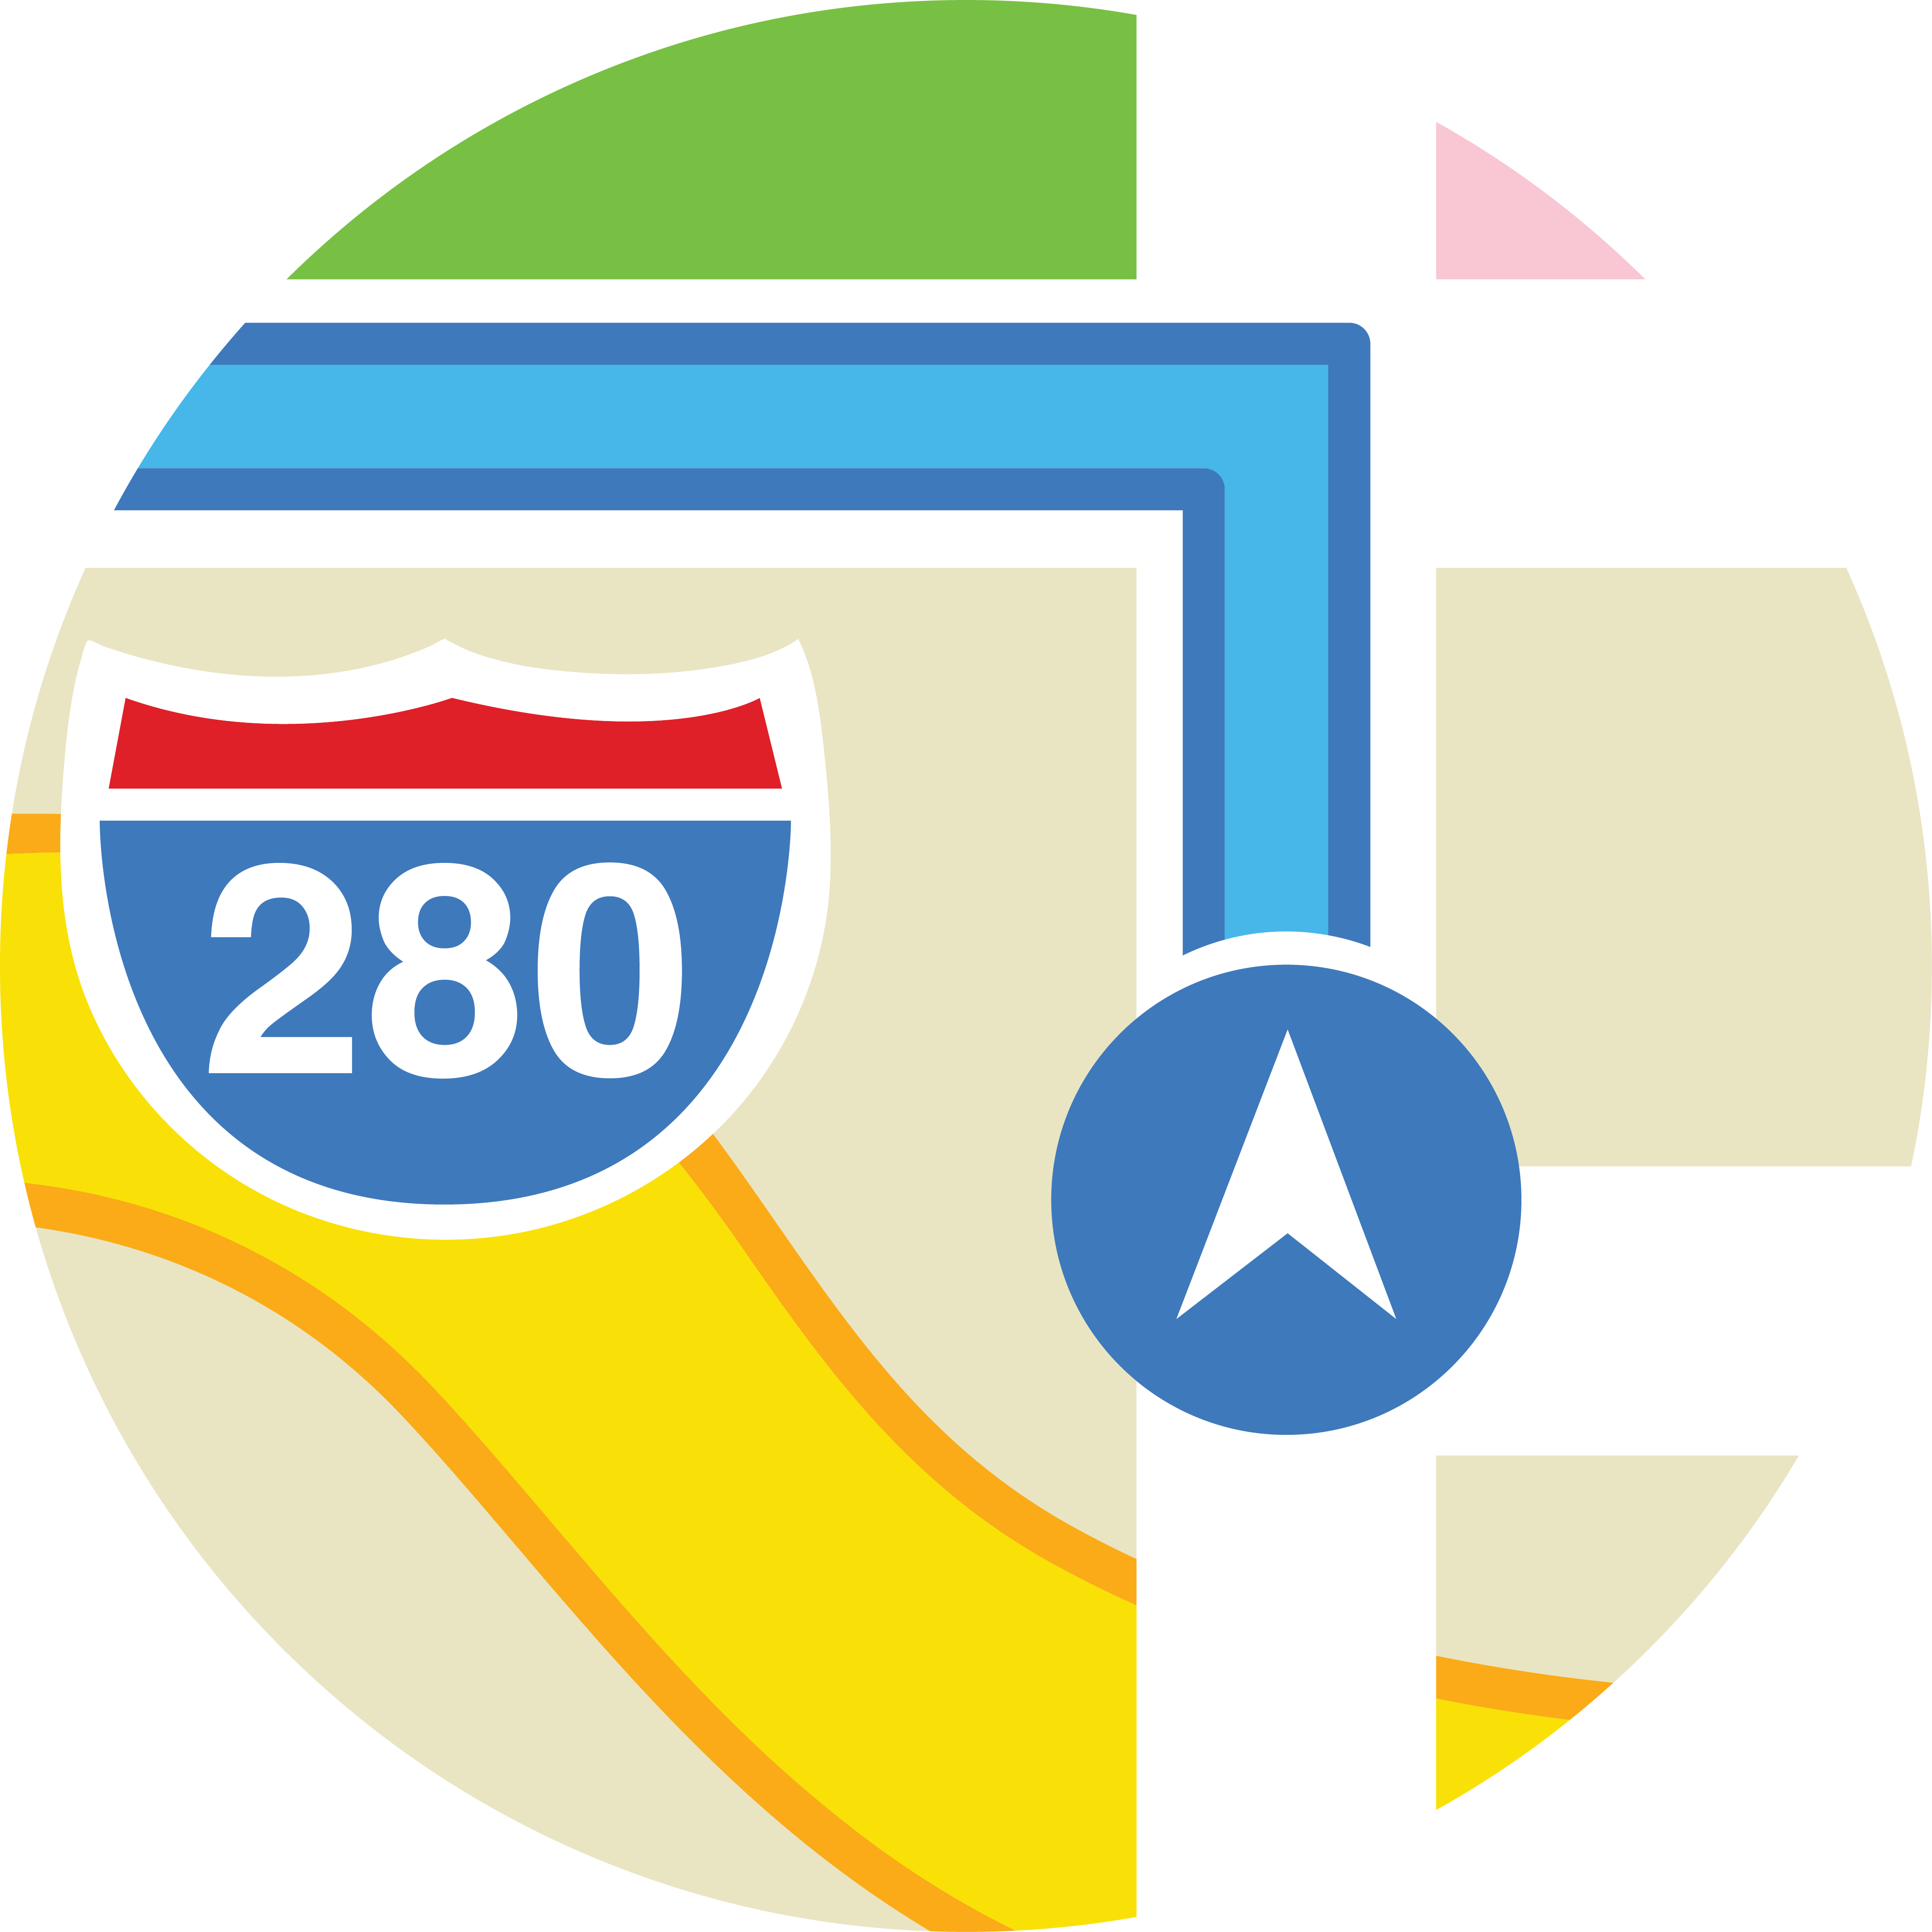
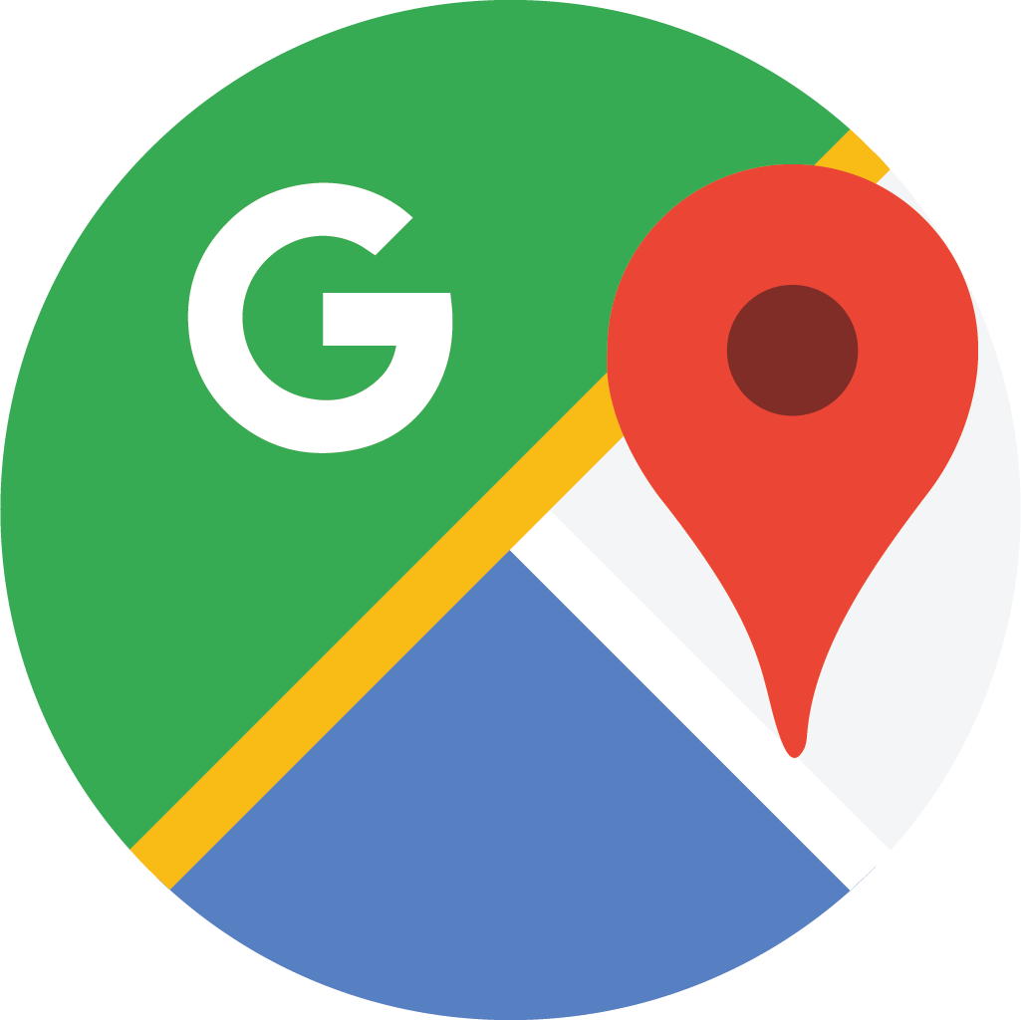
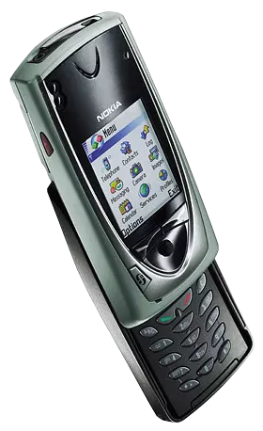
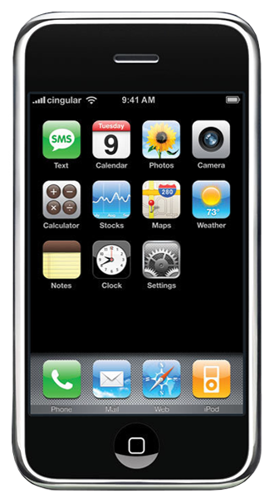
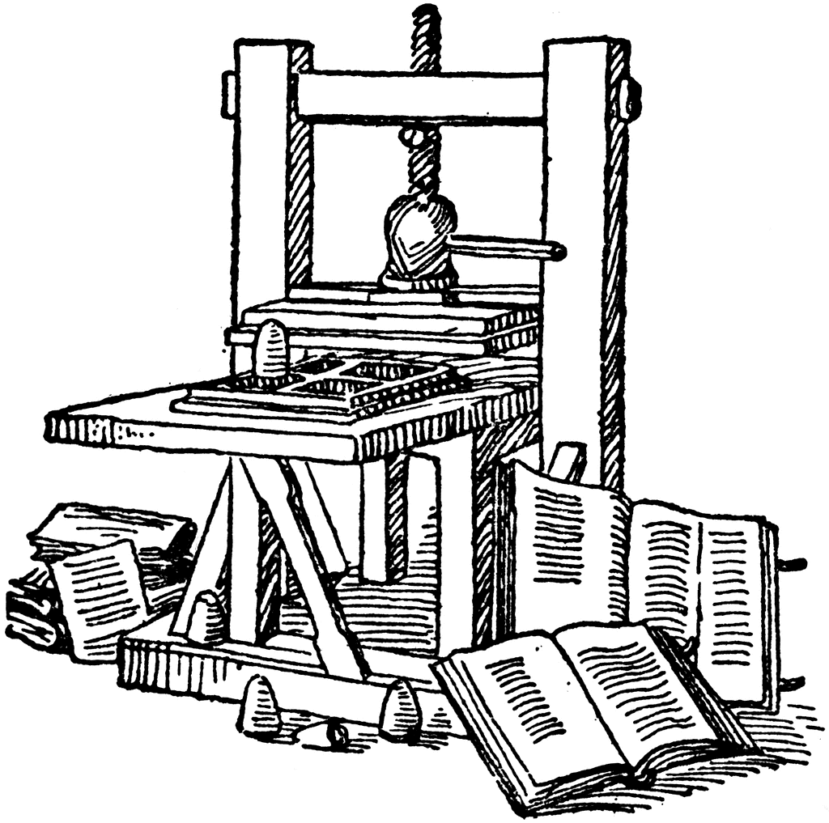
More customer interaction points than ever with new consumer services
AR / VR
VOICE
CONNECTED CARS
CHAT
CONNECTED HOME
MOBILE FIRST
MOBILE MAPS
MOBILE APPS
SOCIAL
GPS
MOBILE WEB
CRM
SEARCH
ECOMMERCE
WEBSITE
EMAIL
Print
1440
1994
1995
1996
1997
1998
1999
2000
2001
2002
2003
2004
2005
2006
2007
2008
2009
2010
2011
2012
2013
2014
2015
2016
2017
2018
Notes:
The number of places where customers interact with your business has exploded, and it continues to climb.
Just over the last few years, we’ve seen the rise of search, map, mobile, chat, and voice services coming online.
-------
DISCOVERY QUESTIONS:
How are you allocating your marketing resources today? Which channel(s) do you focus on? How do you decide which channel(s) to prioritize?
How have your marketing channels evolved over the past few years?
How do your customers typically engage with your business? Where does that engagement happen?
Do your customer engagements differ depending on where they happen?
Which of these services are you managing today? Which ones are you not managing today? Why?
How has this explosion in customer interaction points affected your business?
How have you structured your team to address all these new services?
Which of these services are you focusing on most closely today? Why?
Which of these services are you not investing in today? Why?

Slide 6
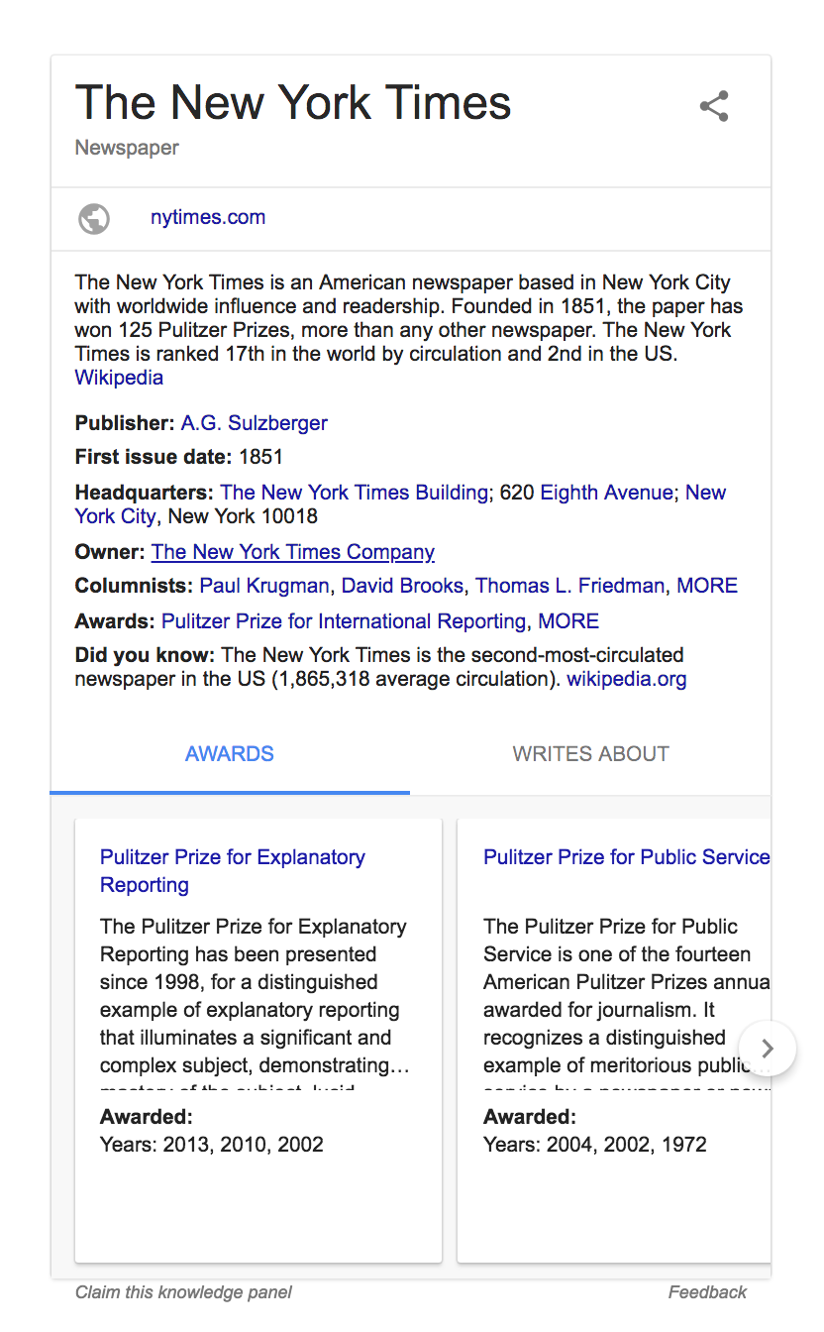
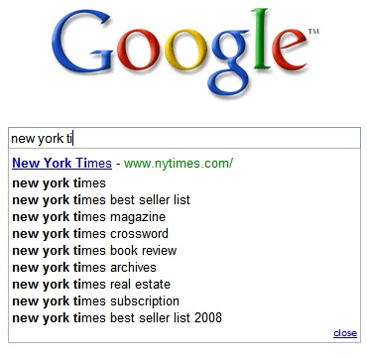
Consumer Evolution of Search
1998
2015
TODAY
2001
2008
Fr o m L I N K S t o A N S W E R S in 2 0 y e a r s
Notes:
There’s a massive paradigm shift going on in the world of search from keyword searches to questions.

Slide 7
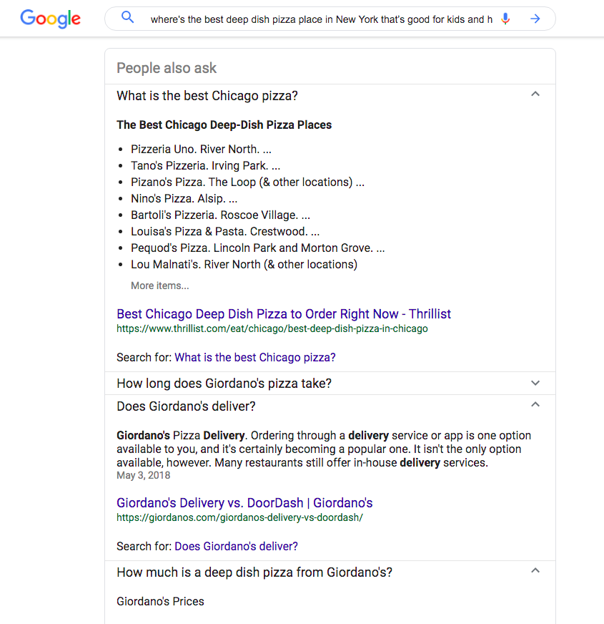
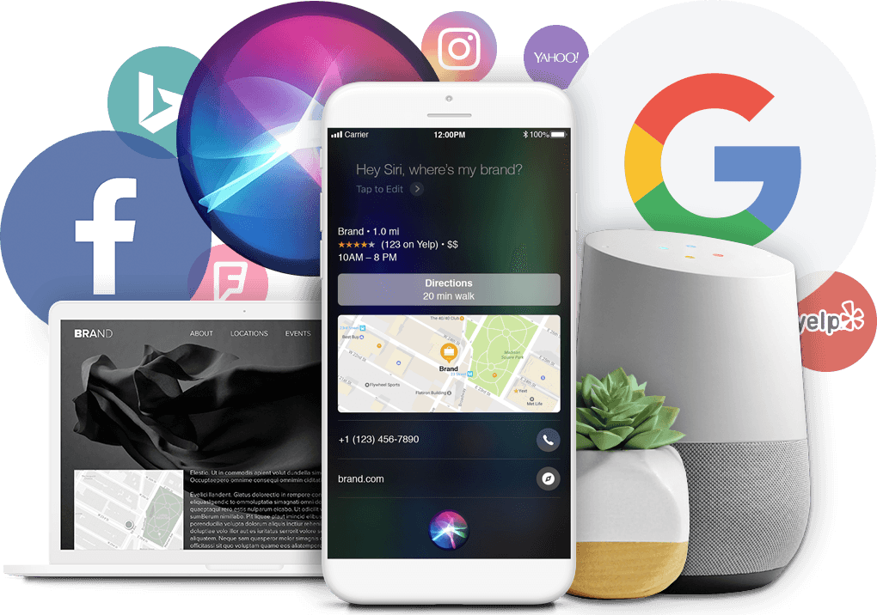
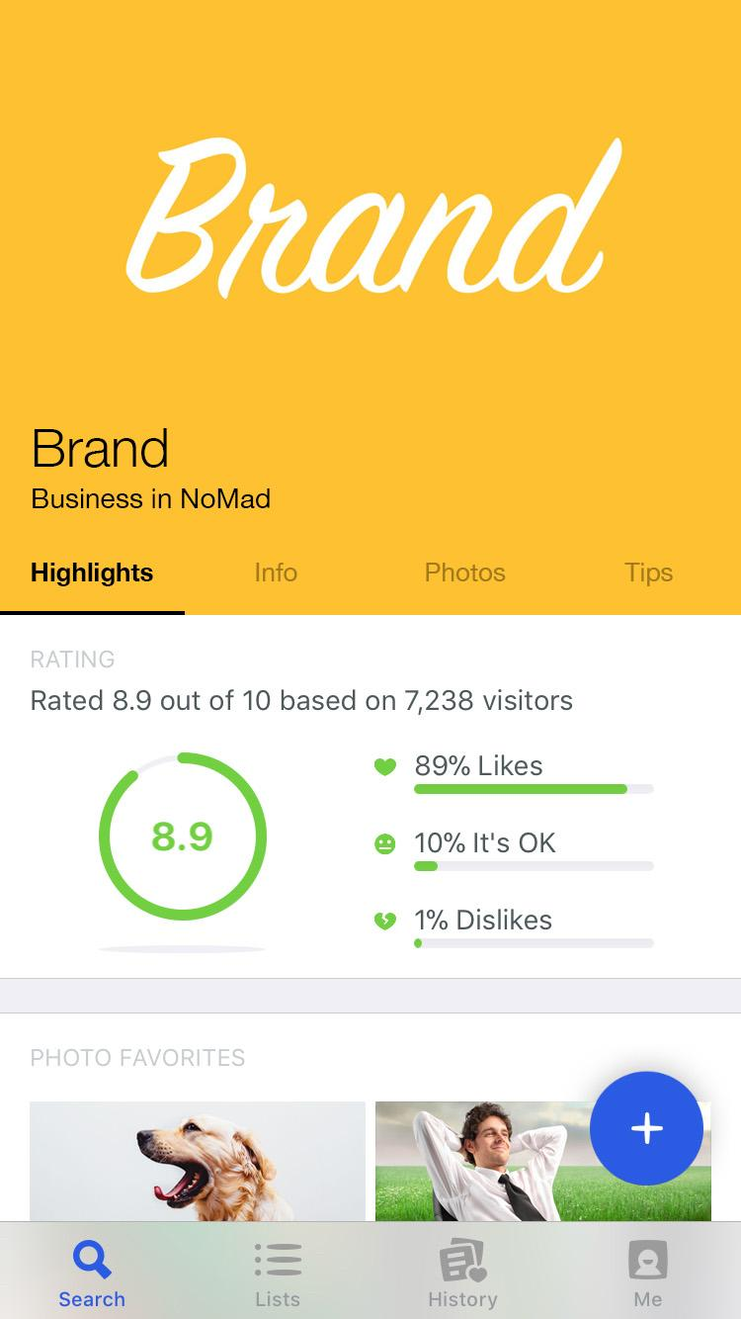
From Browsing to Asking
where’s the best pizza place in New York that’s good for kids and has accessible bathrooms
Notes:
Because of this transition to answers and voice, we’re being trained to search differently — by simply asking for the things that we want!
it’s kind of neat — the entire population of the world is being re-trained to ask for things. We’re moving from a world of browsing to asking.
Years ago, if you typed “pizza” into Google, you’d get a bunch of blogs that talked about pizza.
Now, if you type in “pizza,” you get a little more information. And if you type in “best pizza,” you’ll actually get detailed, structured answers about where to find the best pizza. When we add more depth to our questions, we get better answers back. So now, we’re more comfortable asking things like, “where’s the best pizza place in New York that’s good for kids and has accessible bathrooms”.
You see this “people also ask” section? Google’s literally trying to get you to ask even more questions. If you click on a question, you can see an answer right there. And there’s even a hyperlink where you can perform the search again as a question!

Slide 8
Marketer’s Evolution
From Keywords to Questions
gas station_
Where’s the nearest gas station?
cardiologist_
Who’s the best cardiologist for children?_
insurance_
Who sells the best car insurance?_
cheeseburger_
Where’s the best cheeseburger in Detroit?_
Notes:
So as a marketer, you’re going to move from a world of keywords, to questions.
I want to focus on this for a moment. This is important. For a very long time, marketers have talked about creating intent models, talked about keyword stuffing, talked about buying keywords. But we’re not going to be optimizing for keywords anymore. We’re going to be optimizing for questions!
Some people call this concept “Intent Marketing”. That’s a fancy term for search, or for questions, but it makes sense. We’re trying to understand someone’s intent. What they want. What they’re asking for. And we’re trying to be the answer!
For example, if someone searches for “what are the best speakers” they want to buy speakers. Or if someone searches for “who is the best orthopedic surgeon in NY” they need to get surgery. Understanding the questions people ask on their way to purchase is critical and converts at a higher rate than any other channel!
We think this is going to be the next big thing in marketing.
*******************
NEW: Now we can. As consumers continue to just ask for what they want, they are displaying more and more intent.
As a marketer, you are not just optimizing for keywords anymore. There are now many ways you can optimize your marketing around intent because consumers are asking questions everywhere. This change in consumer behavior is leading to a change in how marketers do their jobs. Now, we can market to our customers based not on who they are or what we can guess about their psychology, but on what they’ve asked for!! It’s privacy safe and does not discriminate.
We find ourselves at the dawn of a new age—intent marketing—where we can meet our customers at the moment of intent.

Slide 9
Questions Convert Better than Keywords
NATURAL
LANGUAGE PHRASES
convert at
2.5x the rate of
SINGLE KEYWORDS
HIGH VOLUME
HIGH COMPETITION
SHORT KEYWORD PHRASES
“museum”
MID-LENGTH KEYWORD PHRASES
“utah law firm”
NATURAL LANGUAGE PHRASES
“What’s a good museum for the whole family, open weekdays?”
LOW VOLUME
LOW COMPETITION
HARD TO RANK
HARD TO CONVERT
EASY TO RANK
EASY TO CONVERT
Notes:
If you meet the consumer at the moment of intent with accurate information about your brand, you can sell more stuff. Such engagement leads to a better brand reputation and increased revenue.
Let’s look at data from just the search engines: a search that’s a multi-word question — which is a strong indicator of consumer intent — converts at 2 and a half times that of a single keyword search.
So, intent marketing means opportunity! And opportunity leads to revenue!

Slide 10
Can your business Answer Questions like this?
primary category
additional attribute: Insurance Accepted
four-star rating or higher
geography-based data
Best Cardiologist near me open Tuesday accepting Cigna
hours of operation
Notes:
Let’s start by looking at the anatomy of a question.
Can your clients’ data answer a question like this today?
In this single question, we’ve got financial advisors, locations, hours, products offered, and look at “best” — where would you even get that data? Just to answer this one question, you need information from all over your organization.
The traditional methods of storage simply can’t handle this complexity. They don’t allow you to relate all this information together. But in order to give customers the answers they need at their moments of intent, it’s critical that your business can answer questions like this.
***************
Lets take a look at the anatomy of a question. Do you have teh data in your org to answer this question?

Slide 11
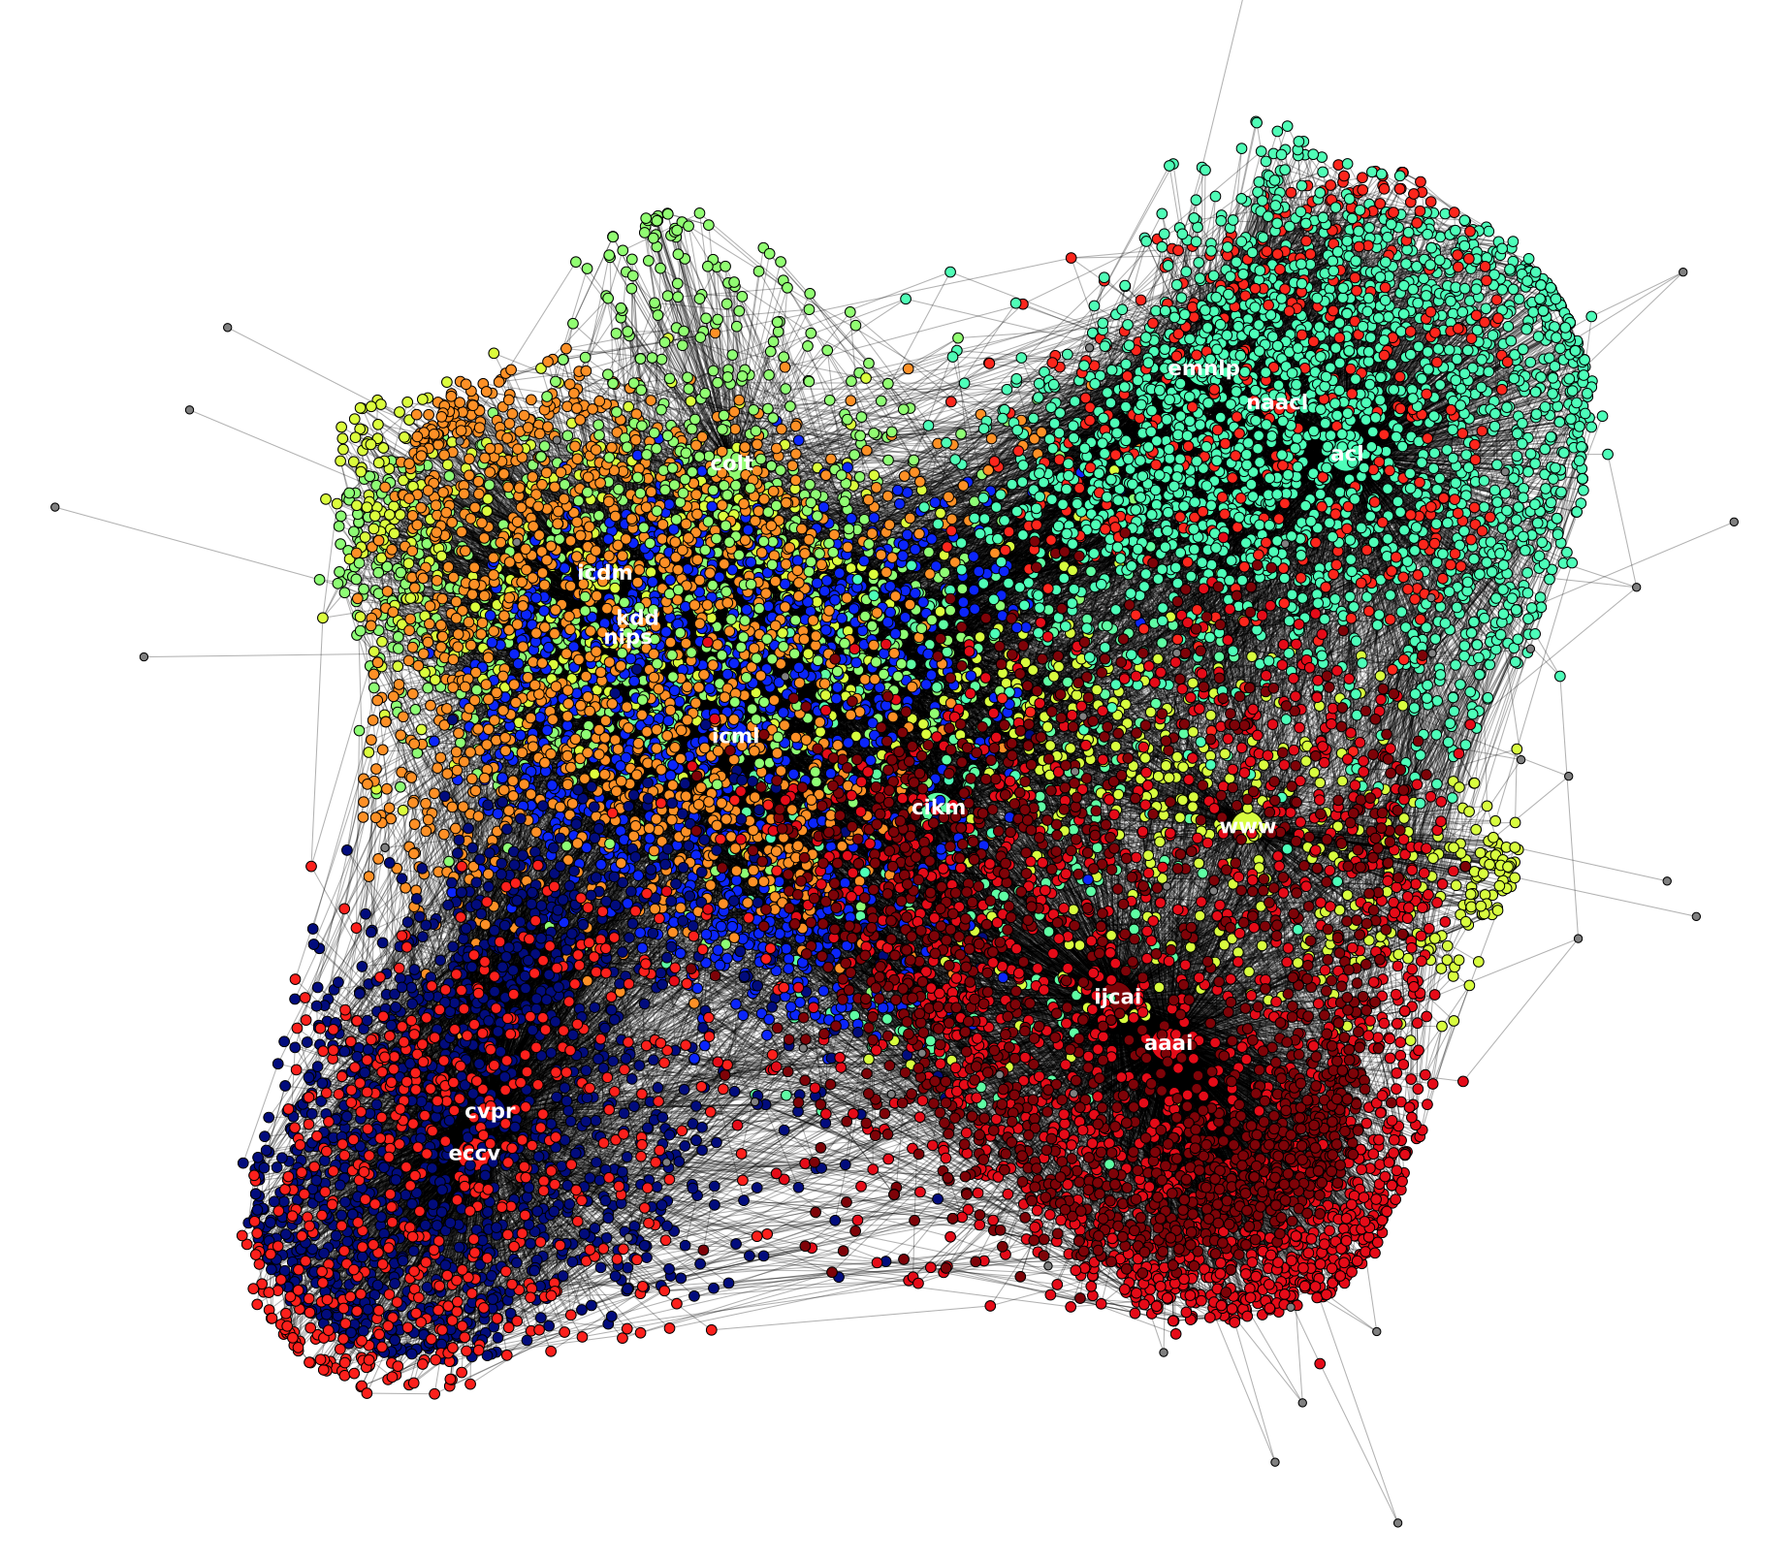
SEARCH ENGINES USE A KNOWLEDGE GRAPH TO ANSWER QUESTIONS-- AND SO WILL YOU
EVENTS
OFFERS
CATEGORY
RESTAURANTS
CITY
BRAND
RATING
PRODUCTS
SERVICES
TIME
NOW
HOURS OF OPERATION
MENUS
HOLIDAY
HOURS
RETAIL
STORES
Notes:
A standard index is not the best data structure for answering questions. Google, Facebook, Apple, and Amazon Alexa all realized this. So they all built something called a Knowledge Graph.
They had to do this to answer the kinds of questions consumers are asking. And, so will you. We believe that every company will have their own Knowledge Graph to structure your client’s data internally to answer questions.
***************

Slide 12
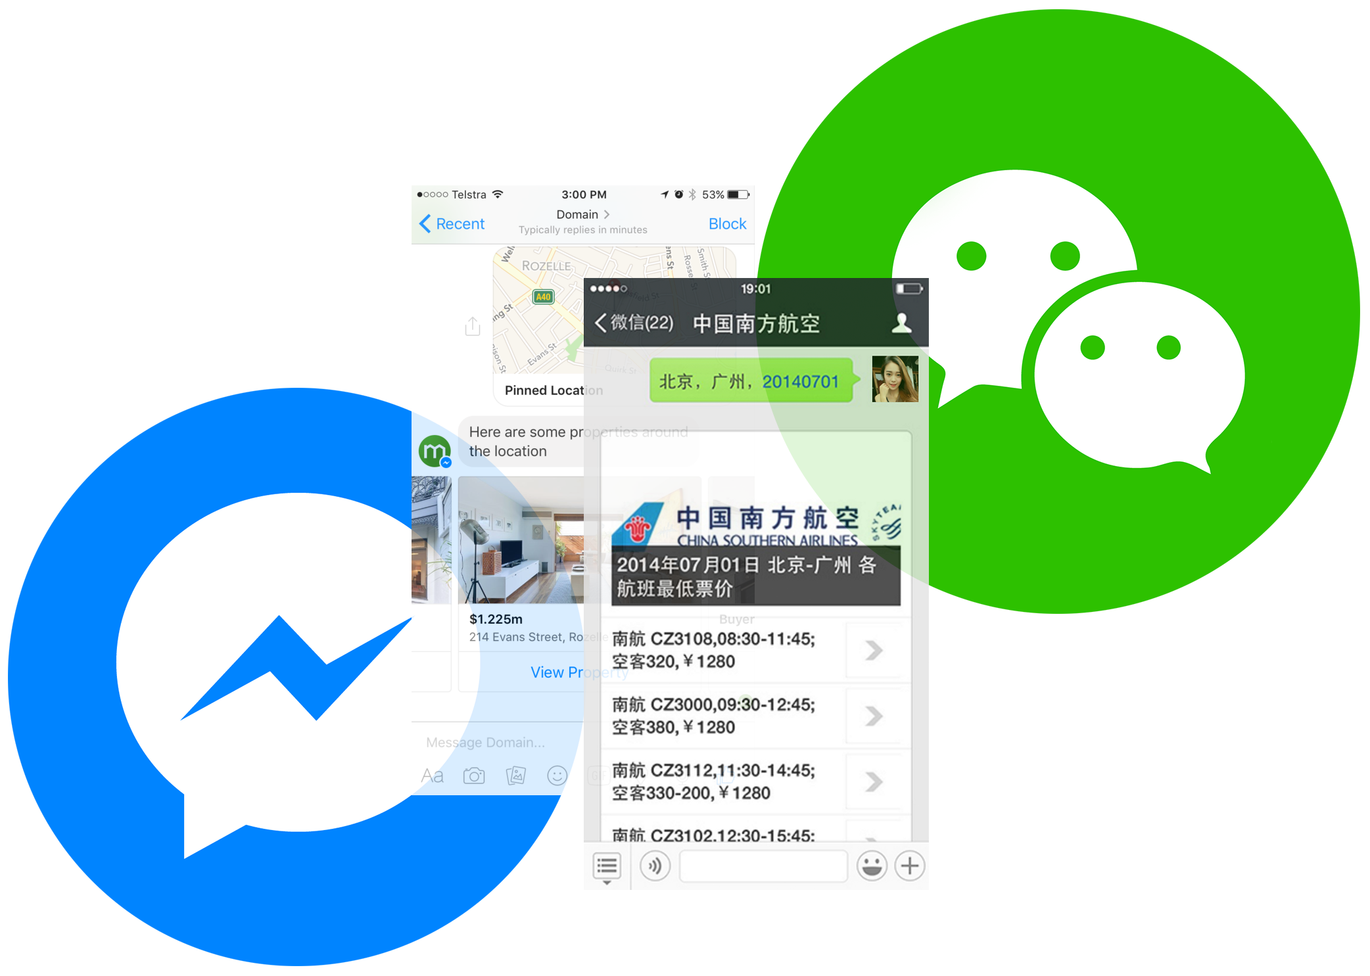
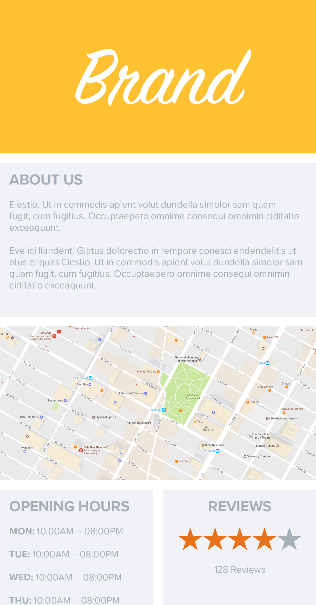
Web
Direct Channels
Search, Maps, Directories
Chat
Voice
Your Knowledge Graph
Notes:
With your own Knowledge Graph, you’ll have the structured data backend you need to power your brand across all the new services of today and tomorrow.
It helps you bring all the facts about your brand together, from your locations and people to your events, products, and company, into one central repository.
Then, it powers those facts on your website and your other direct marketing channels.
It puts you in control of your brand across all those new consumer services, which includes managing your reputation.
And finally, it helps you ensure the new chat and voice interfaces of the future, like Google Assistant and Amazon Alexa, give customers the right answers to their questions.
So let’s say you’re McDonald’s, and you change an item on your menu. You’d just change it in your Knowledge Graph, and boom: that information is updated across your website, your mobile app, and every map, directory, search engine, chatbot, and voice assistant everywhere.
-------
DISCOVERY QUESTIONS:
What information about your brand do you try to publish across the different marketing channel(s) you use?
Tell me about how you manage similar data across all the new services that have popped up recently.
Think about all the facts about your brand that consumers might look for — like where you’re located, when you’re open, products you sell, or your menu items. Where does this information live today?
How are you currently making that information available to consumers?
Walk me through the process of updating something like your store hours or your seasonal menu. What systems do you need to update? Do these systems talk to each other?
What if I told you there was a way to make those updates way easier across your internal systems and ensure that the right information makes its way to consumers?
How are you managing the data behind each of these services today?
Walk me through process of updating something like your store hours or your seasonal menu across all of these endpoints that we’re looking at. How are you managing that today?
What benefit do you think your business would see if you had a Knowledge Graph to power all these places at once?

Slide 13
The Value of Local Search Solution
CONSISTENCY
& CONTROL
Control the facts about your business — everywhere they appear
DISCOVERABILITY
Capture and measure traffic from the AI-powered services of today and tomorrow
Media Insurance
Protect all marketing initiatives by guaranteeing presence through out the customer journey
CUSTOMER EXPERIENCE
Ensure customers see the right answers about your business — and act on their feedback to foster loyalty
OPERATIONAL EFFICIENCY
Reduce time, manual effort, and data discrepancies across your teams and internal systems
Notes:
Businesses who deploy a DKM solution see value in a number of distinct ways:
The first is Consistency & Control. As we’ve discussed, without a DKM solution in place, you have no insight or control over what AI services are saying and showing about your business. By controlling the facts about your business everywhere they appear, you’re removing friction from the customer journey and ensuring your business information is consistent everywhere.
Next is Discoverability. Businesses with DKM see an increase in views across search, maps, and directories. That happens because those services are more confident in the data that they have about those businesses — so they’re more likely to prioritize them to consumers. And, when more people see your business when they search, you get more chances to win customers.
Together, these add up to a better Customer Experience across the board. New prospects can find your business more easily. Current customers see your seasonal offers and your responses to their reviews — and everyone receives accurate, consistent information no matter where they search or what device they ask.
Finally, DKM improves your Operational Efficiency. If you’re struggling to manage the facts about your business today without a DKM solution in place, you know how time-consuming it can be to constantly send changes to Google or update your Facebook page. And, if your data lives in multiple places across your organization, you also need to chase the right answers before you ever go to the consumer services. With DKM, the right personnel can make those updates, and your changes go live automatically with the click of a button.

Slide 14
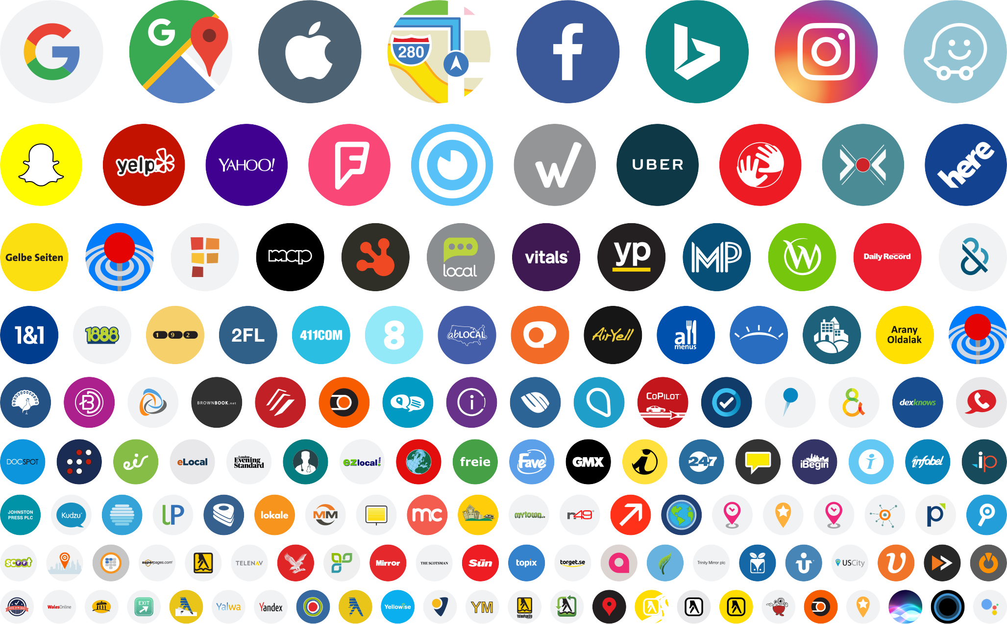
Our Superpower: 100+ Direct Data Integrations
Notes:
Enough trust in the data to turn that tournament off is hard to come by, and that’s the superpower of Yext Listings: over a hundred direct data integrations with sites, maps, apps, and digital services all around the world, across verticals, languages, and geographies.

Slide 15
Obstacles
Inaccurate Listings
Missing in Search
Not Standing Out
Take Control
Drive More Traffic
Build your Brand

Slide 16
Features to Leverage
M4A

Slide 17
Match & Lock

Slide 18
Match & Lock

Slide 19
Real-Time Updates
Update location data on your own schedule
Accurate and up-to-date information about your location(s)
Keep your customers informed

Slide 20
What can you do?
Manual Updates
Data Aggregators
Slow Updates ● Inefficient ● Time-Consuming
No Guarantee ● Inaccurate Data ● No Protection

Slide 21
Where do those facts come from?
Manual Business Claim
Government Filing
Google Places User
Tax State Forms
Mobile Yelp User
Unstructured Forum
Customer Facebook Post
Bank Loan Data
High Volume Tweet Feed
Unique Biz ID Forms
Angie’s List Review
Patent Registration
Yelp App User Signal
API Submission
Yahoo! Mobile User
Phone Records
Regional Directory
Out of Biz Call Center
Claimed Yahoo Listing
Acxiom Database
Claimed Yelp Listing
Infogroup Database
Foursquare Check-in
Lexis Nexis Directory
Google Update
GigWalk Submit
Store Locator
Offshore Location Team
Bing Local Listing
Business has no control
High risk of duplication
Nasdaq Filings
News Article
Thomson Reuters
Notes:
Without Yext, each of these services has its own unique method and algorithm for compiling what it believes to be the most accurate information about your customers. They consult a ton of different sources for this information, from government and phone records to user-submitted content and other directories.
This compilation process turns your customers’ listings into something very similar to March Madness — a tournament with a totally unpredictable outcome.
Are you currently working with data aggregators to solve this problem? When you do that, you’re only sending data to a few teams in the tournament, with no guarantee that data actually makes its way to customers.
It’s also critical to understand that this tournament happens every day, sometimes multiple times a day. This tournament you see here is just one slice of the bracket, at one point in time. As I’ve mentioned, these services are built to serve their users the most accurate location data. They know business aren’t static - they close, rebrand, move, etc. So unlike March Madness, which eventually stops, the data compilation process restarts and goes on 24/7, 365 days a year.

Slide 22
With no control, data degrades over time
Notes:
When your customers’ listings are subject to that process, the data that their customers see often changes or degrades over time. Here’s an example of a listing we followed for over a year across a sample of listings sites. You can see that as time progresses, certain data changes on certain publishers as frequently as multiple times per week.
This means that the experience a consumer could have with your customer’s business could be totally different from one site to another, with no guarantee that the information they see will be consistent or correct.

Slide 23
It’s Not Just This Place
Restaurants
Dentists
Auto Repairs
Painting & Siding
Taxidermists?
In fact, looking at hundreds of samples and data scans we found…

Slide 24
If You Don’t Keep Up With This
The Average Business Studied:
Changed every
Which equals
6
61
days for Name, Address or Phone
Core changes per Year
This was only looking at Business Name, Address, and Phone
If we added hours of operation, websites, social links, etc. it’d be far worse

Slide 25
Update Once, Update Everywhere

Slide 26
The Scan

Slide 27
The Scan
Bundle Yext
Add Scan to Website to Generate Leads
Use on Sales Call
Add Google to the Scan
*Do not use the Scan on Yext.com

Slide 28
High Percentage of Errors
Do you recognize this phone number?
Have you ever moved?
Is that an old business name?

Slide 29
Low Percentage of Errors
How much time do you spend maintaining your online presence?
As your business changes, how do you update your listings?
What differentiates you from your competitors?

Slide 30
No Error Percentage
How are you currently managing your listings?
Are you signed up with Yext?
How are you currently generating reviews?

Slide 31
Power the facts about your business on every Alexa device
Notes:
When 71% of people use voice search for common tasks, it should come as no surprise that Alexa answers questions on the tens of millions of devices it powers every day. Help Alexa answer questions by giving it the best, most up-to-date information about your business.
[SOURCE: Venture Beat, August 2017. https://venturebeat.com/2017/08/05/why-the-typical-voicebot-user-is-a-52-year-old-woman/]

Slide 32
Amazon Alexa joins the
Yext Knowledge Network
Control the information Alexa provides about your business, like name, address, phone, and hours of operation
Help ensure consumers get the most accurate answers to their questions
Notes:
For the first time ever, get control over the information Alexa provides about your business, like hours of operation, address, and more. Through this new integration, you can ensure consumers get the most accurate answers to their questions.
Note, this partnership is not exclusive.

Slide 33
The use of voice-enabled speakers is expected to grow by 130% in the next year
Consumers are asking Alexa questions, like:
Where is the closest restaurant that has gluten-free items?
Tell me which bank has an ATM in my neighborhood.
Give me the address to the nearest urgent care.
What’s the number for the nearest nail salon open now?
Work with Yext to ensure Alexa has the most accurate answers to questions about your business.
Source: eMarketer, May 2017.
Notes:
Consumers are asking Alexa questions, like:
Where is the closest restaurant that has gluten-free items?
Tell me which bank has an ATM in my neighborhood.
Give me the address to the nearest urgent care.
What’s the number for the nearest nail salon open now?
Help Alexa give accurate answers about your business by powering them in Yext.

Slide 34
The world’s biggest brands have adopted DKM
RETAIL
FINANCIAL SERVICES
FOOD SERVICES
HEALTHCARE
HOSPITALITY
DIGITAL AGENCIES
Notes:
To stay ahead of their competition, some of the world’s biggest brands are adopting DKM.

Slide 35
Objections

Slide 36
Objection #1
“I don’t need this”

Slide 37
“I don’t need this”
BRODIE MART
TOWN OF HILLSDALE
DYNASTY BUFFET
ELMHURST HOSPITAL
“Your digital presence is as foundational as your business’s signage.”

Slide 38
“I don’t need this”
76%
of people who use location search buy within one business day
43%
of businesses across the US have at least one incorrect or missing address online
Missing/Wrong Information = LOST SALES!

Slide 39
Objection #2
“I only care about Google”

Slide 40
“I only care about Google”
Imagine asking 10 random people where a particular restaurant is
and receiving the following answers:
Goodfella’s
Pizzeria
144 Orchard St
(212)432-3200
Goodfella’s
Pizzeria
144 Orchard St
(212)432-3200
Goodfella’s
Pizzeria
144 Orchard St
(212)432-3200
Goodfella’s
Pizzeria
144 Orchard St
(212)432-3200
Goodfella’s
Pizzeria
144 Orchard St
(212)432-3200
Goodfella’s
Pizzeria
144 Orchard St
(212)432-3200
Goodfella’s
Pizzeria
144 Orchard St
(212)432-3200
Goodfella’s
Pizzeria
144 Orchard St
(212)432-3200
Goodfella’s
Pizzeria
144 Orchard St
(212)432-3200
Goodfella’s
Pizzeria
144 Orchard St
(212)432-3200
High Confidence

Slide 41
“I only care about Google”
Now imagine asking 10 random people where a particular restaurant is
and receiving the following answers:
Good Fella
Brick Oven
114 Orchard St
Good Feelings
Pizzeria
414 Orchard St
You mean Goodfella’s LES?
I don’t think I know them.
144 Orchid Ave.
Goodfella’s
Pizzeria
144 Orchard St
(212)432-3200
144 Archer St.
(212)343-4300
Where?
Never heard
of it.
Great movie.
Low Confidence

Slide 42
The Search Ecosystem
Consistency | Authority | Number
:

Slide 43
Objection #3
What happens if I cancel?

Slide 44
No Solution = No Control
For the average business studied, listing information...
Changed every
Which equals
6
61
days for name, address or phone
core changes per year

Slide 45
No Solution = No Control
Business data changes constantly for tons of reasons:
Changed Owners
Social Posts
Business Moved
Old Data
Data Aggregators
State Tax Forms
Local Business Listings

Slide 46
No Solution = No Control

Slide 47
Solution = Full Control

Slide 48
Objection #4
“I can’t afford this right now”

Slide 49
“I can’t afford this right now”
Billboard
Radio
Pay Per Click
Sponsorship
Current marketing expenses?
Prevent a leaky budget!

Slide 50
Closing the Sale
How much money do you think you’re losing by having that wrong phone number / wrong address listed?
How do you normally find new businesses? (restaurants, retailers, tailors, etc)? Do you ever use your mobile device?
How do you plan on fixing this without us?
Were you aware that you have 0 chance of reaching a prospective client on [missing listing]?
Frame as an investment, not a cost.

Slide 51
Build the Foundation
Web Design
SEO
Content Creation
Reputation Management
Other Marketing Programs

