Slide 1
Primary Care Recommendations
August 5, 2019
Readback from Workshop

Slide 2
Contents
1
Objectives & Goals
2
2020 Update
3
Recommendations
Notes:
Assumptive Journey

Slide 3
Scope of Work

Slide 4
Journey Workshop Objectives
Strategic Objectives & Goals
Our FY-19 goal is a 5% increase in Physician Clinic visits. FY-18 total clinic visits: 8, 636
Grow total Clinic visits from 8,636 to 9,068=432 more visits.
Grow Pediatric visits from 2,879 to 3,023=144 more visits.
Grow Surgery visits from 689 to 723=34 more visits.
Grow Internal Medicine visits from 2,138 to 2,245=107 more visits.
Grow Urology visits from 698 to 733=35 more visits.
Journey Use Cases
Understand current patient journey for pediatric patients in order to:
Improve any processes that may need clarification or change.
Identify like prospects to increase pediatric patient visits.
Develop marketing and online strategies and tactics to target and manage prospects to meet growth goals.
Understand how the current journey might be affected by changing from pediatricians to family medicine physicians.
Utilize the process to map journeys of internal medicine, urology and general surgery patients for Physicians Clinic, as well as OB/GYN patients for the Women’s Wellness Center.
Utilize the process to map journeys of other targeted growth service lines at the hospital.

Slide 5
Journey Objectives

Slide 6
Objectives & Goals
Strategic Objectives:
Grow the patient base while optimizing staffing utilization and capital investment.
Goals:
FY2020 goal is a 15% increase in patient visits (984 total visits with a focus on Ortho visits)
Surgical
Pediatrics
IM/FM
Urology
Note: FY2019: growth was 2.4%
Notes:
FY-19 Physicians Clinic visits=6,560 compared to 6,404 in FY-18. Goal was 5% increase, 320 visits, actual is 156 visits
Surgical-567 down from 689
Pediatrics-2,839 down from 2,879 (pediatrician left in June)
IM/FM=2,438 up from 2,138 (internist left in May, Kristin Pratt added in May)
Urology=716 up from 698 (added a urologist)

Slide 7
Update from HRMC
New Providers
Family Medicine physician – 6/24/2019
Orthopedic Surgeon – 7/8/2019
Projected physicians:
Dr. Belyea, full-time Family Medicine
Kristin Pratt, full-time FNP
Dr. Todd Anderson, half-time Orthopedics, permanent (recruited resident arriving July 2023)
Dr. James Laferriere, temporary Pediatrician through September?
Dr. Anita Inveiss, temporary Family Medicine. Begins August 19, 2019, hoping to become full-time permanent
Locum surgeons through July 2020, then permanent new surgeon arrives

Slide 8
Our Understanding
Desired Outcomes
Clarify message and brand strategy to retain and acquire patients in Primary Care (Family Medicine/Pediatrics).
Key Challenge
Major Objective
This project was focused on Primary Care and the transition from specialists (Pediatrics) to generalists (Family Medicine).
Attract and retain patients in the HRMC health system.

Slide 9
Recommendations

Slide 10
Key themes identified during the 2nd workshop.
Messages
Patient Experience
Clarify message and brand strategy to engage prospects in the HRMC value. Experienced and exceptional care in your own backyard.
Improve the patient experience for access to care.
It is a team approach.
Build on the HRMC brand message and value proposition to care based on the entire team – the doctors are a part of that team not the entire team.
Provide messaging and profiles for a team approach and specific new doctors.
Know me
Birthday cards, reminders and information on wellness visits matter.
New Patient welcome forms/kits:
Link to the online forms.
Request email address & permission to email or text.
Include the care team profile.
Promote the Health Library, Health Navigator and other online content.
Encourage patients to sign up for service line nurturing campaigns (future – after marketing creates them).
Provide information on options for after-hours care.

Slide 11
Strategic Recommendations
Immediate/Mid-Term & Physician Transition
Brand Campaign
Service Lines
Patient Experience
Shift the weight of the message to include more of a total team approach.
You have a team behind your health care.
Tactics:
October Chamber Meeting: in addition to docs/tour, celebrate employees’10-, 15-, 20-year anniversaries.
Spotlight employees on social media and during community events.
Provide Team bios with the doctor bio.
Establish trust and confidence by prioritizing efforts that transform a patient from “worried and insecure” to “confident.”
Roll out by service line based on enterprise goals (Primary Care and Orthopedics).
Tactics:
Digital Marketing with educational content on a custom landing page and nurturing emails.
What to expect: pre-, during and post-care communications and support.
Remove unnecessary anxiety in every patient interaction. They are guests in your home.
Tactics:
Script the top FAQs (e.g., What do I do for after-hours care?).
Update New Patient kits and Appointment Reminders.
Create bios for the care teams that focus on experience and the “personal side.”

Slide 12
Action Plan
Initiative | Tactic(s) | Resources
Brand Your Team | Chamber Meeting: in addition to docs/tour, celebrate employees’10-, 15-, 20-year anniversaries. Spotlight employees on social media and during community events. Real People – Real team bios – on website, FB and as handouts. Digital Campaigns – Display Social and GDN. | Content/Writers Interview Employees Videos/Photos Digital Marketing
Service Lines | Add Evergreen Paid Search campaigns, starting with PCP then Orthopedic based on capacity and growth. Test PCP and Ortho campaigns – Google Display Network to custom landing page and call tracking. | Digital Marketing Ad Content
Patient Experience | Create FAQs. Update New Patient kits & Appt. Reminders. Update Team bios. Provide link to educational content. | Marketing

Slide 13
ROAD MAP
Q1 20 | Q2 20 | Q3 20 | Q4 20
BRAND CAMPAIGN
FB & Website Update: Monthly Employee Spotlights
Location Posters
October Chamber Employee Recognition
Traditional Media
SERVICE LINE CAMPAIGNS
Primary Care: Digital Marketing - Paid Search Campaign Evergreen
Primary Care: GDN Landing Page & Remarketing
Orthopedics: Digital Marketing - Paid Search Campaign Evergreen
Orthopedic Campaign Display, Landing Page and Remarketing
PATIENT EXPERIENCE
Develop FAQs
Update New Patient kits and Appointment Reminders
Write Team bios & update website

Slide 15
APPENDIX

Slide 16
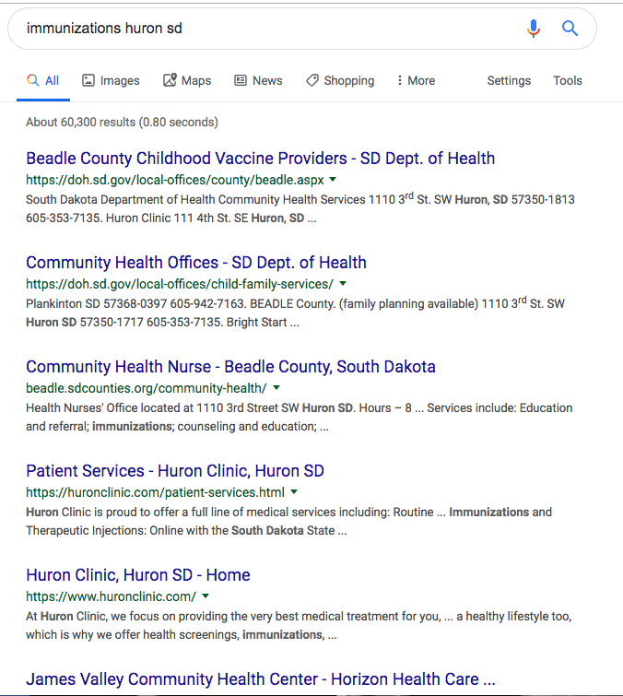
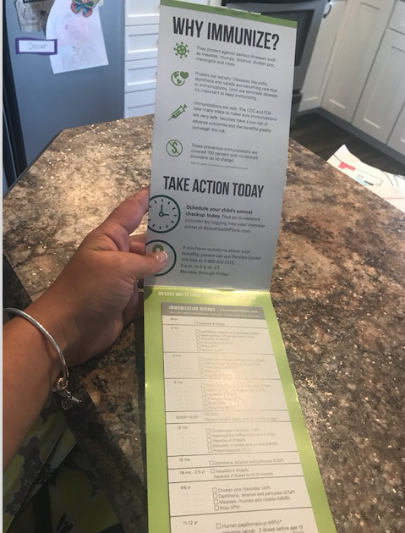
Immunizations – Bidding on keywords?
Huron Clinic
Horizon Health

Slide 17
Huron Regional Medical Center
Key Facts & Stats
Huron, SD population 12,600 – serves 7 counties; 37,000 population
10 Maternity suites
25-bed critical care access with 17 active board-certified physicians
HRMC Physicians Clinic
Same-day Surgery
Breast Cancer Services
1,326 patients admitted with an average length of stay of 3.6 days for an average of 13 patients per day
60,721 outpatients
279 births
6,013 ER visits
2,616 outpatient treatment room visits (includes chemotherapy)
8,636 HRMC Physicians Clinic visits
4,370 Women's Wellness Center visits
2,777 Specialty Clinic visits
Notes:
The racial makeup of the city was 86.9% White, 1.0% African American, 1.2% Native American, 4.9% Asian, 0.1% Pacific Islander, 3.9% from other races, and 1.9% from two or more races. Hispanic or Latino of any race were 9.8% of the population.
There were 5,418 households of which 28.7% had children under the age of 18 living with them, 44.4% were married couples living together, 9.8% had a female householder with no husband present, 4.4% had a male householder with no wife present, and 41.3% were non-families. 36.1% of all households were made up of individuals and 15% had someone living alone who was 65 years of age or older. The average household size was 2.27 and the average family size was 2.94.
The median age in the city was 39.8 years. 24.1% of residents were under the age of 18; 8.7% were between the ages of 18 and 24; 22.8% were from 25 to 44; 26.4% were from 45 to 64; and 17.8% were 65 years of age or older. The gender makeup of the city was 49.4% male and 50.6% female.

Slide 18
Behavior Assessment Pillars
I need a guide to help me transform from a “worried and insecure” mom to a “confident” mom. Be my partner and trusted resource for the care of my child’s health.
Motives
Needs
Pain Points
The triggers to seeking a pediatrician generally fall into these categories:
Experiencing a change:
New baby
New mover/location
Insurance
Experiencing dissatisfaction:
Service (billing/convenience)
Access to care
Negative experience
Convenience.
Access to care.
Affordability.
Quality care.
Know me – I want a trusted relationship for my child’s health care provider.
Help me be confident in my ability to care for my child.
Doctor is changing – anxious.
What do I do for after-hours care?
Help me experience how you will be my trusted “resource.”
New baby classes.
Online new-mom groups.
Virtual tours.
How much will it cost? No surprises.
Note: The differences in the various journeys are related to confidence and experience of the parent(s).
Notes:
Behavior Assessment looks at the moments of truth on the journey through the lens of motives, needs and pain points.

Slide 19
Workshop #1: Action Items
Marketing
Clinical/Operations
Clarify message strategy to engage prospects in the HRMC brand regardless of Pediatric or Family Practice model.
Create a tighter synergy between OB/GYN practice, Birthing Center and Physician's Clinic.
Improve the patient experience for access to care.
New Patient onboarding:
Provide online forms, get email address and permission to email or text.
Create a Pricing Transparency strategy:
Develop insurance and estimated pricing for key service lines with “no surprises.”
How will this change with a different provider model?
Optimize options for After-hours care.
Increase patient comfort while waiting for the doctor. Explore ideas such as:
Assigning an exam room at check-in to wait vs. waiting in the lobby.
In-room amenities, such as Wi-Fi, bottled water, health information/events information on a TV.
Develop a New Moms program that starts with pregnancy (e.g., FB Group or expand the breastfeeding support group).
Develop content strategy for key pain points:
New Patient onboarding
After-hours coverage
Pricing transparency
Establish a broader digital presence:
Example: paid search, display ads on FB/IG – given the demographic.
CRM: Secure opt in and send emails to nurture

