Slide 1


Internal 1.20.20

Slide 2
IDI “called out” Goals and Objectives
Attract More and Better Patients
Bring in more new patients overall (MDR)
Support practices AND doctors that do not have full schedules
Sell services to current patient base (stop “leakage”) AND recalls
Attract higher end cases digitally/external (for example, but not limited to, aesthetics)
Assist their recruitment efforts (identify residents and drip market to them)
Better integrate doctors into a common brand.
Create a company, not a series of independent practices.
Grow 15% per year
Notes:
Note: Pathology is being sent out. Path dept does not do the best job promoting themselves. MDs will refer to their residency programs.
Build career path for MD’s, PA’s, NP’s to share in growth and success

Slide 3
Back Story - 11 Partners, 9 Practices
Formation was a merger of 8 practices at the time. Practices that had been in existence for 10-25. They all came together in 2009. 8 partners. Original Greenberg, Harris Kaylis, Lorber, Madrea, Mandrea, Odonohohgh, Montalvo but he left (retired and went to Florida). Keith cam on as a partner with Mandrea sbu. Practices that merged became SBUs Mandrea had two locations at the time. Lorber had two. Then Mandrea shit down one move then started two more. Flores helped create the lab. Joined for benefit of shared services looking for economies of scale.
Lakeside
Golder is an employee (out of Rush). They helped set him up but he is not a partner. Functions as an SBU. Profitability of his practice is paid out. He is the only one. IF he leaves, he takes his practice with him. Don’t’ spend a lot of time but we should understand how he fits in. he was afraid he would lose referrals. Docs said they would pull their Mohs if he brought in general derm, they hired their own Mohs anyway. They are looking at an additional Mohs surgeon. They have three Mohs in addition to him. HE doesn’t promote himself much.
They do have other websites,
Same guy doing all of the sites

Slide 4
Coverage Area

Slide 5
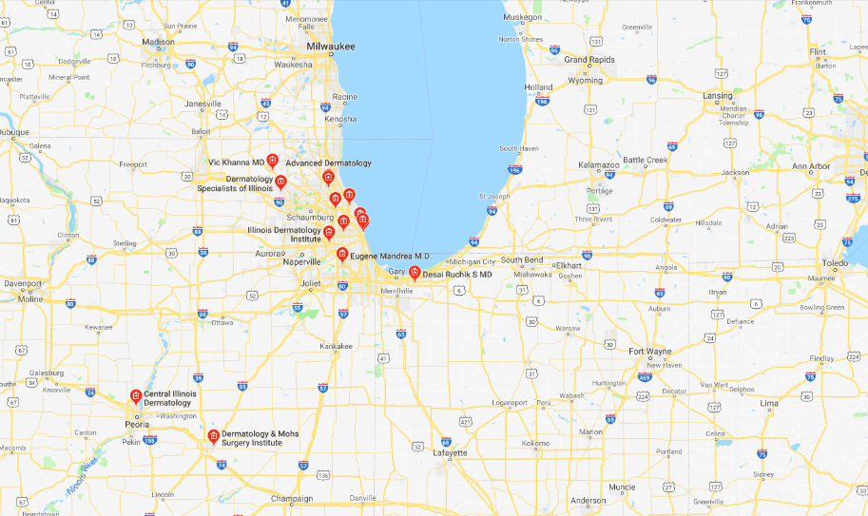

Slide 6
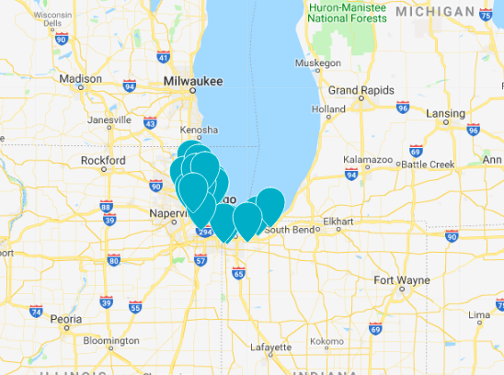

Slide 7
Partners

Slide 8
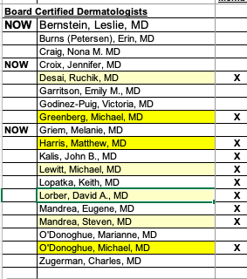
Notes:
Michael O Donoghue; Michael Greenberg; Matthew Harris; Ruchik Desai; David A. Lorber, M.D.; Steven Mandrea; Work

Slide 9
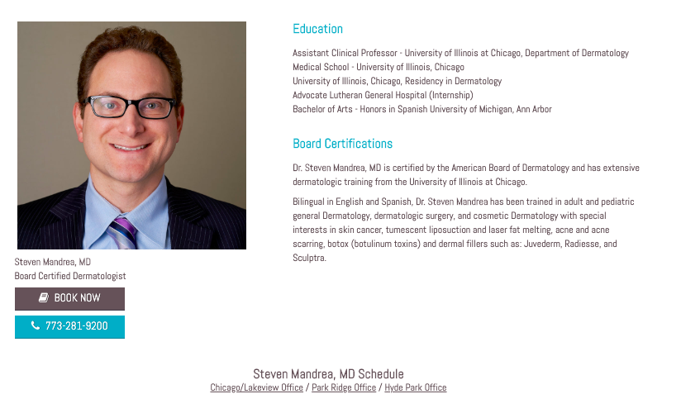
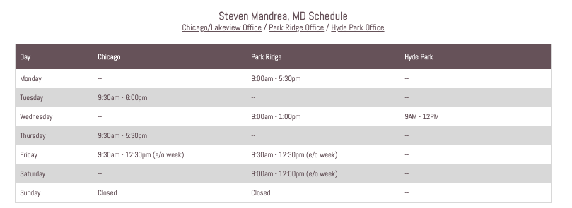

Slide 10
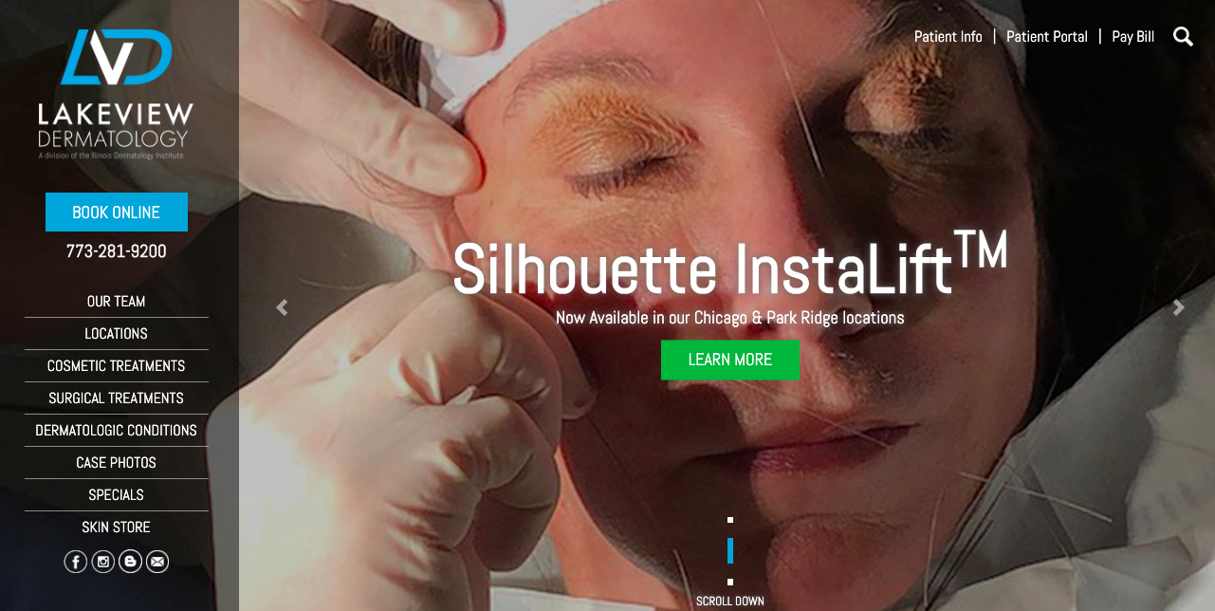
Notes:
https://www.lakeviewderm.com/

Slide 11
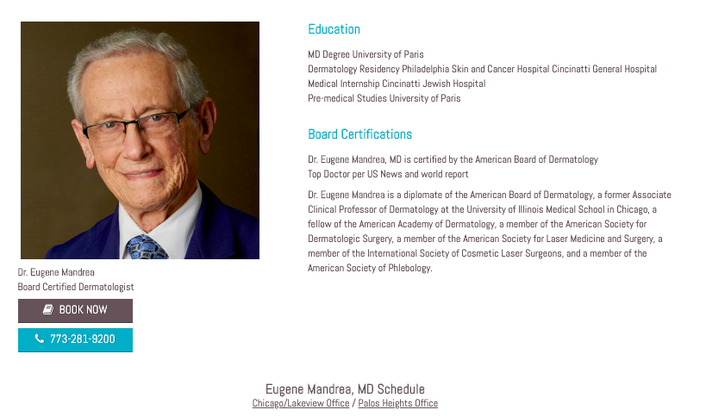

Slide 12
Interview Notes – Steven Mandrea
All MDs are under one umbrella, all used to be private - 10 years as IDI
Built pathology lab, can do group purchasing
Add vein to Lakeview – Lakeview has it’s own brand. Division of IDI
They depend on their website, especially for the Chicago market
The see a lot of WOM and MD referrals
HE spends more on adwords that anyone else in IDI
HE feels now is a great opportunity to create synergy
No acquisitions this year will give them time to regroup and think as a group
Dad piqued his interest in derm, also works with IDI, loves the diversity of derm

Slide 13
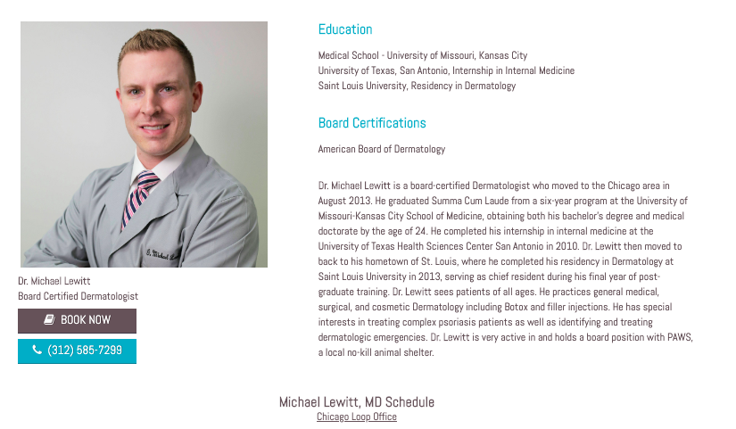
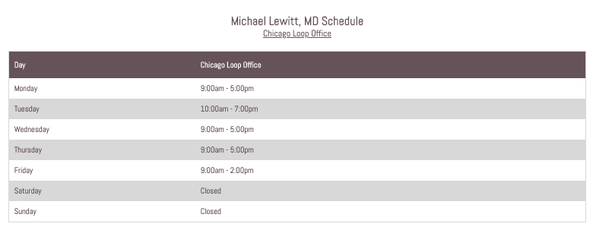

Slide 14
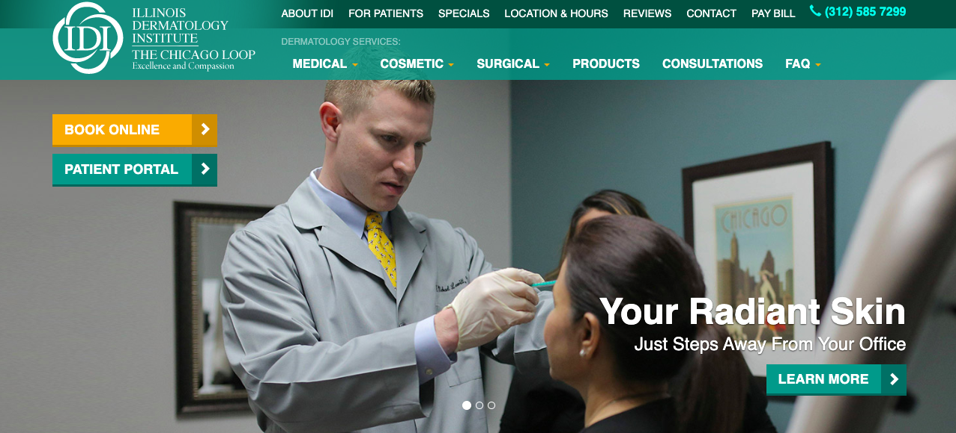
Notes:
https://idi-loop.com/

Slide 15
Interview Notes
Just added 4 new providers – 2 from golden circle
Loop has a transient population
50% new patients per day
He has done Yelp, FB, website, zocdoc,
Wants: help with social, ongoing “maintenance” of strategies
Goal
Feed new providers

Slide 16
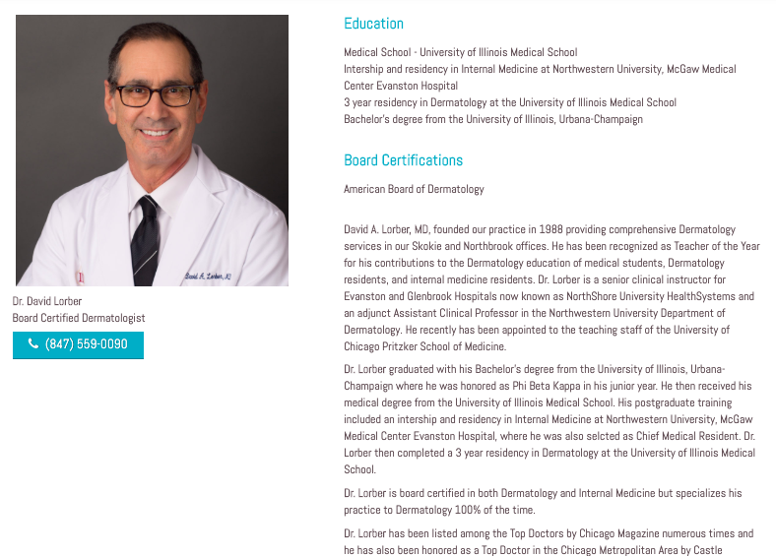
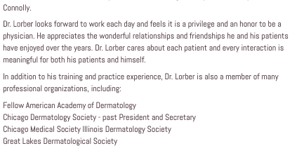
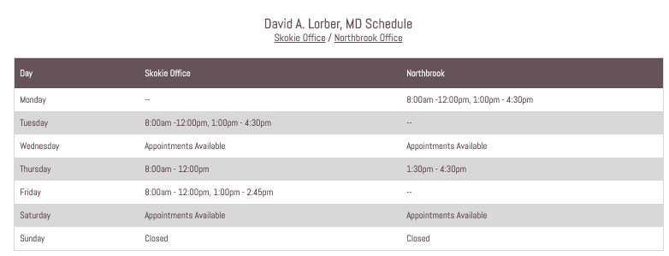

Slide 17
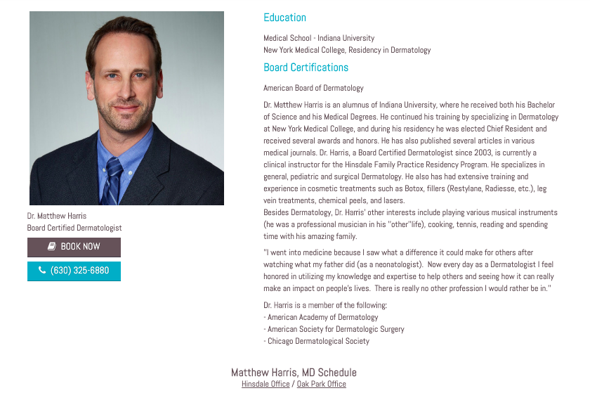
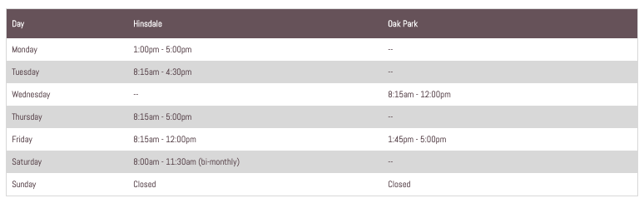

Slide 18
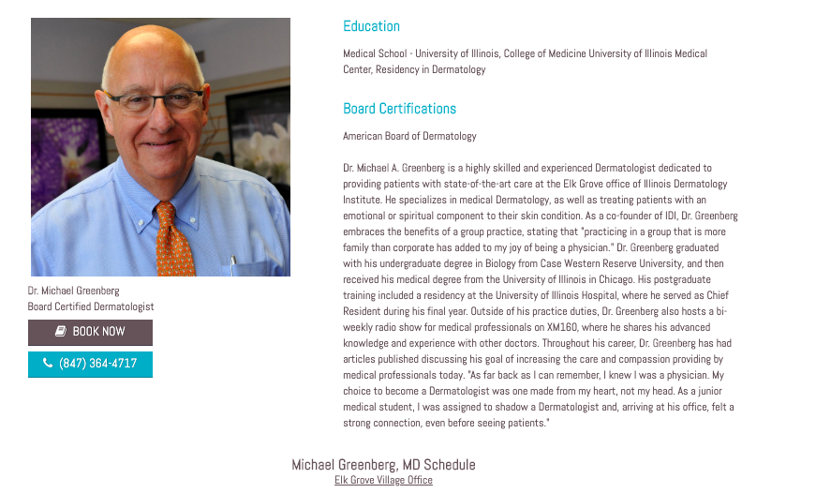
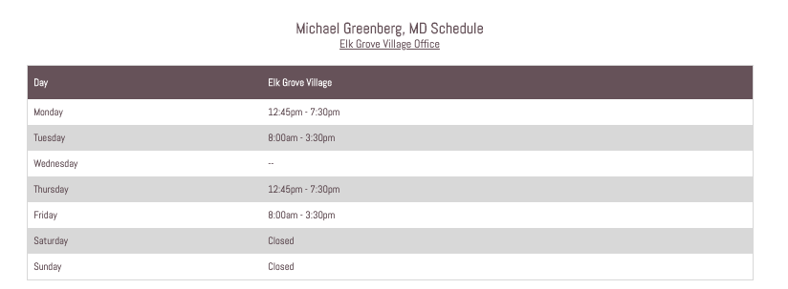

Slide 19
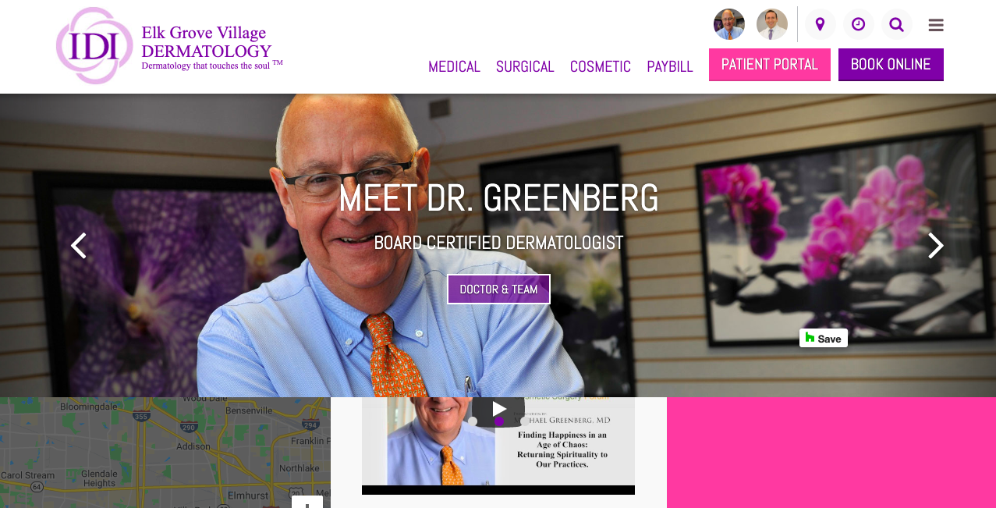

Slide 20
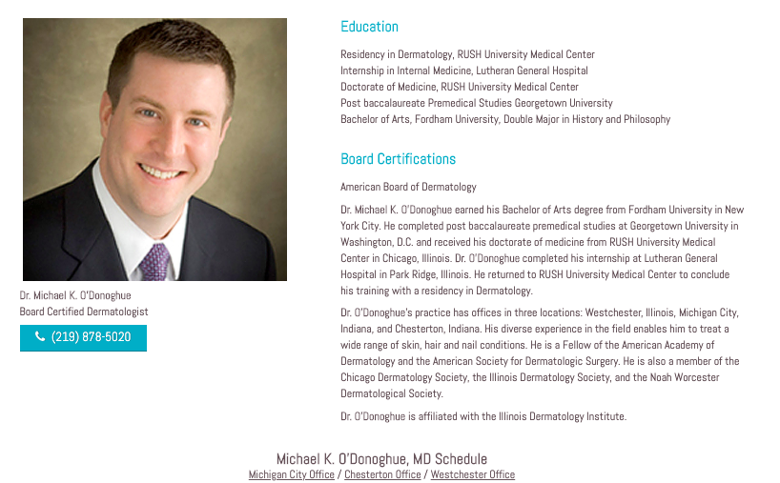
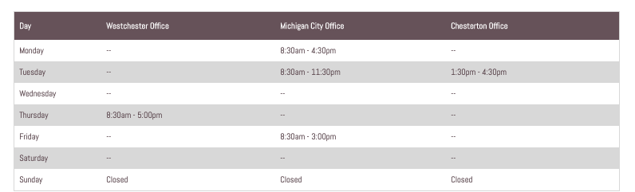
Notes:
https://www.lakeviewderm.com/

Slide 21
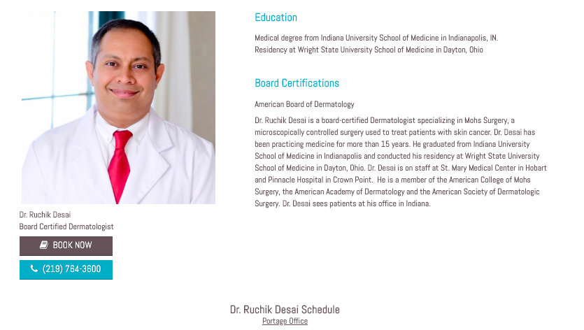
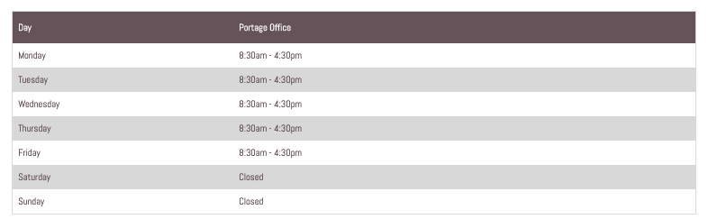

Slide 22
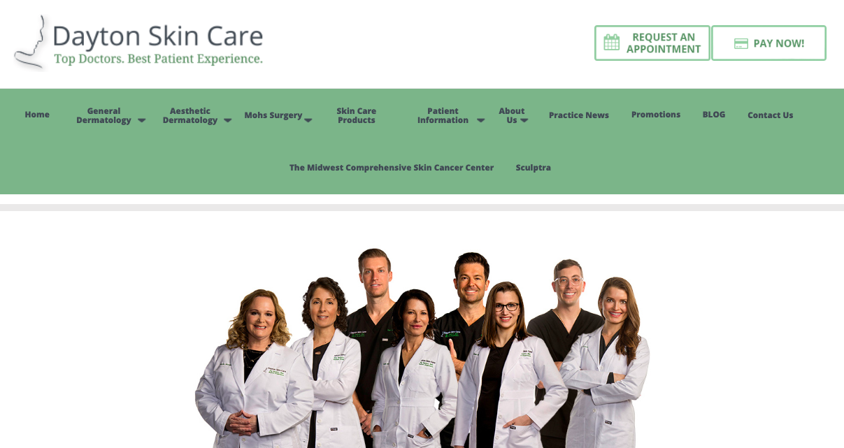

Slide 23
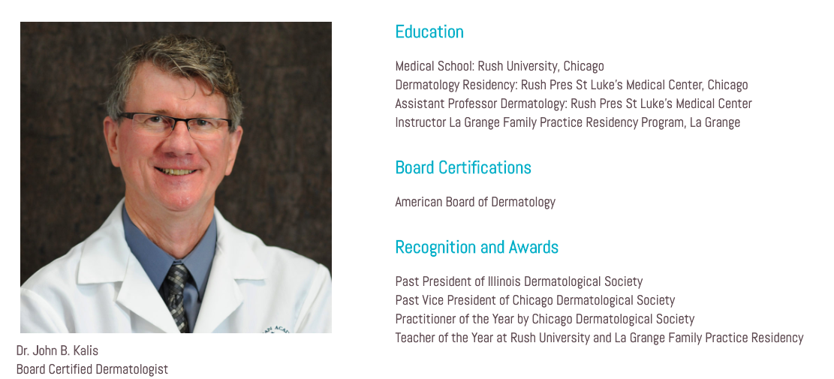
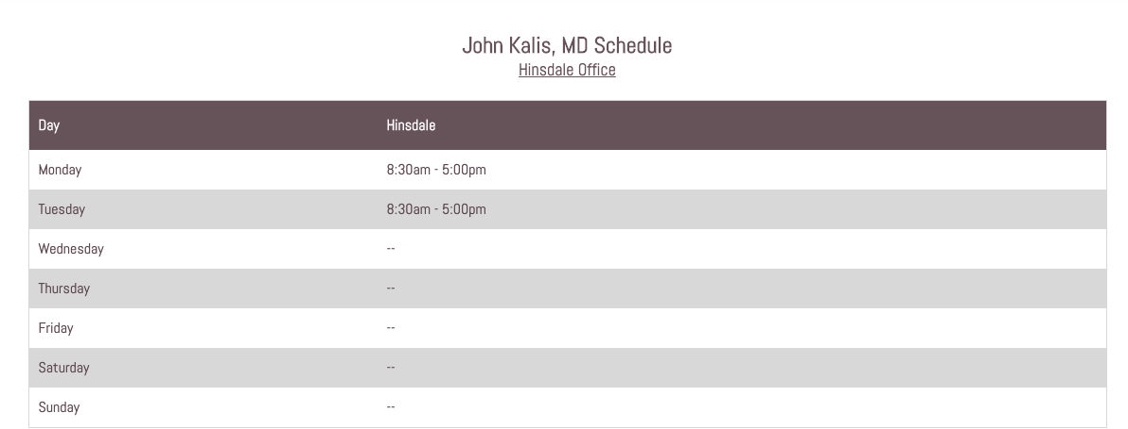

Slide 24
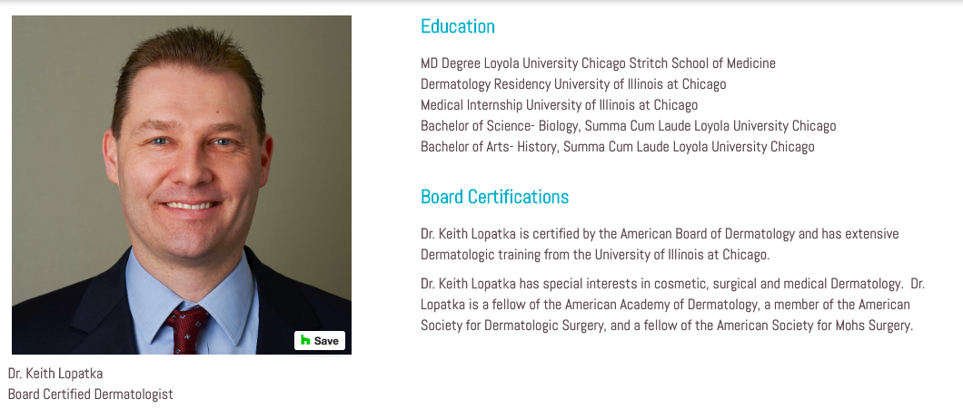
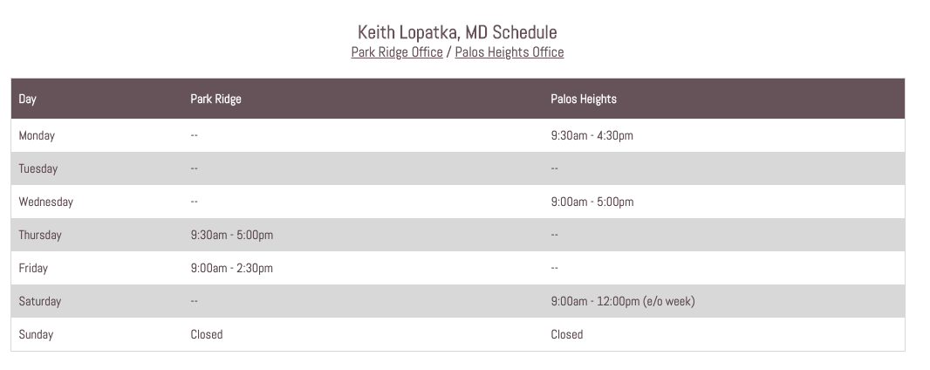

Slide 25
Website(s) Review www.illinoisderm.com xwww.lakeviewderm.com https://www.idi-elkgrove.com xhttps://idi-loop.com http://www.idi-skokie.com/ xhttps://drsaradickie.com/ xhttps://www.drgoulder.com/ xhttp://www.hinsdalederm.com/ xhttps://www.daytonskincare.com/
Confirm with doctors during interview x

Slide 26

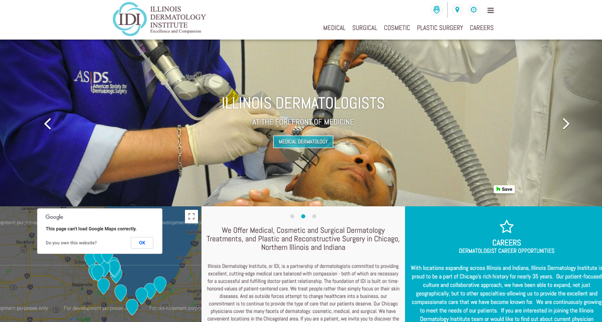
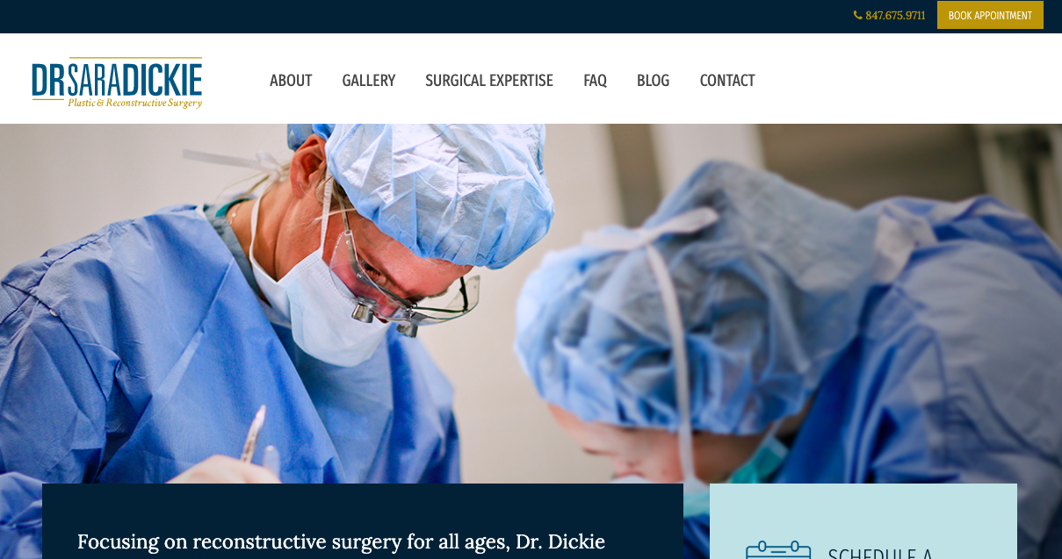
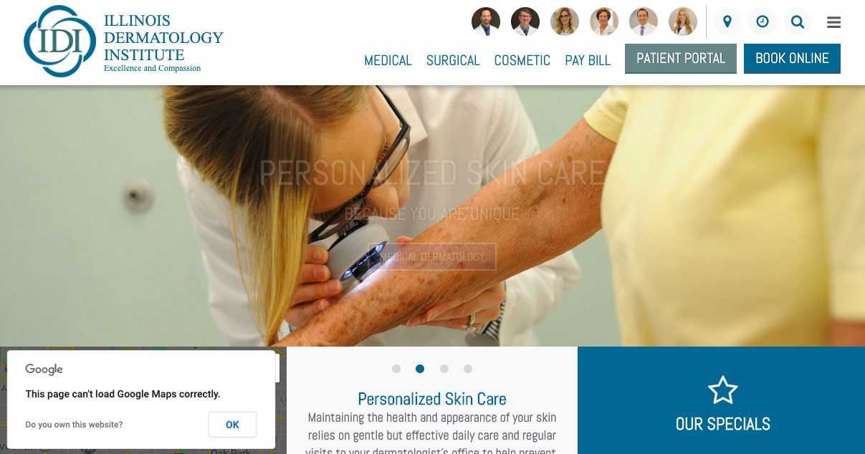
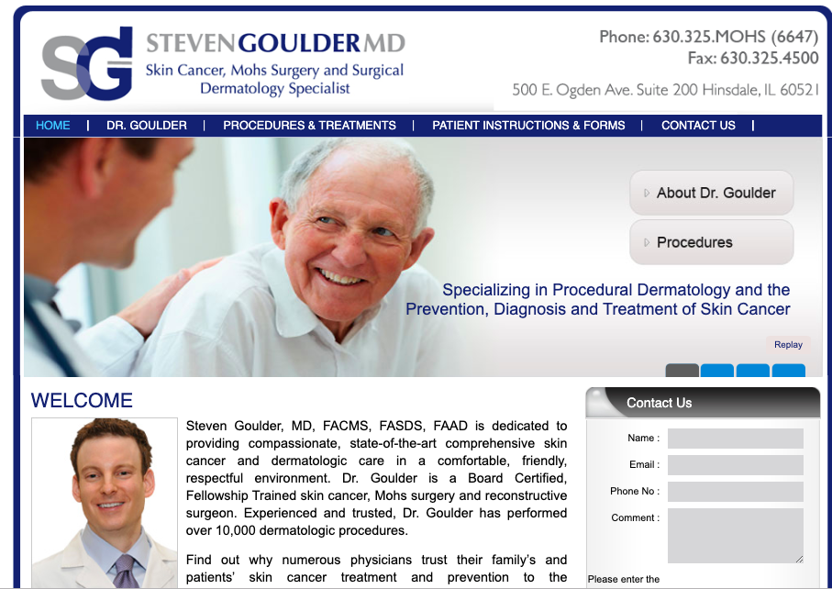
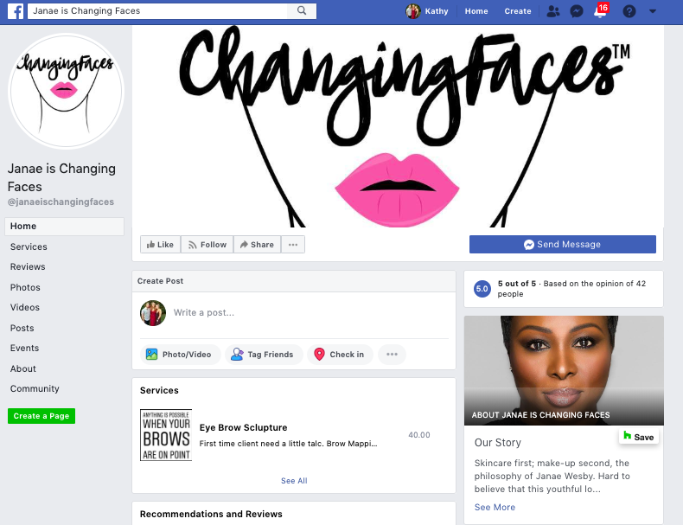

Slide 27
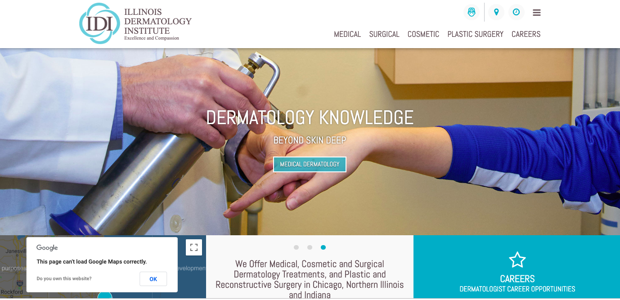
Notes:
Illinoisderm.com

Slide 28
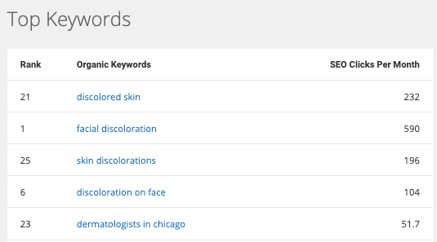
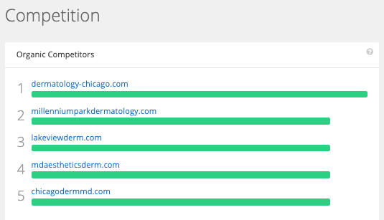
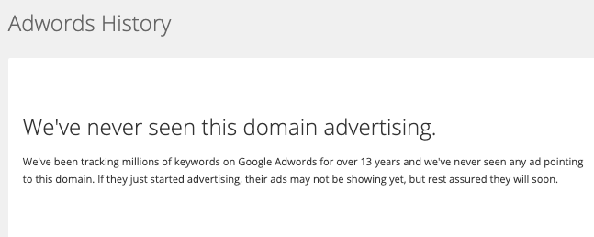
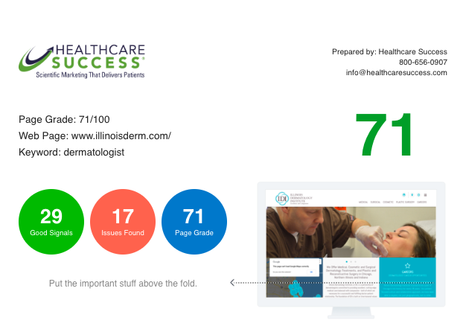
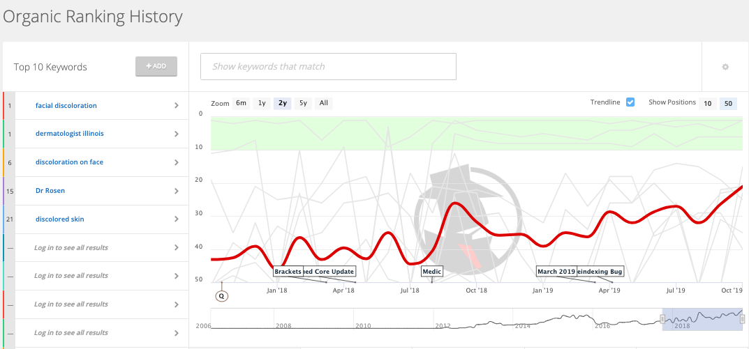
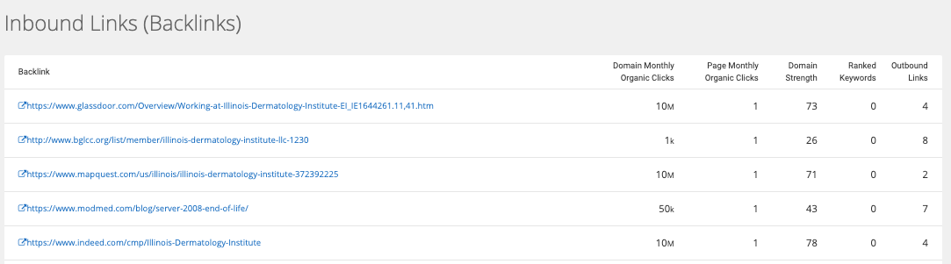

Slide 29
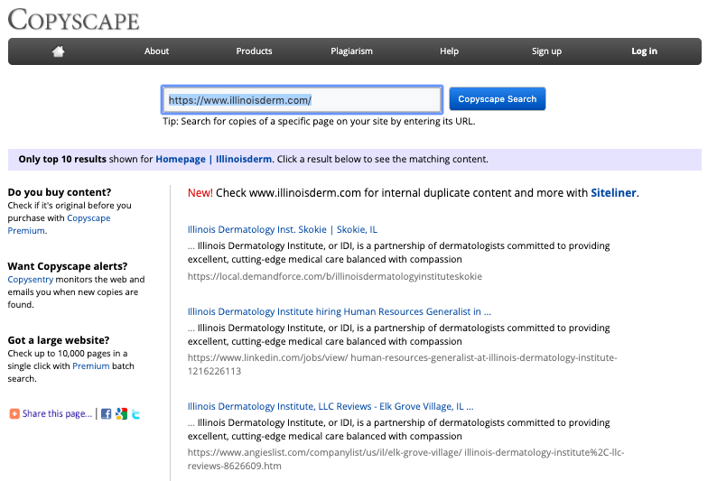
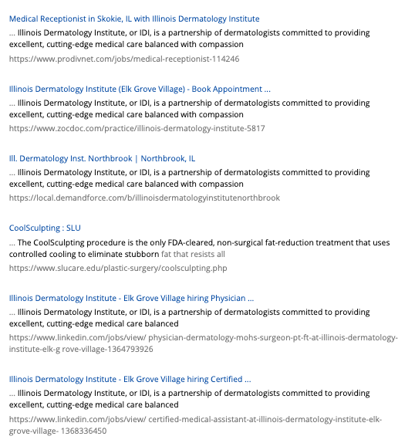


Slide 30
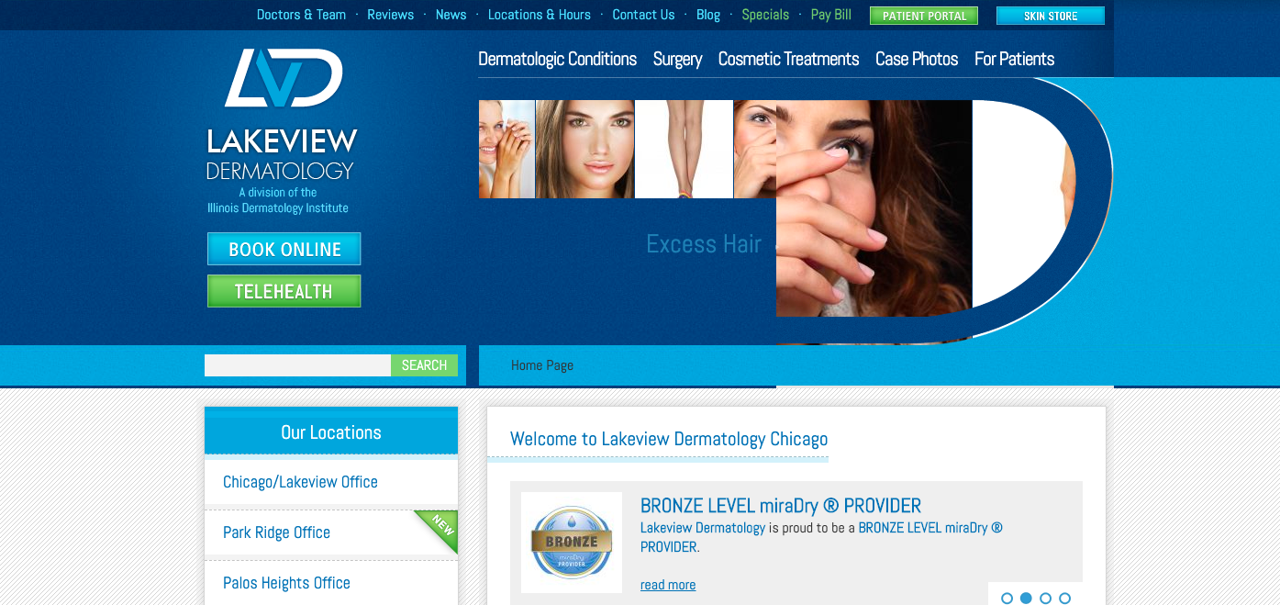
Notes:
www.lakeviewderm.com

Slide 31
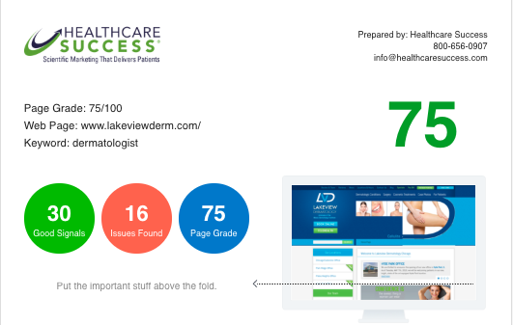
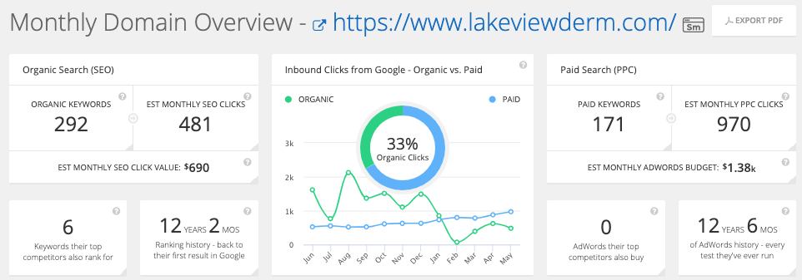
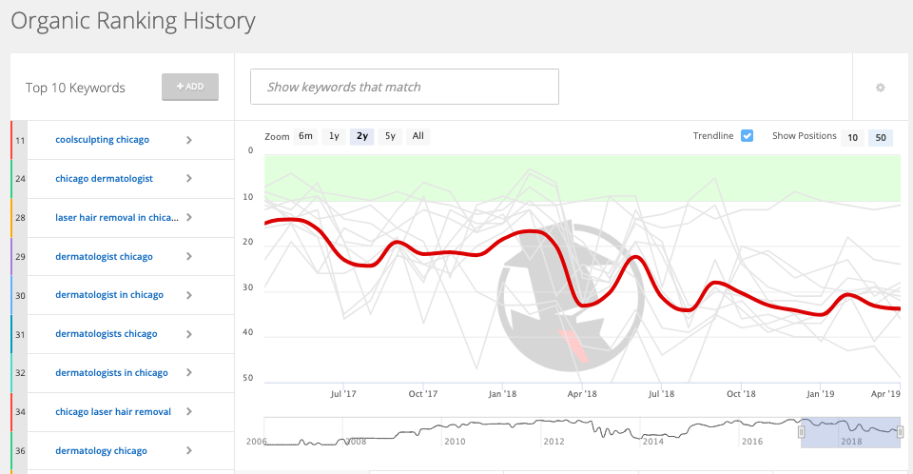
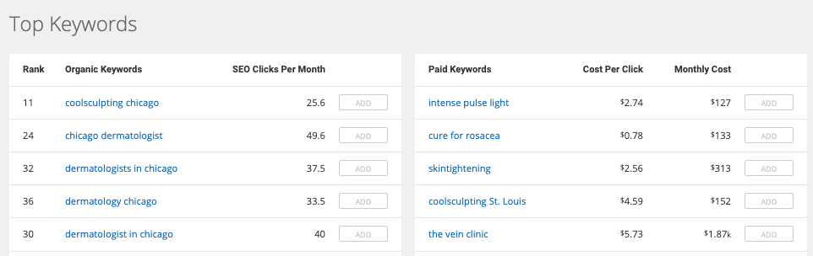
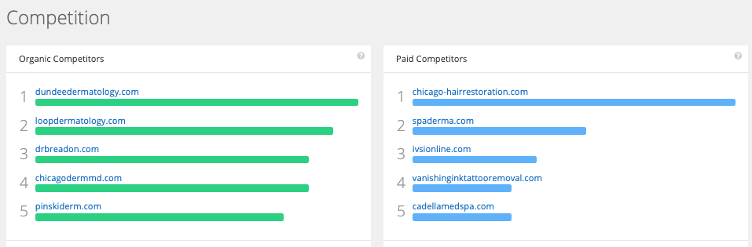
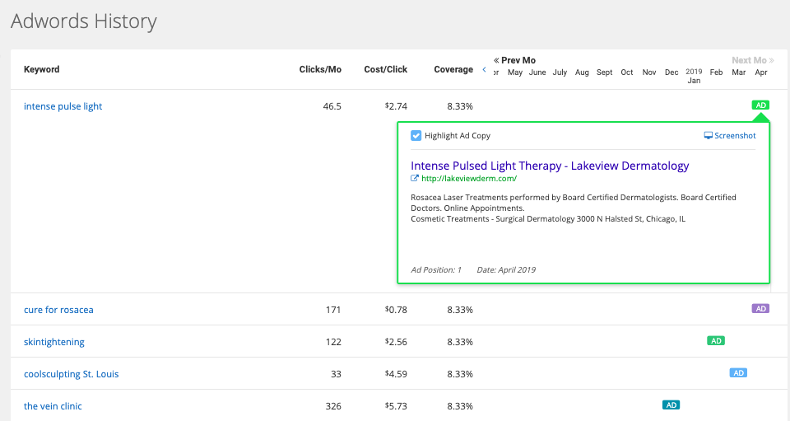

Slide 32
Notes:
https://idi-loop.com/

Slide 33
Notes:
/www.daytonskincare.com

Slide 34
Notes:
www.drgoulder.com

Slide 35
Notes:
http://www.idi-skokie.com

Slide 36
Notes:
https://www.idi-elkgrove.com/

Slide 37
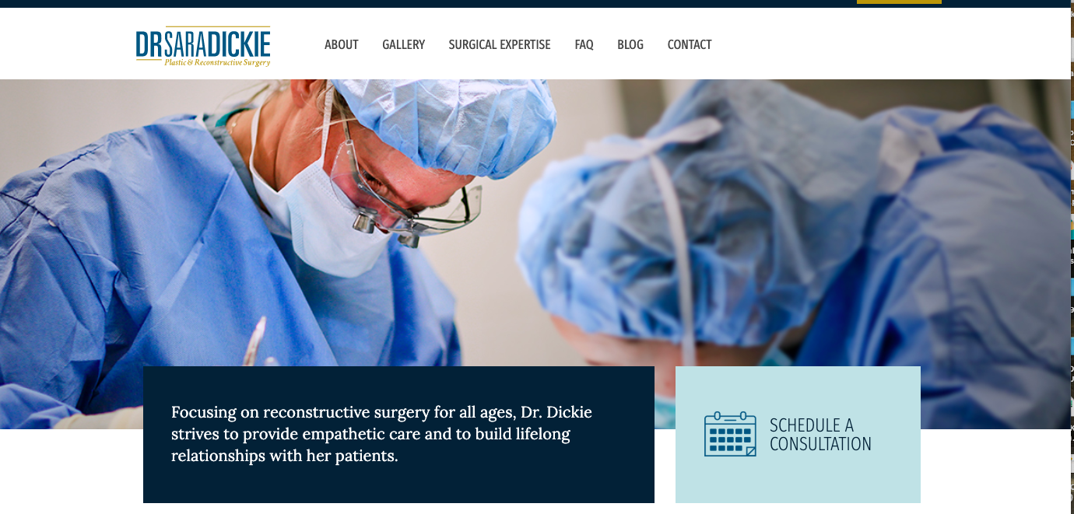
Notes:
drsaradickie.com

Slide 38
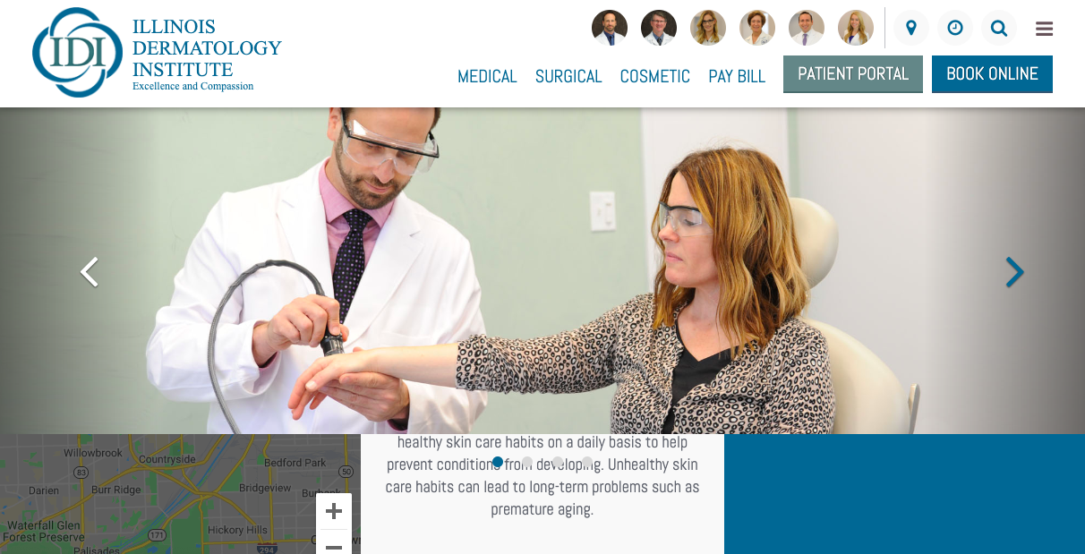
Notes:
https://www.hinsdalederm.com/

Slide 39
Competition

Slide 40
Main Competitors
Pinnacle Dermatology
Forefront Dermatology
Derick Dermatology
Advanced Dermatology
Pinsky

Slide 41



Slide 42



Slide 43



Slide 44





Slide 45

Pinsky???

Slide 46


Slide 47






Slide 48


Slide 49





Slide 50





Slide 51



Slide 52





Slide 53

Locations

Slide 54








Notes:
17 locations

Slide 55


Chesterton
Chesterton

Slide 56


Calumet
Desai
Rhonda Someson
Calumet

Slide 57


Location
Lakeview

Slide 58


Location
Loop

Slide 59



Location
Gold Coast

Slide 60


Loop
Elk Grove
Notes:
Elk Grove

Slide 61


Loop
Hinsdale

Slide 62


Hyde Park

Slide 63


Michigan City

Slide 64


Northbrook

Slide 65


Oak Park

Slide 66


Palos Heights

Slide 67


Park Ridge

Slide 68


Portage

Slide 69



Skokie

Slide 70


Wetchester

Slide 71


Crown Point

