Slide 1
The New Heroin Epidemic
Melissa “MJ” Jendusa, MS, CHES, CADC
Recovery Management Coordinator
Chris Gleason, MA, CAADC
Director of McHenry County Services
Rosecrance Health Network

Slide 2
Agenda
Heroin overview and statistics
Signs and symptoms
Medication-assisted treatment
Substance use among the emerging adult population
Treatment implications: what works vs. what doesn’t work
Strength-based approaches
Overdose prevention

Slide 3
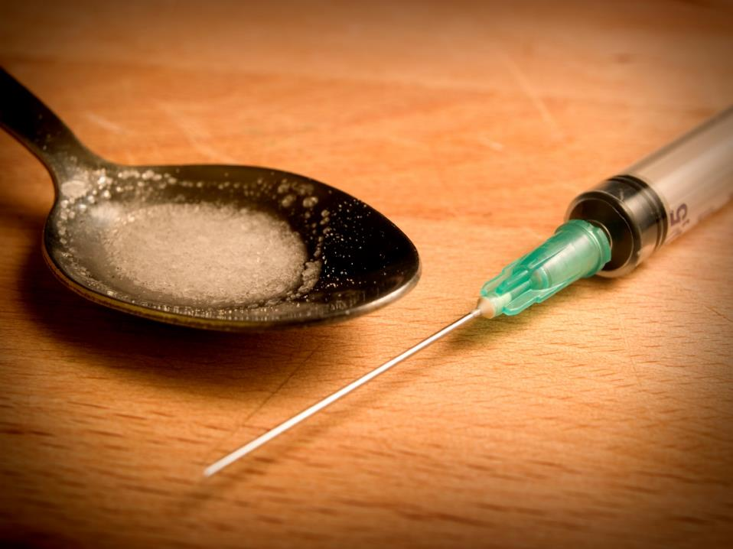
Heroin overview and statistics

Slide 4
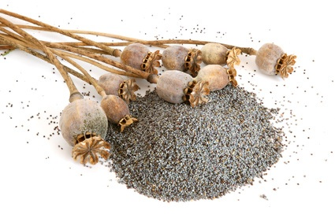
What is heroin?
Heroin is a highly addictive opioid drug made from morphine, a mind-altering substance that occurs naturally in the resin of the opium poppy plant.
Heroin can be smoked, injected or snorted.

Slide 5
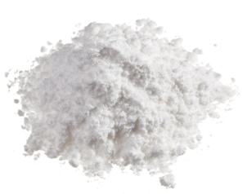
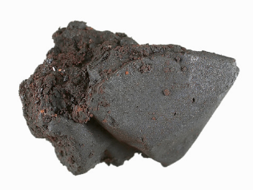
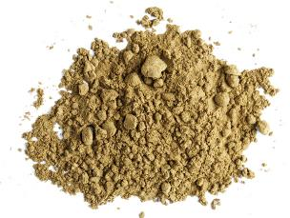
What does it look like?
Heroin can be white or brown powder or a black, sticky substance called “black tar heroin.”

Slide 6
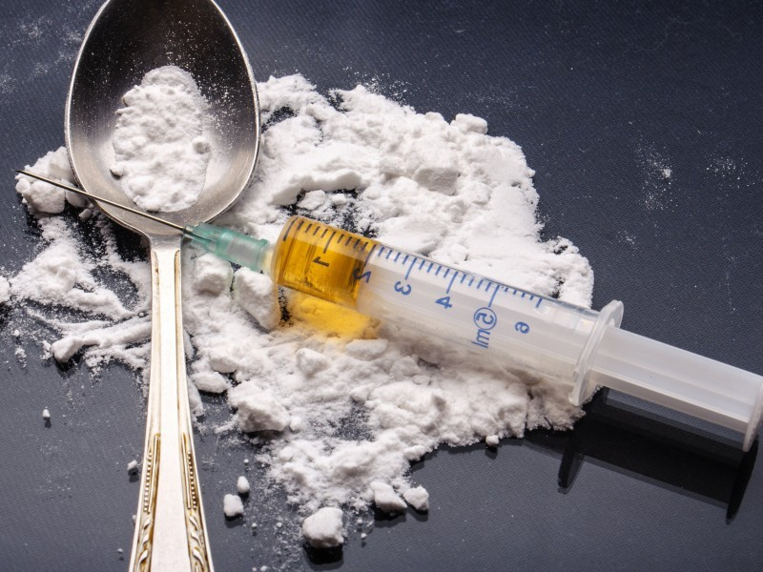
People who are addicted to…
Alcohol are 2x
Marijuana are 3x
Cocaine are 15x
Rx Opioid Painkillers are 40x
…more likely to be addicted to heroin.

Slide 7
Where do you get these drugs?

Slide 8
Heroin use has increased among most demographic groups
 | 2002–2004* | 2011–2013* | Percent Change
Sex
Male | 2.4 | 3.6 | 50%
Female | 0.8 | 1.6 | 100%
Age, Years
12–17 | 1.8 | 1.6 | --
18–25 | 3.5 | 7.3 | 109%
26 or older | 1.2 | 1.9 | 58%
Race / Ethnicity
Non-Hispanic white | 1.4 | 3 | 114%
Other | 2 | 1.7 | --
Annual Household Income
Less than $20,000 | 3.4 | 5.5 | 62%
$20,000–$49,999 | 1.3 | 2.3 | 77%
$50,000 or more | 1 | 1.6 | 60%
Health Insurance Coverage
None | 4.2 | 6.7 | 60%
Medicaid | 4.3 | 4.7 | --
Private or other | 0.8 | 1.3 | 63%

Slide 9
Heroin admissions
Notes:
Use this as a divider page

Slide 10
Signs and symptoms

Slide 11
Signs & symptoms
Physical/emotional
Unexplained extreme mood swings, nodding off
Increased aggression or anxiety
Change in dress or appearance/hygiene
Changes in sleeping habits
Inability to focus
Dilated or constricted pupils and bloodshot eyes
Threats and attempts of suicide
Nosebleeds/unexplained burns
Loss of appetite, yet periods of binge eating
Notes:
More irritated and aggravated. In a pattern, not once or twice.

Slide 12
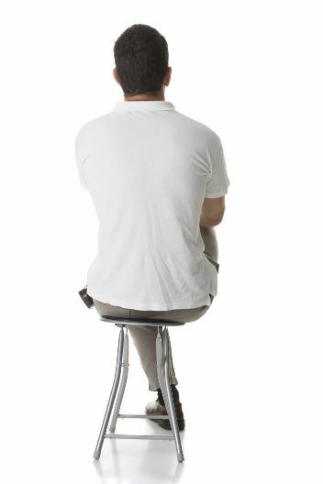
Signs & symptoms
Social
Changes in friends
Drug use by friends
Engaging in risky behavior
Avoids contact with concerned persons
Loses interests in hobbies/activities
Secretive and defensive regarding actions and possessions

Slide 13
Signs & symptoms
Financial
Steals money or objects from family or friends
Develops unexplained shortages of money
Loss of possessions
Increased amounts of alcohol/pills missing in the home
Notes:
Creative ways to buy drugs…lunch money, selling their things, stealing, etc.

Slide 14
Heroin
Physical side effects
Withdrawal is never fatal in otherwise healthy adults, but includes two to seven days of:
Restlessness and yawning
Cold flashes with goose bumps, diarrhea
Muscle and bone pain
Vomiting and insomnia
Notes:
Major withdrawal symptoms peak between 24-48 hours after the last dose and subside after a week

Slide 15
Heroin
Physical side effects
Slowed breathing, slowed cardiac function
Suppression of pain, clouded mental functioning
Constricted pupils, droopy eyelids, slowed/slurred speech
Constipation and nausea
Nodding off
Runny nose, needle track marks
Notes:
Duration of high: Euphoria sets in within seven seconds (intravenous injection), two to five minutes (intramuscular injection) or 10 to 15 minutes (sniffed or smoked). The high lasts from 10 to 30 minutes. Euphoria is followed by lethargy, sleepiness and apathy.

Slide 16
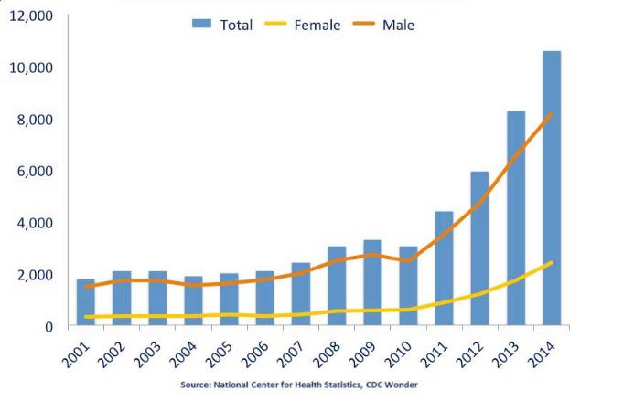
National overdose deaths: Number of deaths from heroin
Notes:
From 2001 to 2014 there was a 6-fold increase in the total number of deaths.

Slide 17
Opioid receptors
OPIOID RECEPTORS
Opiod receptor class | Effects
Mu₁ | Euphoria, supraspinal analgesia, confusion, dizziness, nausea, low addiction potential
Mu₂ | Respiratory depression, cardiovascular and gastrointestinal effects, miosis, urinary retention
Delta | Spinal analgesia, cardiovascular depression, decreased brain and myocardial oxygen demand
Kappa | Spinal analgesia, dysphoria, psychomimetic effects, feedback inhibition of endorphin system

Slide 18
Opioid system before drugs
Circles=Mu Receptors Triangle=Kappa Receptors
Purple Stars=Endorphins

Slide 19
Opioid system on drugs
Circles=Mu Receptors Triangle=Kappa Receptors
Black stars=opiates/heroin

Slide 20
Opioid system in withdrawal
Red Circles=Mu receptors in withdrawal
Pink Triangles=Kappa receptors in withdrawal

Slide 21
Medication-assisted treatment

Slide 22
Medically Assisted Treatment (MAT)
Medication is used for different purposes while in treatment
Medication is most effective when combined with counseling and other support
Rosecrance uses medication in treatment to:
Treat symptoms of withdrawal
Prevent relapse and treat cravings
Treat symptoms of other medical conditions

Slide 23
Opioid system on buprenorphine
Circles=Mu Receptors Triangles=Kappa Receptors
Purple Stars=Endorphins Black stars=Buprenorphine

Slide 24
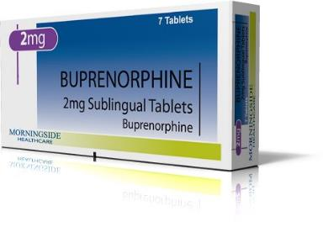
Buprenorphine
Pros
Cons
Stops withdrawal
Reduces cravings
Longer treatment stays
Eases chronic pain
Helps brain repair
Safe for pregnant women
Potential abuse/diversion
Still activates the opiate receptor
Need to taper carefully

Slide 25
Buprenorphine in medical withdrawal and maintenance
20
15
Buprenorphine
Number remaining in treatment
10
5
P=0.0001
Control
0
0
50
100
150
200
250
300
350
Time from randomization (days)
Kaplan-Meier curve of cumulative retention in treatment (Kakko et al, 2003)

Slide 26
Opioid system on Naltrexone
Circles=Mu Receptors Triangles=Kappa Receptors
Purple Stars=Endorphines Teardrops=Naltrexone

Slide 27
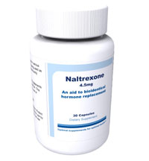
Naltrexone
Pros
Cons
No abuse/diversion
No activation of opiate receptor
Injectable, only take once a month
Not as good at curbing cravings
Not for pregnant women
Injectable (Vivitrol) can be expensive

Slide 28
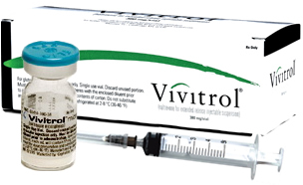
Extended Release Naltrexone
Much evidence based on one large Russian study (Lancet 2009)
2009, 250 patients, 13 sites in Russia
Double blind, placebo controlled
24 weeks of study
Results
Confirmed abstinence – 90% vs 35%
Reported days drug free – 99.2 vs 60.4
Retention 168 days vs 96 days

Slide 29
Substance use among the emerging adult population

Slide 30
What is emerging adulthood?
An additional life stage between Erickson’s stages of adolescence and young adulthood (Jeffrey Arnett’s theory)
It generally applies to young adults between the ages of 18 and 30
A period of life where there is much conflict, difficulty, confusion and consequently greater susceptibility to substance abuse

Slide 31
What is emerging adulthood?
Shift in attitude about adulthood obligations (marriage, home and children) from pursuit to avoidance (Arnett, 2005)
Less stable financial times causing young adults to remain in parents’ home longer, allowing for increased freedom from responsibilities (Arnett, 2005)
A new period of development brought on by societal changes

Slide 32
Ripple effect
Increased focus on education creates a later age for leaving parental dwelling and/or financial assistance and marriage
Instances of substance use and abuse are likely related to the discomfort often associated with forming oneself
Feelings of the “shoulds” are great as the individual tries to compare self to those in the next or previous stage
Young adults are often searching for “who am I”

Slide 33
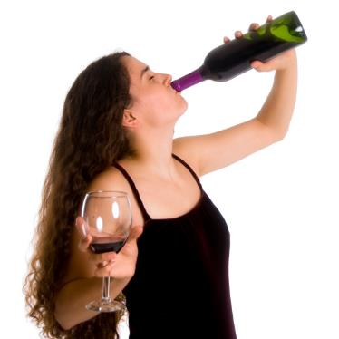
So, how do young adults cope with this?
Distraction, distraction, distraction
Extreme risk-taking behaviors
Binging behavior (food, shopping, sex, etc.)
Focus on external image (societal cause)
Drugs/alcohol
Internet
Friends

Slide 34
Why might young adults be more susceptible to substance abuse?
Psychological factors
Coming to terms with self as a unique and independent individual
Security/comfort base shifts toward internal
Identity less peer based

Slide 35
Why might young adults be more susceptible to substance abuse?
Social factors
Peer groups change drastically
“Societal” expectations
Acceptance by others vs. acceptance from self
Sensation seeking

Slide 36
Why might young adults be more susceptible to substance abuse?
Familial factors
Changing “role” in the family
Boundaries
Expectations

Slide 37
Why might young adults be more susceptible to substance abuse?
Biological factors
Biological growth still occurring
Emergence of mental health problems more refined and evident
Lack of healthy stress responses

Slide 38
Implications
Four times higher failure rates for high school
Four times greater rates of unemployment or lack of enrollment in advanced education for 18 to 21- year-olds
Three times greater risk of engaging in illegal activities
Six times greater risk of being involved with youthful pregnancy

Slide 39
Implications
Anorexia and other eating disorders become more prevalent among males and females
Suicide remains the 2nd leading cause of death in young adulthood; for every successful suicide, there are 40 failed attempts (nine times this amount “consider” killing themselves)
Opiate use continues to rise to epidemic proportions

Slide 40
Treatment implications: What works and what doesn’t

Slide 41
Treatment considerations for counselors
View client as the expert
Educate on developmental issues
Involve community support systems
Grow internal motivation
Encourage self-exploration
Accept client’s ownership in the counseling and recovery process (empowerment)
Instill confidence in life skills

Slide 42
What doesn’t work
Fear- or threat-based approaches
Long, large groups
Constant siding with family
Focusing solely on consequences
Attempts to control client progress
Poor boundaries
Anger
Inconsistency
Lecturing

Slide 43
Strength-based approaches

Slide 44
Core principles of strength-based practice
An absolute belief that every person has potential and it is their unique strengths and capabilities that will determine their evolving story as well as define who they are—not their limitations (not, I will believe when I see— rather, I believe and I will see).
Notes:
Use this page to place a large photo/chart/graphic with a title

Slide 45
Core principles of strength-based practice
What we focus on becomes one’s reality—focus on strength, not labels—seeing challenges as capacity fostering (not something to avoid) creates hope and optimism.
Notes:
Use this page to place a large photo/chart/graphic with a title

Slide 46
Core principles of strength-based practice
The language we use creates our reality—both for the care providers and the children, youth and their families.
Notes:
Use this page to place a large photo/chart/graphic with a title

Slide 47
Core principles of strength-based practice
Belief that change is inevitable—all individuals have the urge to succeed, to explore the world around them and to make themselves useful to others and their communities.
Notes:
Use this page to place a large photo/chart/graphic with a title

Slide 48
Core principles of strength-based practice
Positive change occurs in the context of authentic relationships—people need to know someone cares and will be there unconditionally for them. It is a transactional and facilitating process of supporting change and capacity building—not fixing.
Notes:
Use this page to place a large photo/chart/graphic with a title

Slide 49
Core principles of strength-based practice
Person’s perspective of reality is primary (their story)– therefore, need to value and start the change process with what is important to the person— not the expert.
Notes:
Use this page to place a large photo/chart/graphic with a title

Slide 50
Core principles of strength-based practice
People have more confidence and comfort to journey to the future (the unknown) when they are invited to start with what they already know.
Notes:
Use this page to place a large photo/chart/graphic with a title

Slide 51
Core principles of strength-based practice
Capacity building is a process and a goal – a lifelong journey that is dynamic as opposed to static.
Notes:
Use this page to place a large photo/chart/graphic with a title

Slide 52
Core principles of strength-based practice
It is important to value differences and the essential need to collaborate—effective change is a collaborative, inclusive and participatory process – “It takes a village to raise a child.”
Notes:
Use this page to place a large photo/chart/graphic with a title

Slide 53
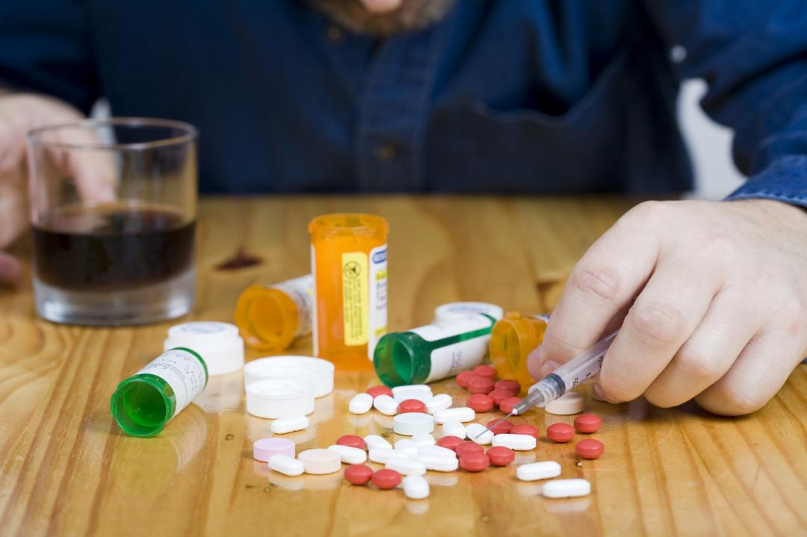
Overdose prevention

Slide 54
Overdose prevention
Importance of education on:
Change in tolerance
Danger of heroin in area
Discussion of Narcan
Importance of ongoing recovery support
Importance of continuing with doctors if medication has been prescribed

Slide 55
Thoughts
Treating young adults requires unique approaches and appropriate staff.
Today’s young adults are not equipped with the same skill set of a generation ago.
Providers should not get bogged down in traditional treatment while enacting many changes with minimal cost.

Slide 56
Thoughts
Young adults succeed in peer-based groups with whom they can realistically identify.
This age group is still coming to terms with itself, so providers who are willing to meet the young adult where they are will ultimately fare better.
Rapport is everything. Be genuine!!

Slide 57
Key points
If in doubt, call - Rosecrance is here to help, if you are not sure if someone you love is abusing heroin or any other substance, call us, we can help.
This epidemic is not going away - This situation will not go away anytime soon and it will likely get worse before it gets better. We all will have to work together if we are to push this epidemic out of our community.
There is hope - While the situation is not a happy one, success stories continue to occur. There is hope.

Slide 58
815.391.1000
888.928.5298
www.rosecrance.org
* Pictures of individuals in this presentation are for illustration purposes only. These pictures portray models and are not pictures of actual clients of Rosecrance. No inference should be made, or is implied, that the pictures used here are of individuals connected in any way to Rosecrance or to its affiliates or programs.
Notes:
You can use this as the last slide. If you are not using photos in the presentation, you can delete the disclaimer.

