Slide 1
Year in Review 2018
Strategy Recommendation 2019
December 18, 2018

Slide 2
Agenda
FY 2018 Marketing Performance Review
FY 2019 Marketing Performance Review
Strategy Overview 2019
Marketing Objectives
Digital Media Plan
Additional Capabilities
Traditional Media
Q & A

Slide 3
2018 Fiscal Year in Review

Slide 4
FY 2018: Total Call Volume
2017
2018
Oct
132
Feb
140
Mar
141
Nov
111
Jan
103
Apr
98
May
97
Aug
89
Sep
79
Dec
89
Jul
30
Jun
72

Slide 5
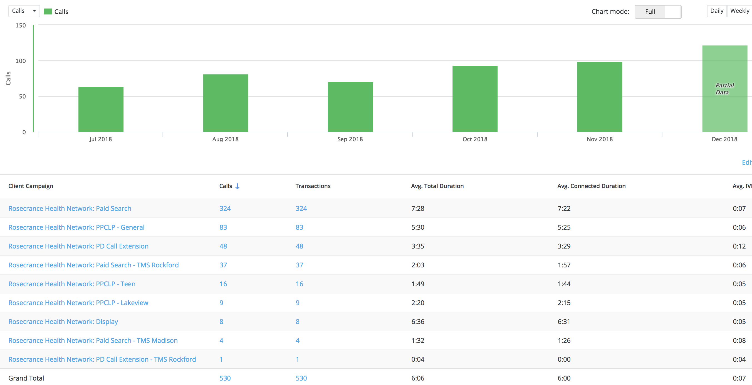
FY 2019: Total Call Volume
Dec
122
Jul
64
Aug
81
Sep
71
Oct
93
Nov
99

Slide 7
FY : 2019
Top Keywords
That led to Calls
AdWords Keywords
+rosecrance | inpatient rehab
rosecrance rockford | +teen +drug +abuse +help
+teen +treatment +center | +recovery +home
alcohol treatment | +rose +crance
rehab center | +drug +programs +for +teens
+inpatient +rehab | +adult +rehab
rosecrance rockford il | +residential +treatment
rosecrance rockford illinois | +adult +residential +treatment
substance abuse treatment | outpatient treatment
sober living | rosecrance treatment center
addiction treatment | adolescent residential treatment centers
+teen +substance +abuse | residential treatment centers
+rosecrance +lakeview | +recovery +home +chicago
+substance +abuse +treatment | +teen +residential +treatment
drug rehab | +treatment +centers +for +teens
inpatient treatment | +young +adult +treatment
substance abuse treatment facility | +teen +drug +rehab
inpatient treatment center | +treatment +center +chicago
drug treatment | residential treatment programs
+teen +drug +programs | +alcohol +rehab +chicago
+adolescent +inpatient | rosecrance rehab
AutomaticContent | +adolescent +treatment +center
+teen +rehab +facility | +teen +drug +counseling
residential treatment | +drug +rehab +chicago
recovery homes | +rehab +centers +in +chicago
+rosecranse | +addiction +treatment +chicago

Slide 8
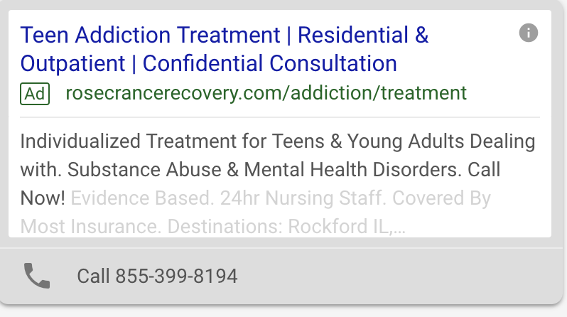
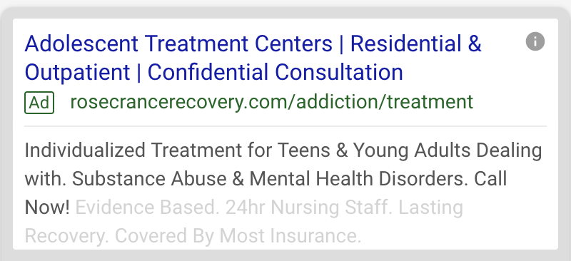
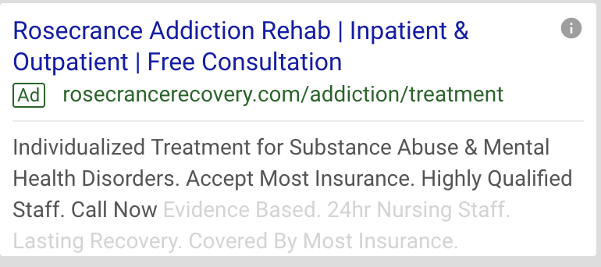
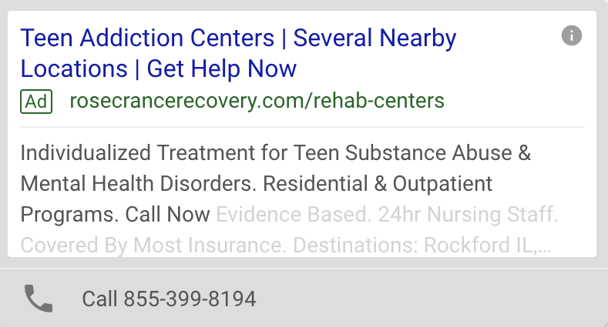
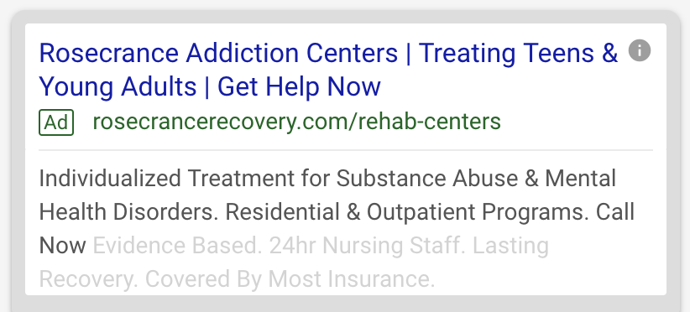
PPC: Search Text Ads

Slide 9
FY 2018: Search Campaign

Slide 10
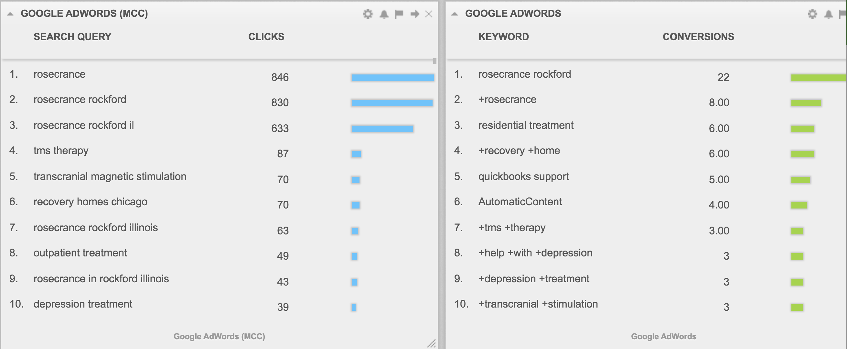
FY 2018: Search Campaign

Slide 11
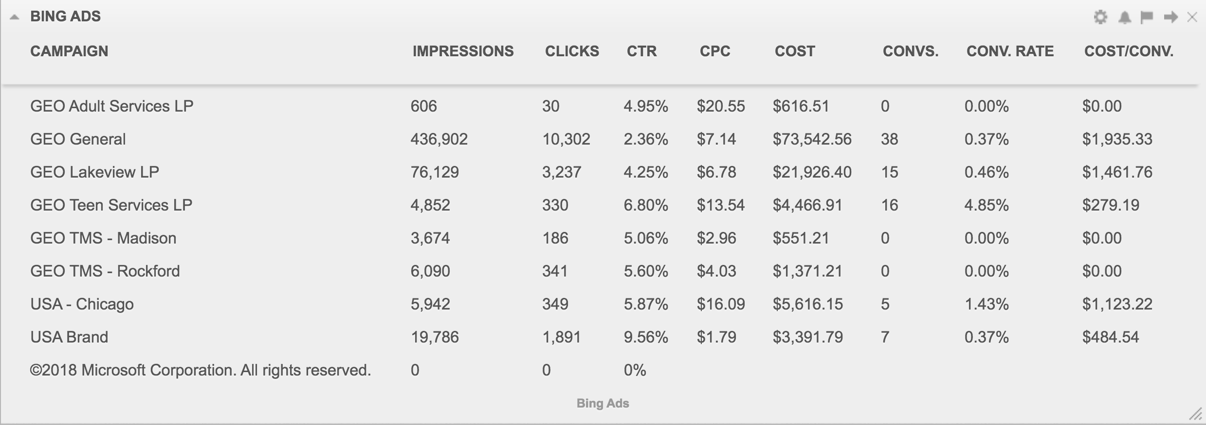
FY 2018: Search Campaign

Slide 12
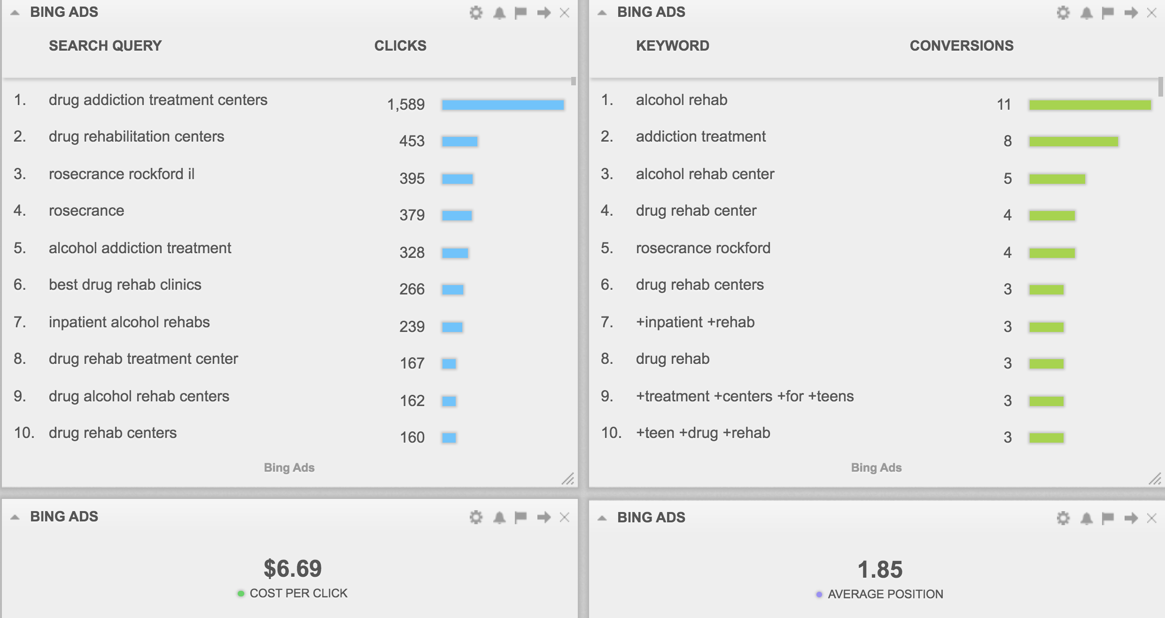
FY 2018: Search Campaign

Slide 13
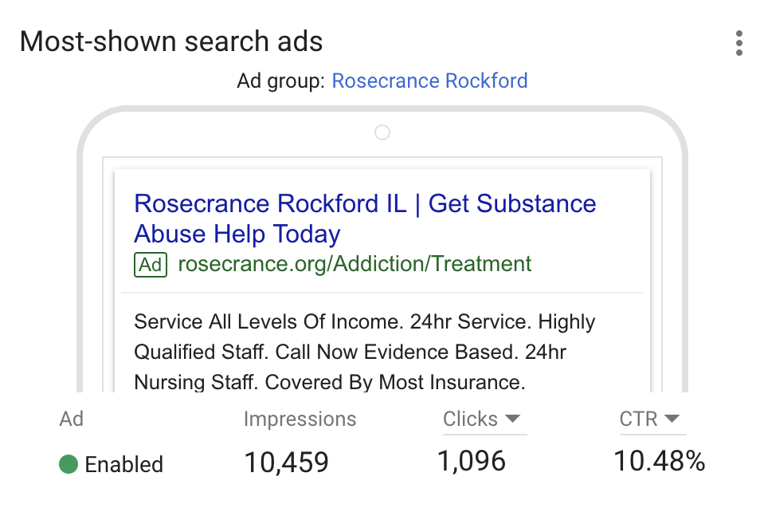
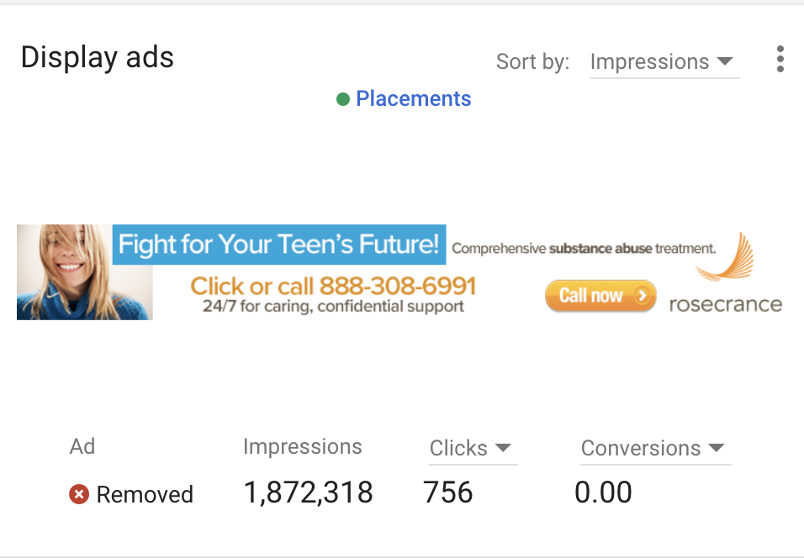
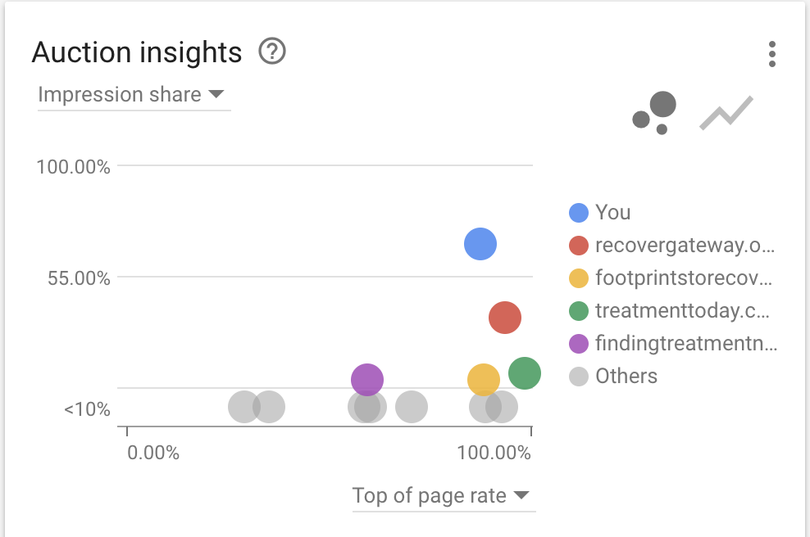
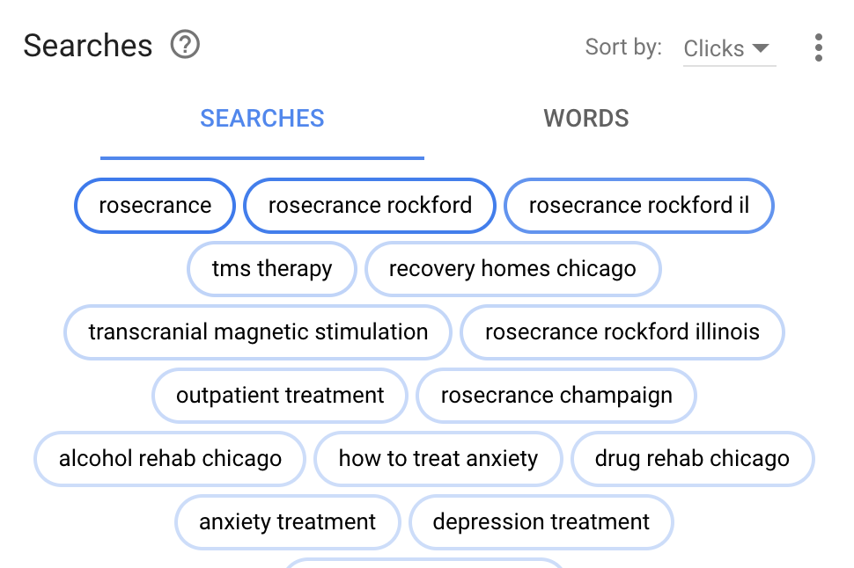
Fiscal Year 2018

Slide 14
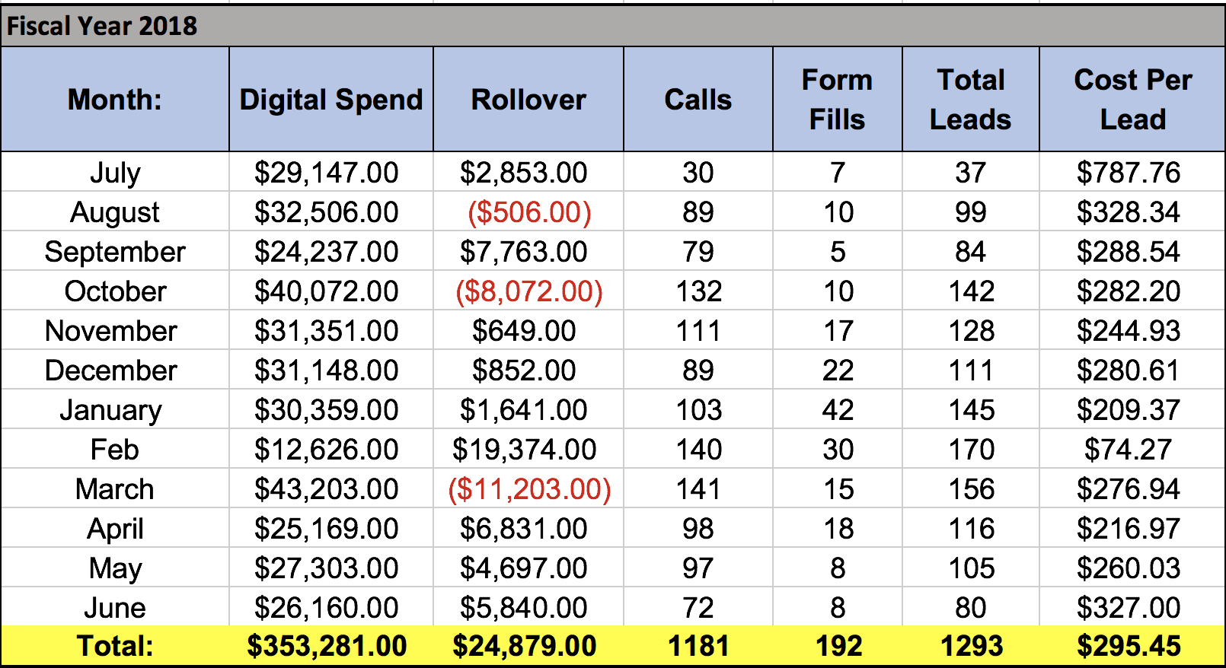
Total Leads

Slide 15
FY 2019: Search Campaign

Slide 16
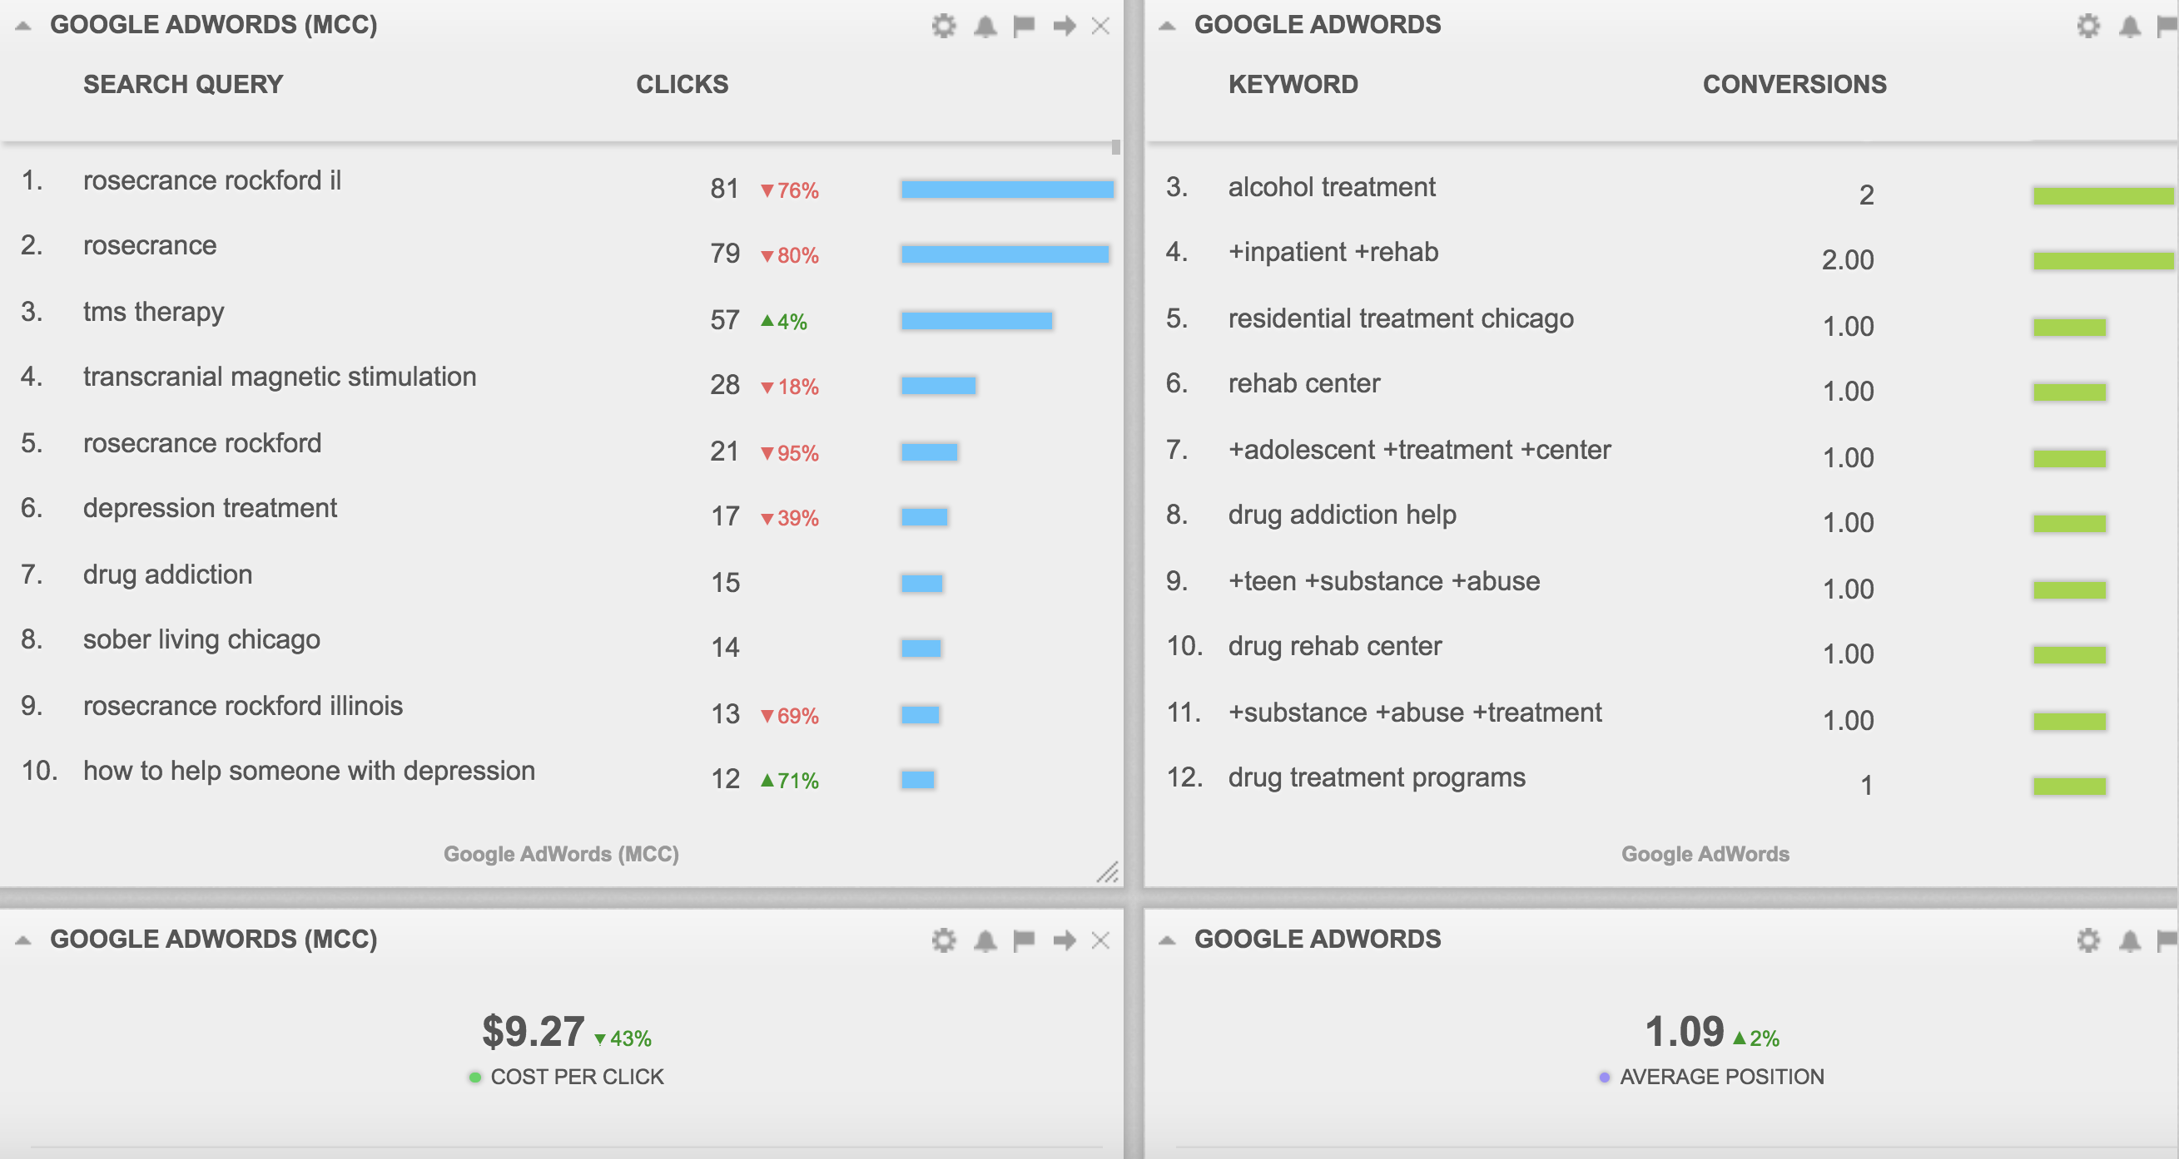
FY 2019: Search Campaign

Slide 17
FY 2019: Search Campaign

Slide 18
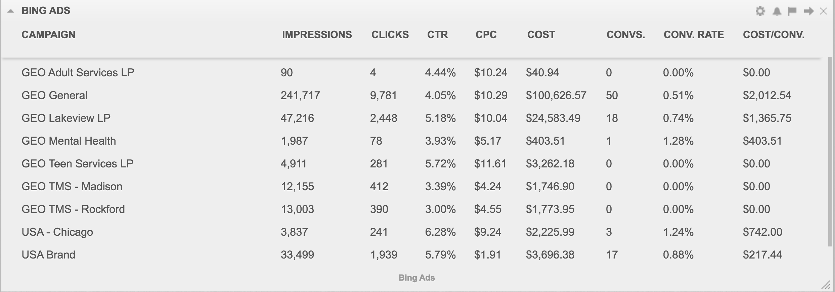
FY 2019: Search Campaign

Slide 19
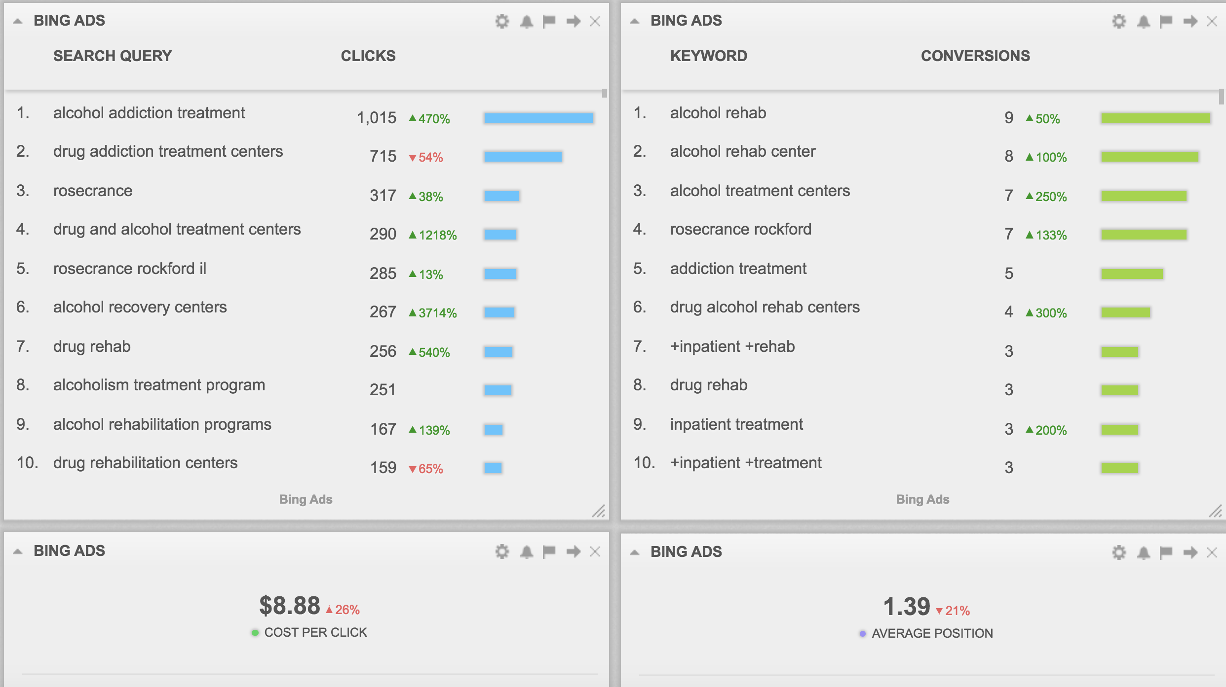
Search Campaign

Slide 20
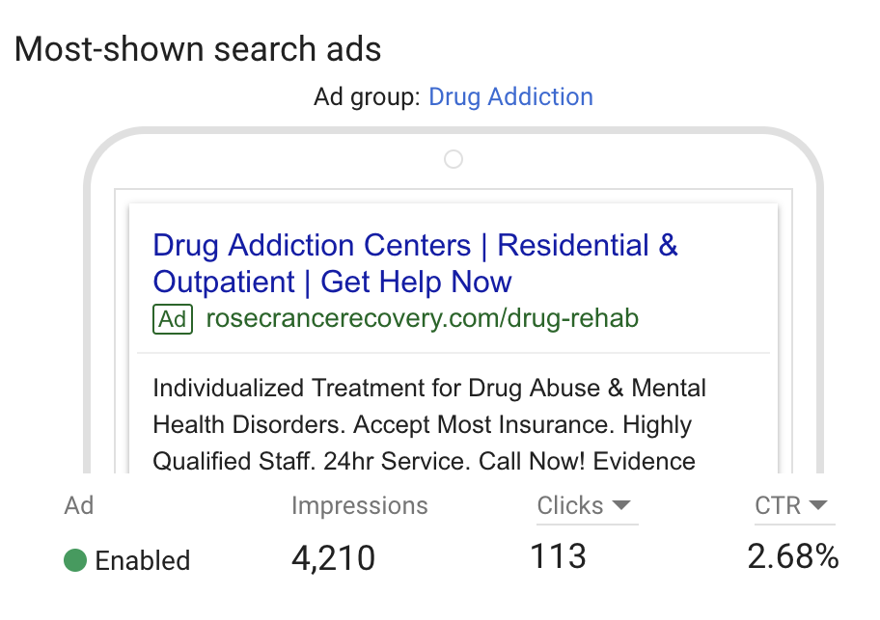
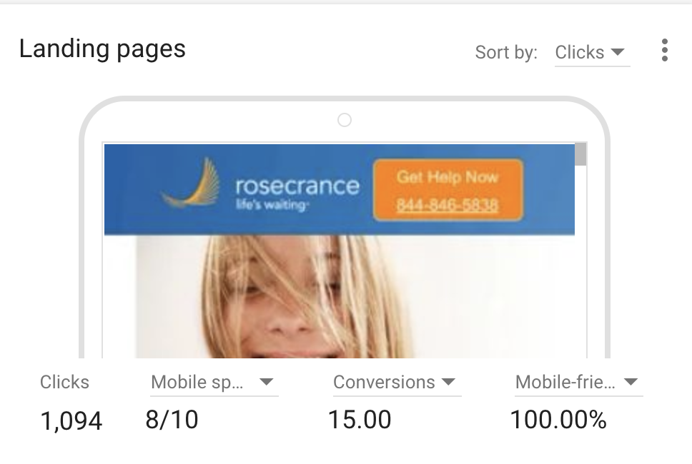
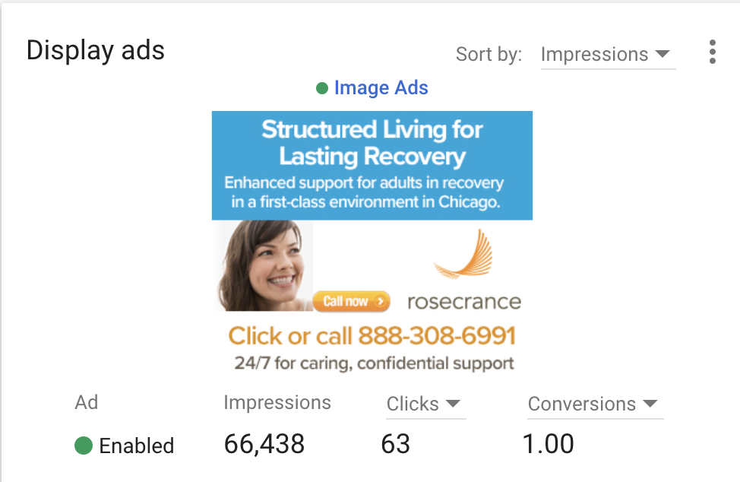
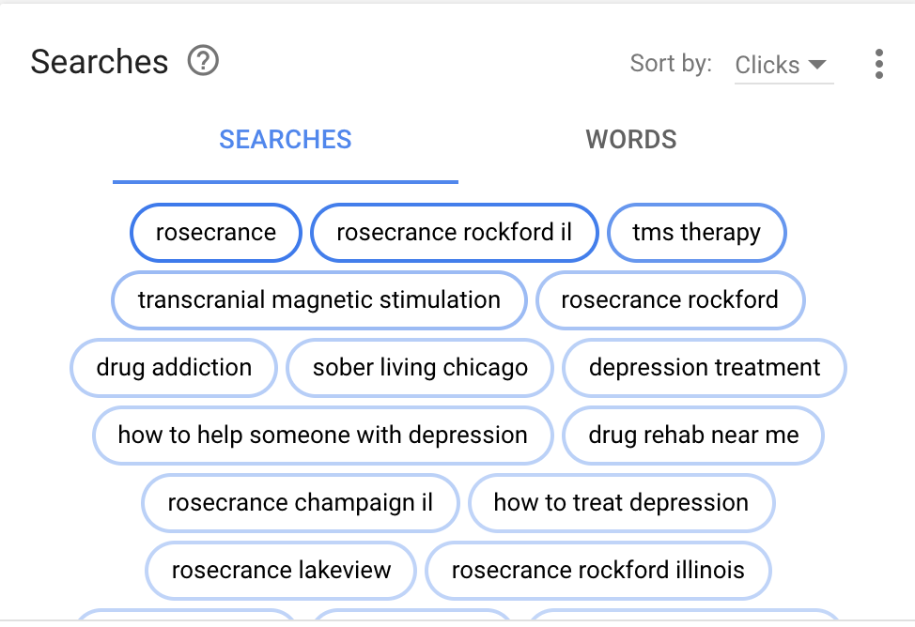
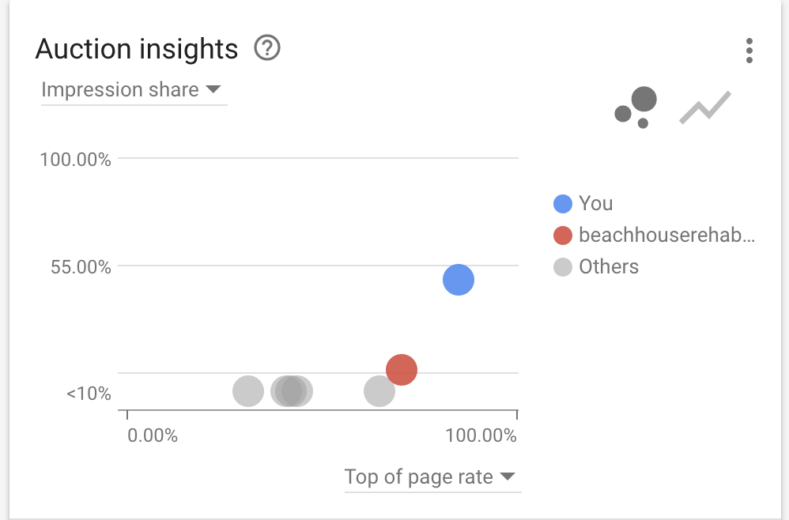
Fiscal Year 2019

Slide 21
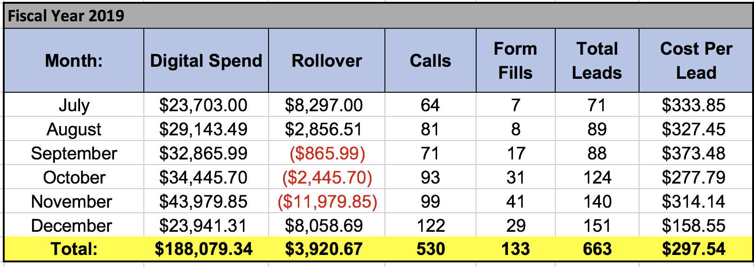
Total Leads

Slide 22
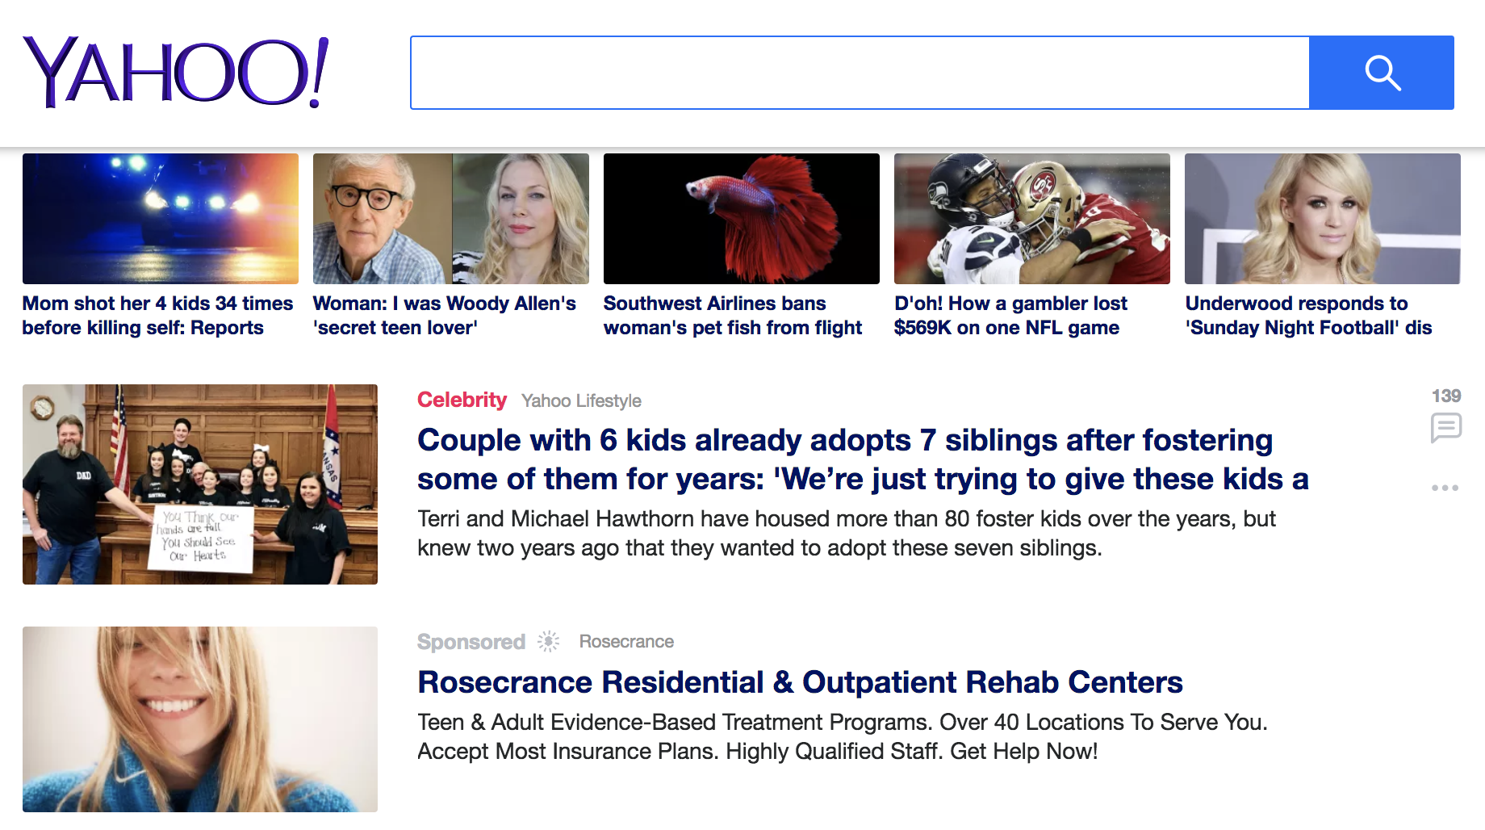
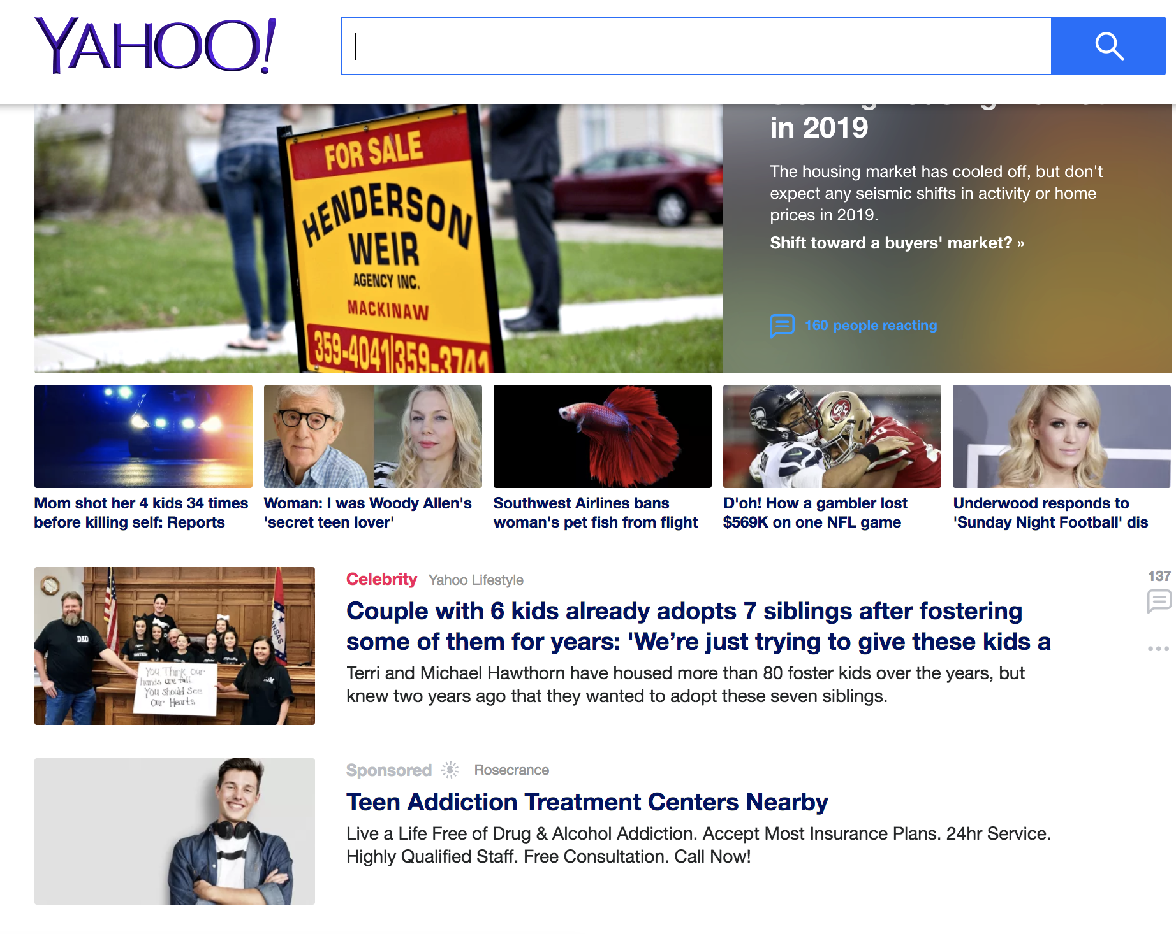
Yahoo Native Ads

Slide 23
Key Takeaways
August & September were strong months for website traffic, paid search traffic and form submissions
We finally hit our KPI for phone calls in November, with 99 total calls. December now being the highest this fiscal year at 122 (before end of month)
We had our second biggest month of all time with form fills in November. We landed at 199 for the month.
This Fiscal Year Google Form Fills accounted for 33, Bing Form Fills accounted for 89, and Yahoo accounted for 9. Total of 133 form fill from our marketing efforts.
Google/Bing Average CPC was $13.12 last fiscal year and is about $9.08 this fiscal year
Looks like RGW Admissions were up a bit in November (82). We matched our all-time record for Chicagoland RGW Admissions with 53; the last time we saw that number was back in February of 2015.

Slide 24
Strategy Overview FY 2019

Slide 25
Marketing Objectives/Goals: FY 2019
Increase
Teen Admissions
Increase Traffic to Lakeview
Increase Quality Leads
New focus on brand recognition for new locations
Maintain Adult Admissions

Slide 26
SEO -
Search

Slide 27
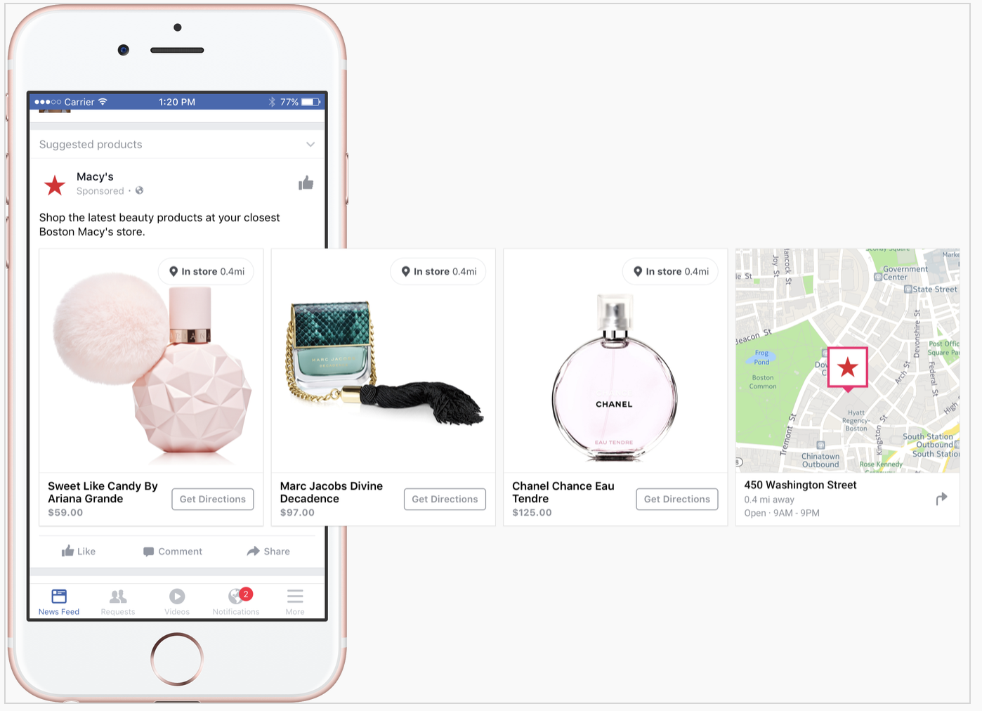
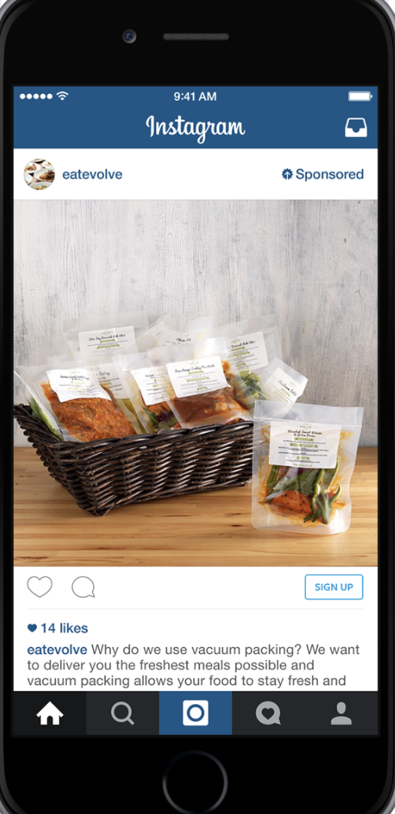
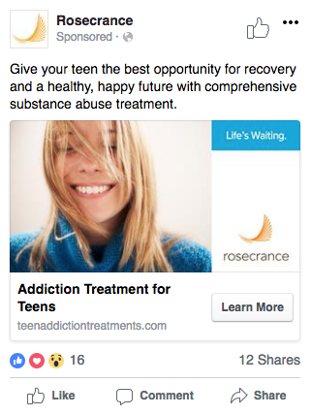
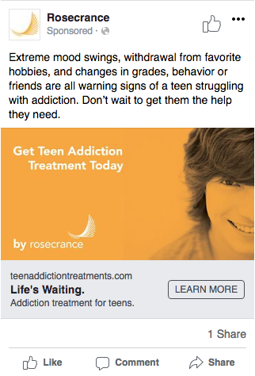
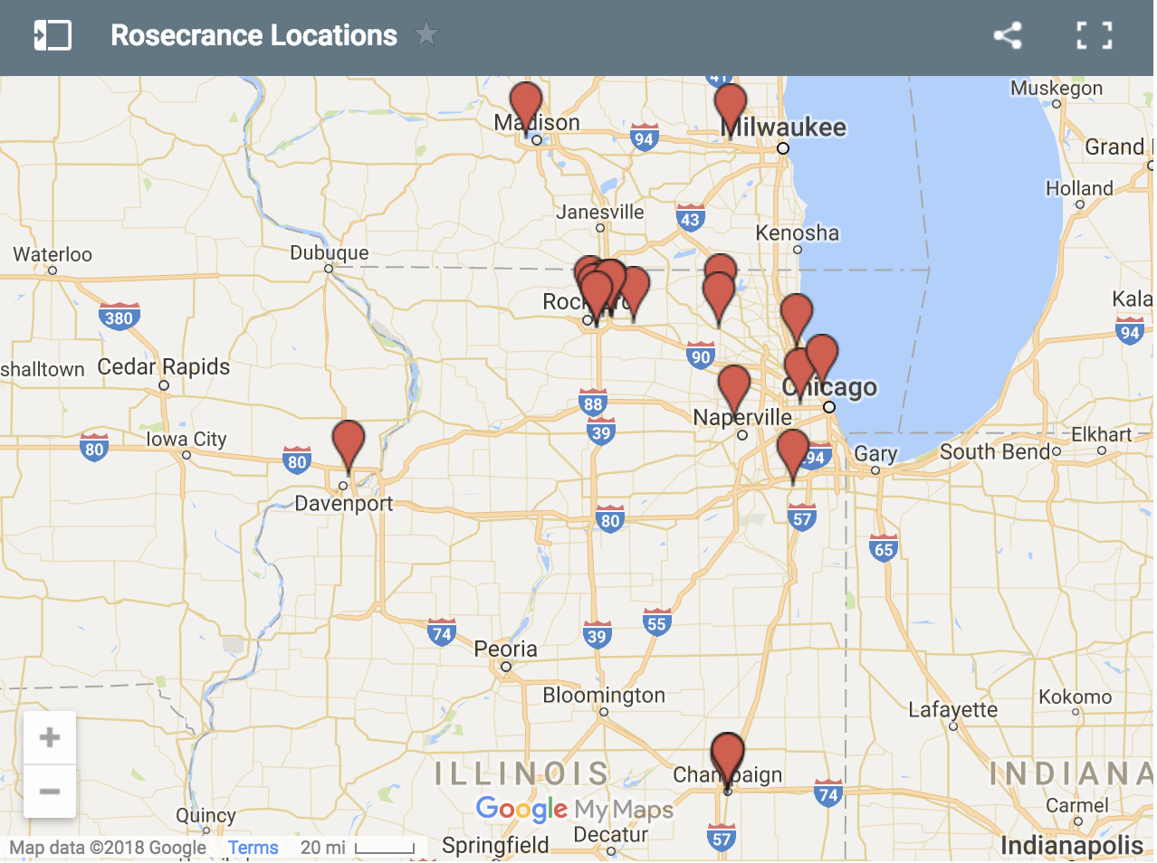
Social Media Campaigns
Social Media Examples
Carousel Ads

Slide 28
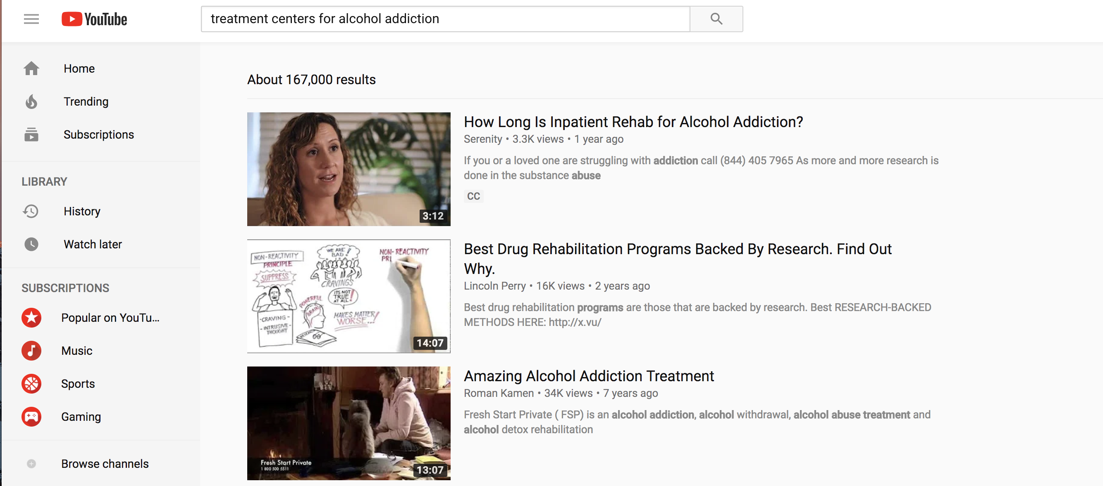
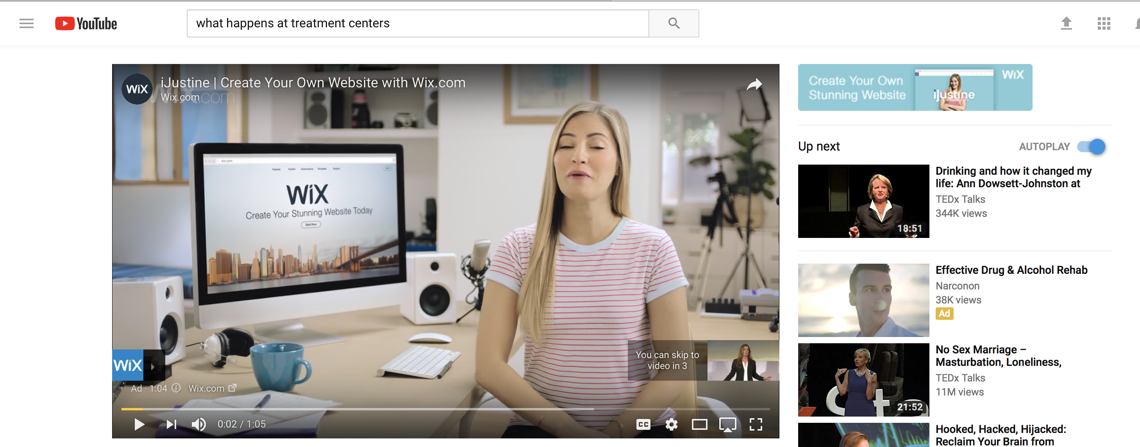
Videos
“1 in 5 Video Searches is Health Related”
Youtube Capabilities:
Rank for important key words
Video Pre-Roll Ads - play before patient testimonials or other relevant content
SEO Strategy

Slide 29
Traditional Media: Ads
The schedule will run for a total of 30 weeks between September 3, 2018, and June 17, 2019
The total budget is $250,000.00 gross.
Within the 30 week schedule, we will air a total of 2,124 commercials
Gross Impressions (W 35-54) is 8.4 million. Gross Impressions (Adults 25-54) is 24 million. FREQUENCY for both demos is 8 and the reach for W 35-54 is 83.8% and for Adults 25-54 is 83.7%.
Average gross rating points per month are 85.
There are 2010 sixty-second spots scheduled and 86 fifteen-second spots scheduled.
We also incorporated: 05-second traffic and weather ID spots as well.
Station breakout: (3 of spots)
WBBM-AM 574 spots
WBBM-FM 520 spots
WJMK-FM 510 spots
WUSN-FM 520 spot

Slide 30
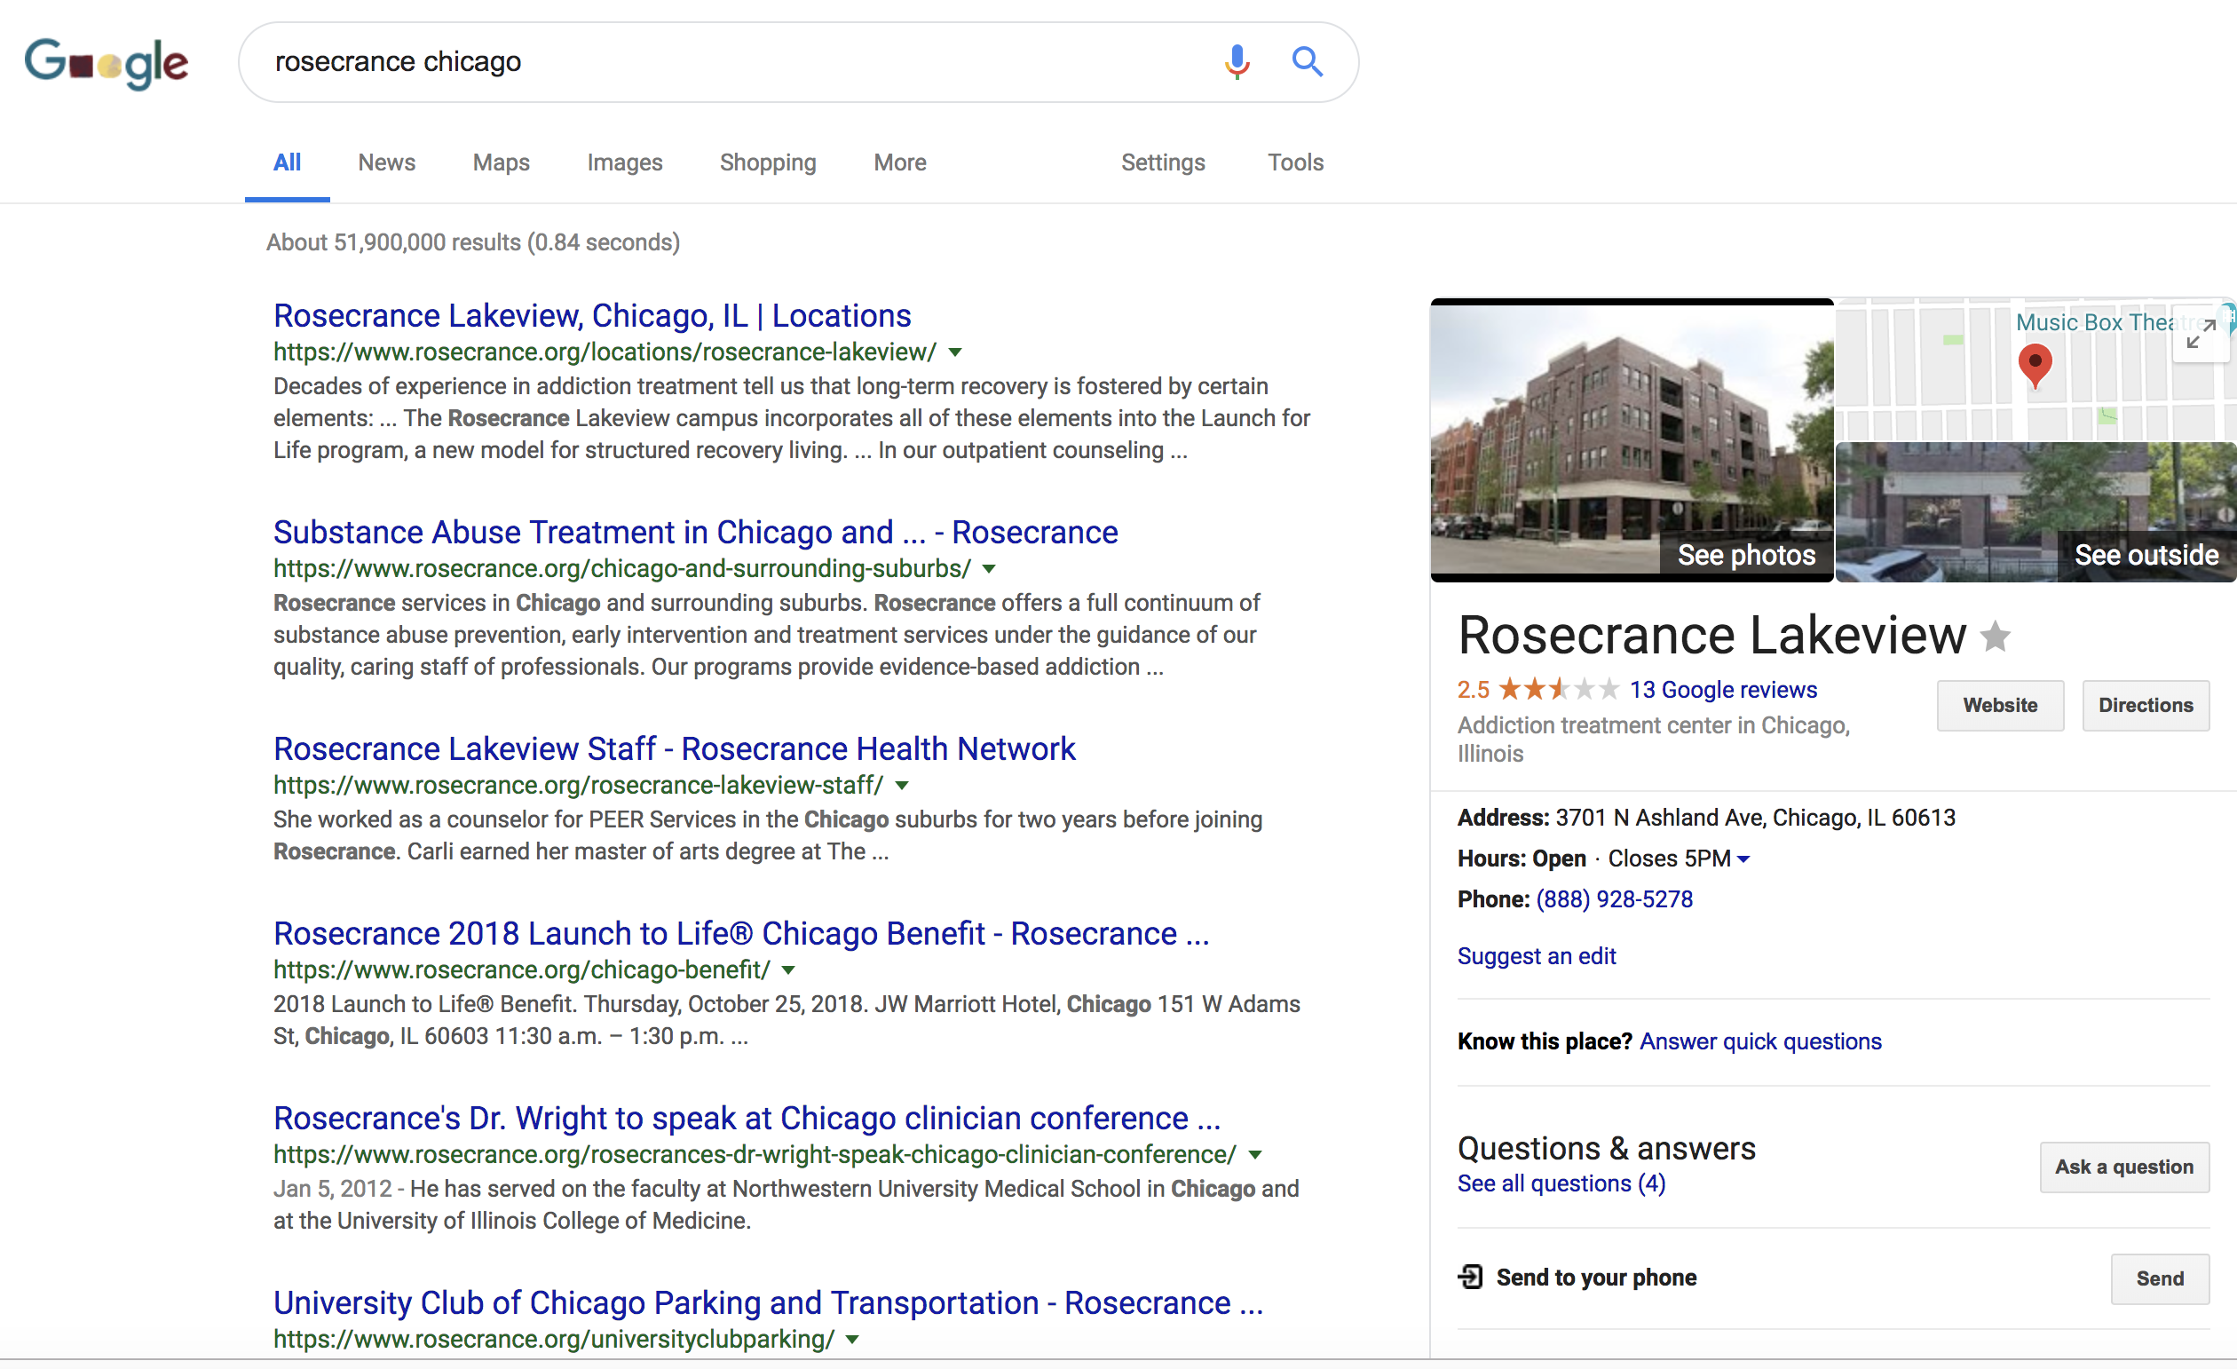
SEO
Schema – is a variety of tags that you can add to your HTML to improve the way search engines read and represent your page in SERPs (Search Engine Results Pages).
Local SEO – create local content for your chosen keyword and business location.
Keywords – Expand Keyword search to include more opioid keywords (Vicodin, oxycodone,).
YouTube- Video Titles, Tags, Channel, Description
Blog – Ensure the blog topic coincide with popular search terms
Notes:
Schema

Slide 31
Additional Capabilities FY 2019

Slide 32
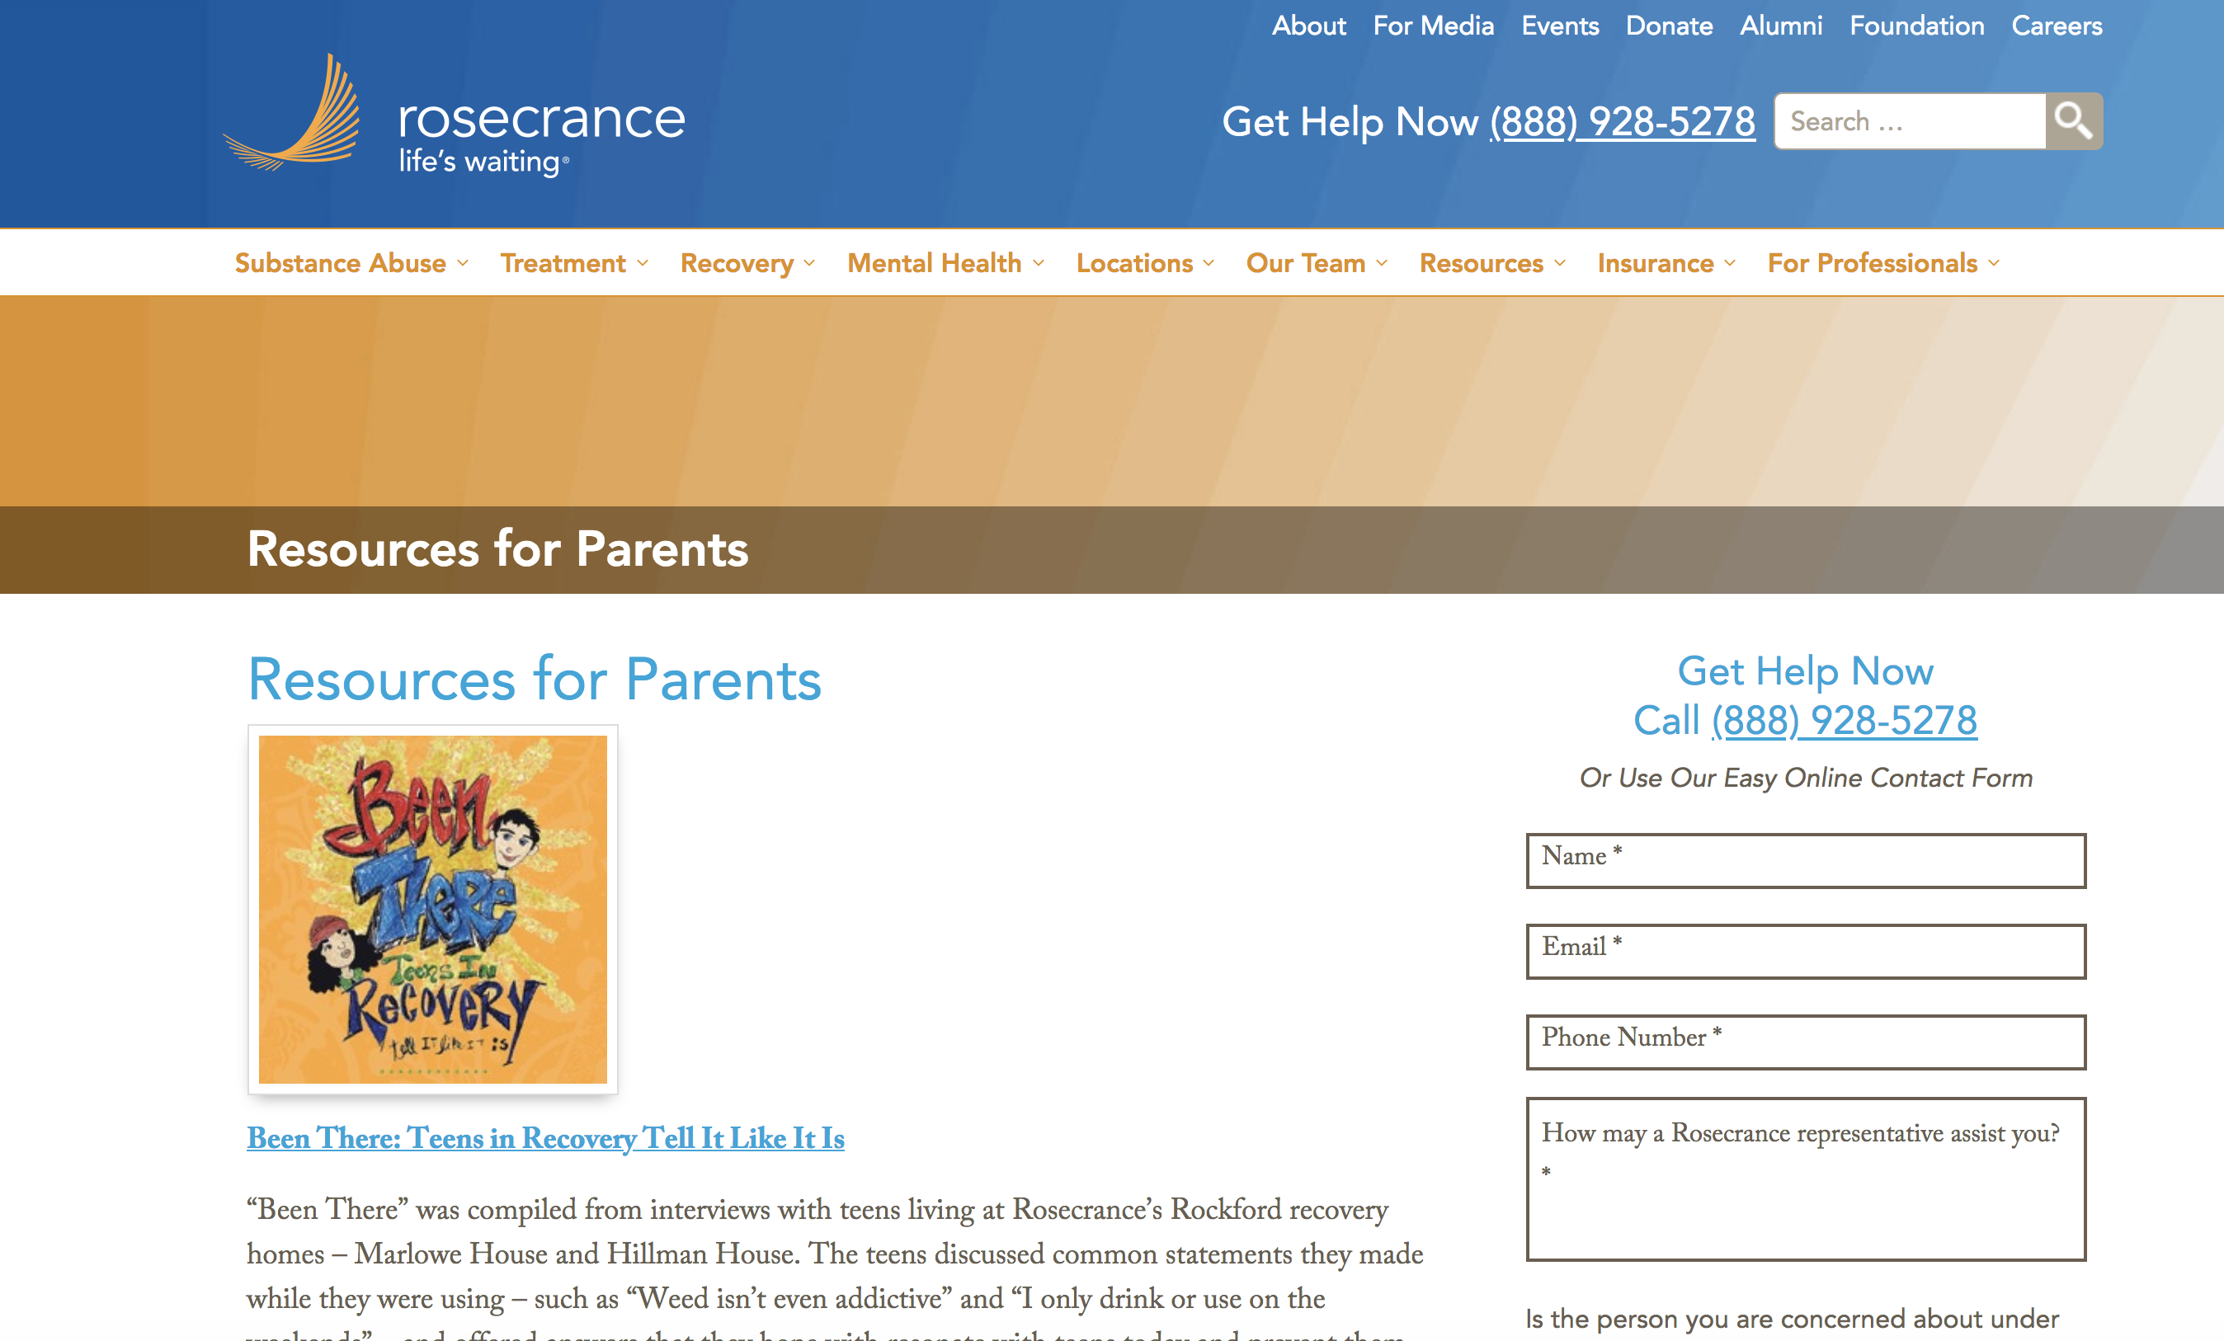
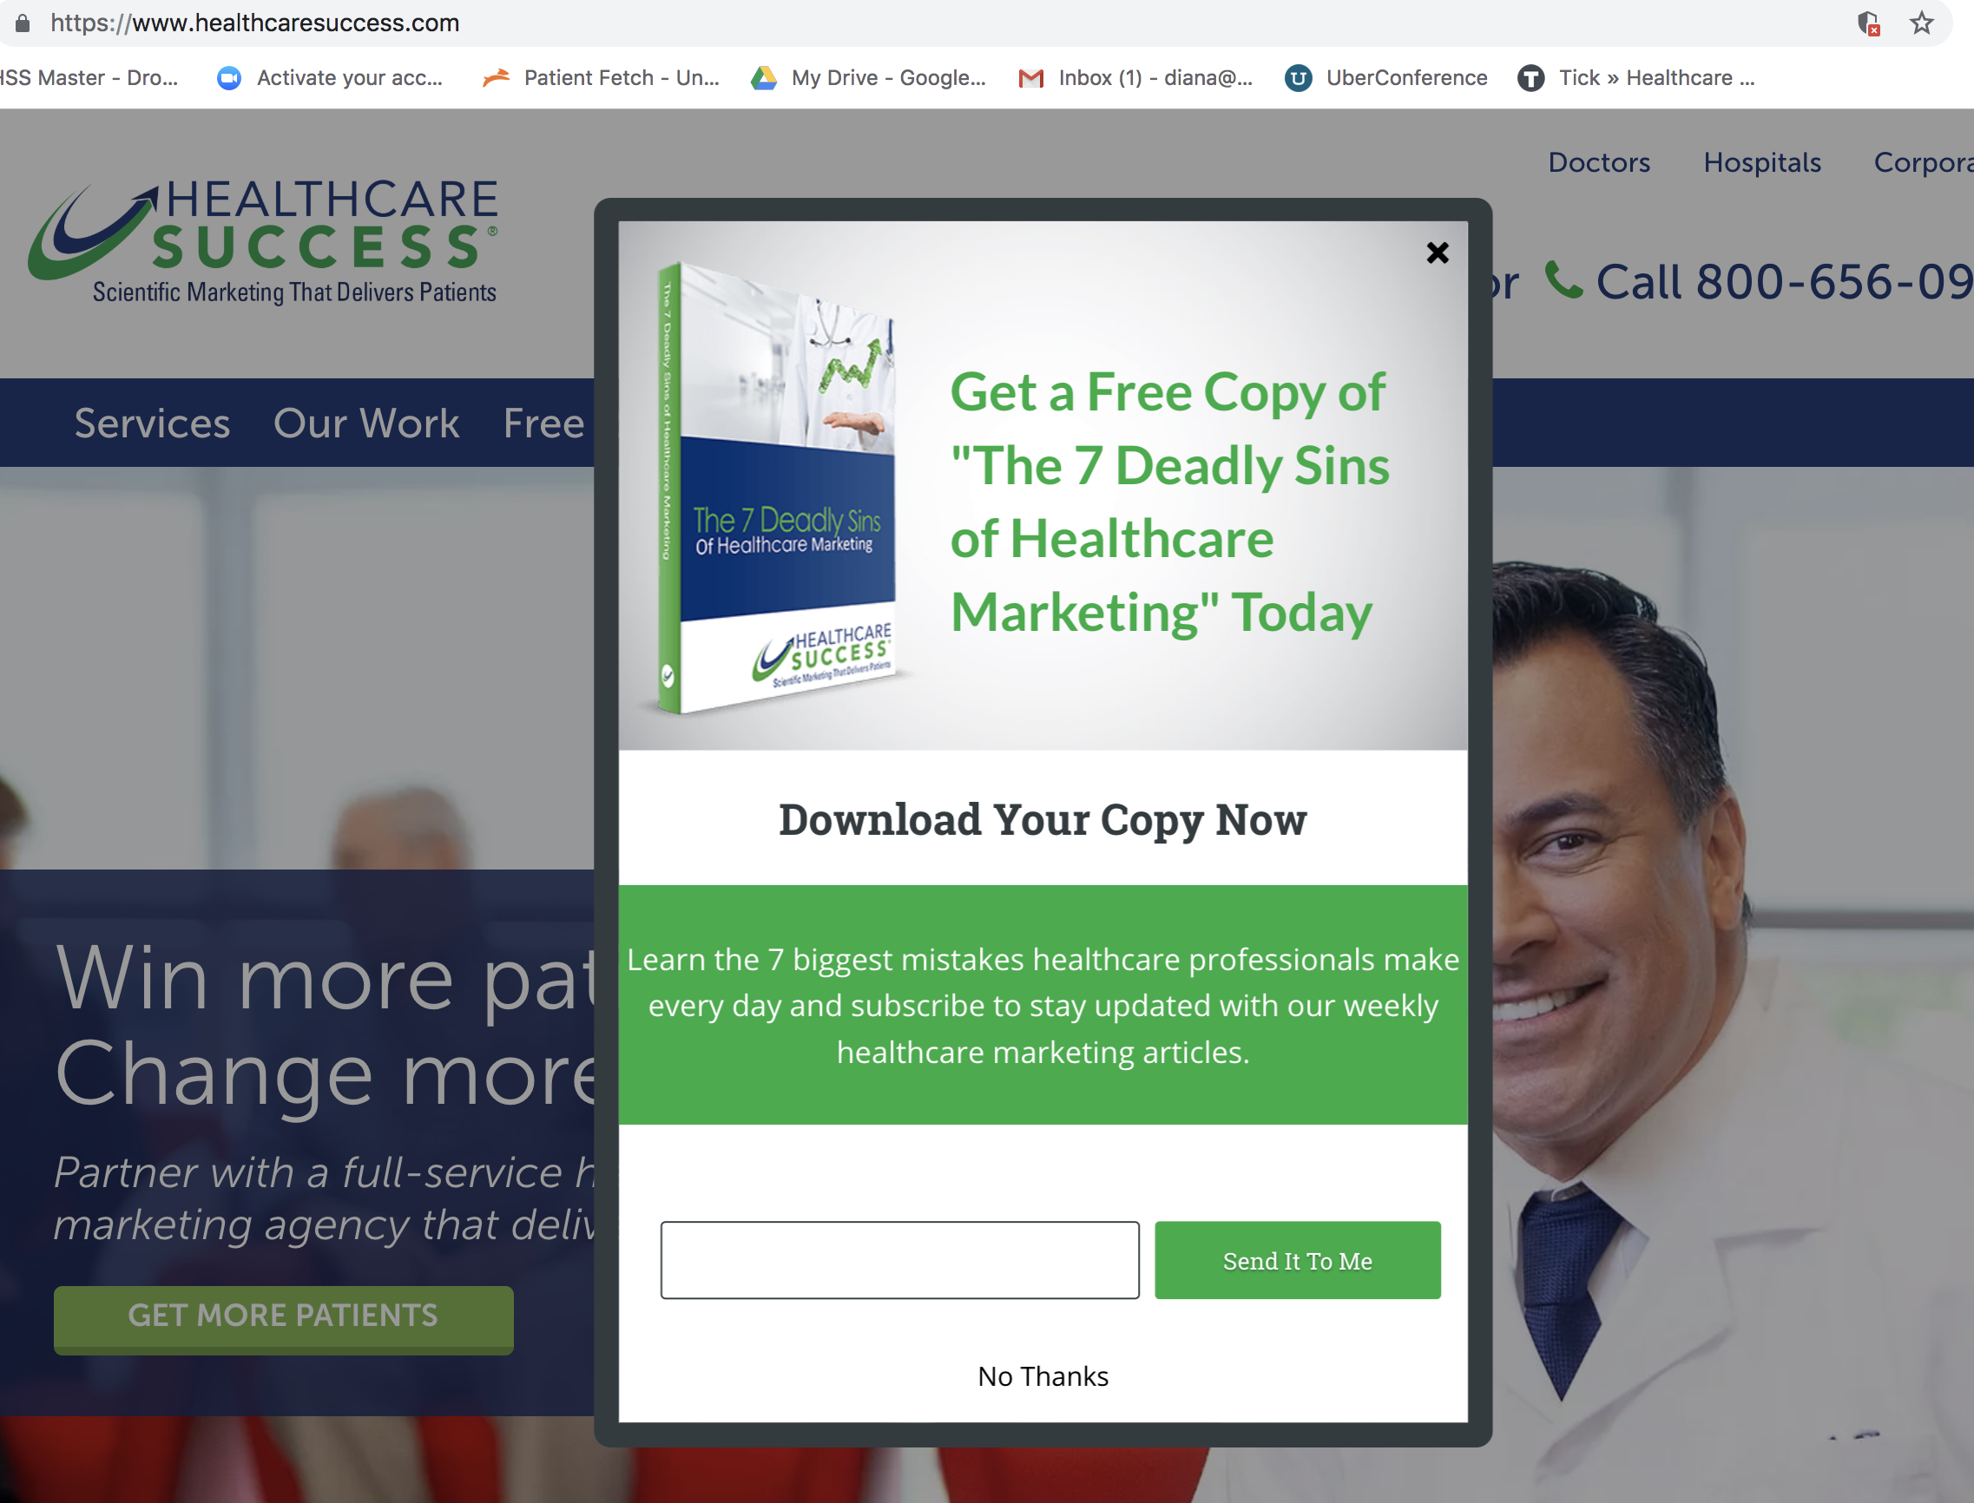
Teen Admissions Strategy
Marketing Objective: Increase teen admissions
Tactics: eBooks, YouTube, Videos, Display, Blog Posts/Articles
Messaging: Helping teens who were not able to get help anywhere else,
We can help you even if you failed before, Don’t give up hope. Providing education to parents.
Strategy:
Everything you need to know about teen addiction, all in one place. Add a right side bar to the webpage
Create an exit and intent eBook pop-ups, also lead generator
Develop a YouTube Channel for teens - video series on just teens, could be about the program, or testimonials, etc.
Directory of blog posts specific to teens or parents of teens.
Notes:
Leave the website, exit intent and fill out forms (name and email) – ebook
Blog Posts – Marijuana
Right Side bar –
Landing page – download the ebook
Add all teen resources
Largest adolescent-specific specialty program (in the US? Region?) - biggest beds, most facilities, more are closing CONFIRMED IN ILLINOIS
Check against Aidan recovery
Strategically, are we this is THE place to send your kid
Largest centers in America, we specialize in adolescents. CAN WE SAY THAT?
Position as a premier center - they’ve got a great story for adolescents. Outpatient compensation, changing attitudes - doing more outpatient than inpatient IOP for adolescents is not profitable?
Is IOP even effective for adolescents?
Help people who couldn’t get help anywhere else.
“We can help you even if you’ve failed before. Don’t give up hope.” New hope
They probably DO fail after IOP
Can now target with a primary mental health diagnosis - still need more primary care, that also have alcoholism or depression and suffering from addiction or anxiety we can treat your teen.
Test with blogs
Test with Social Media

Slide 33
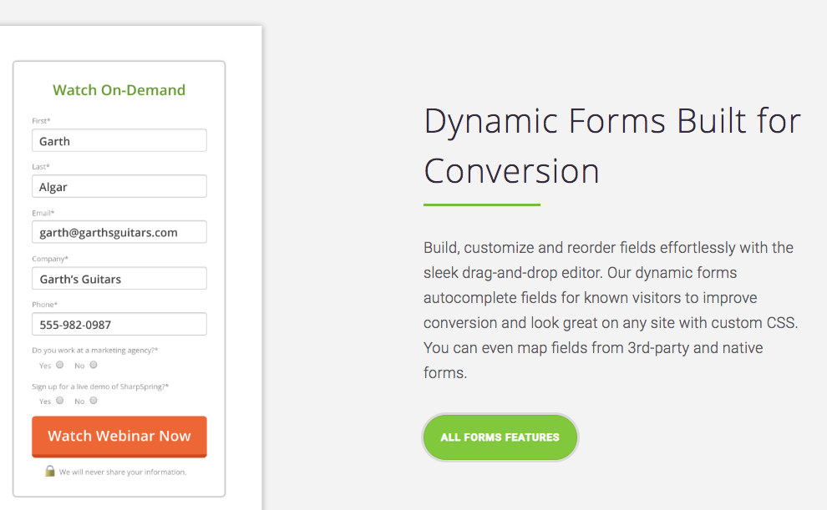
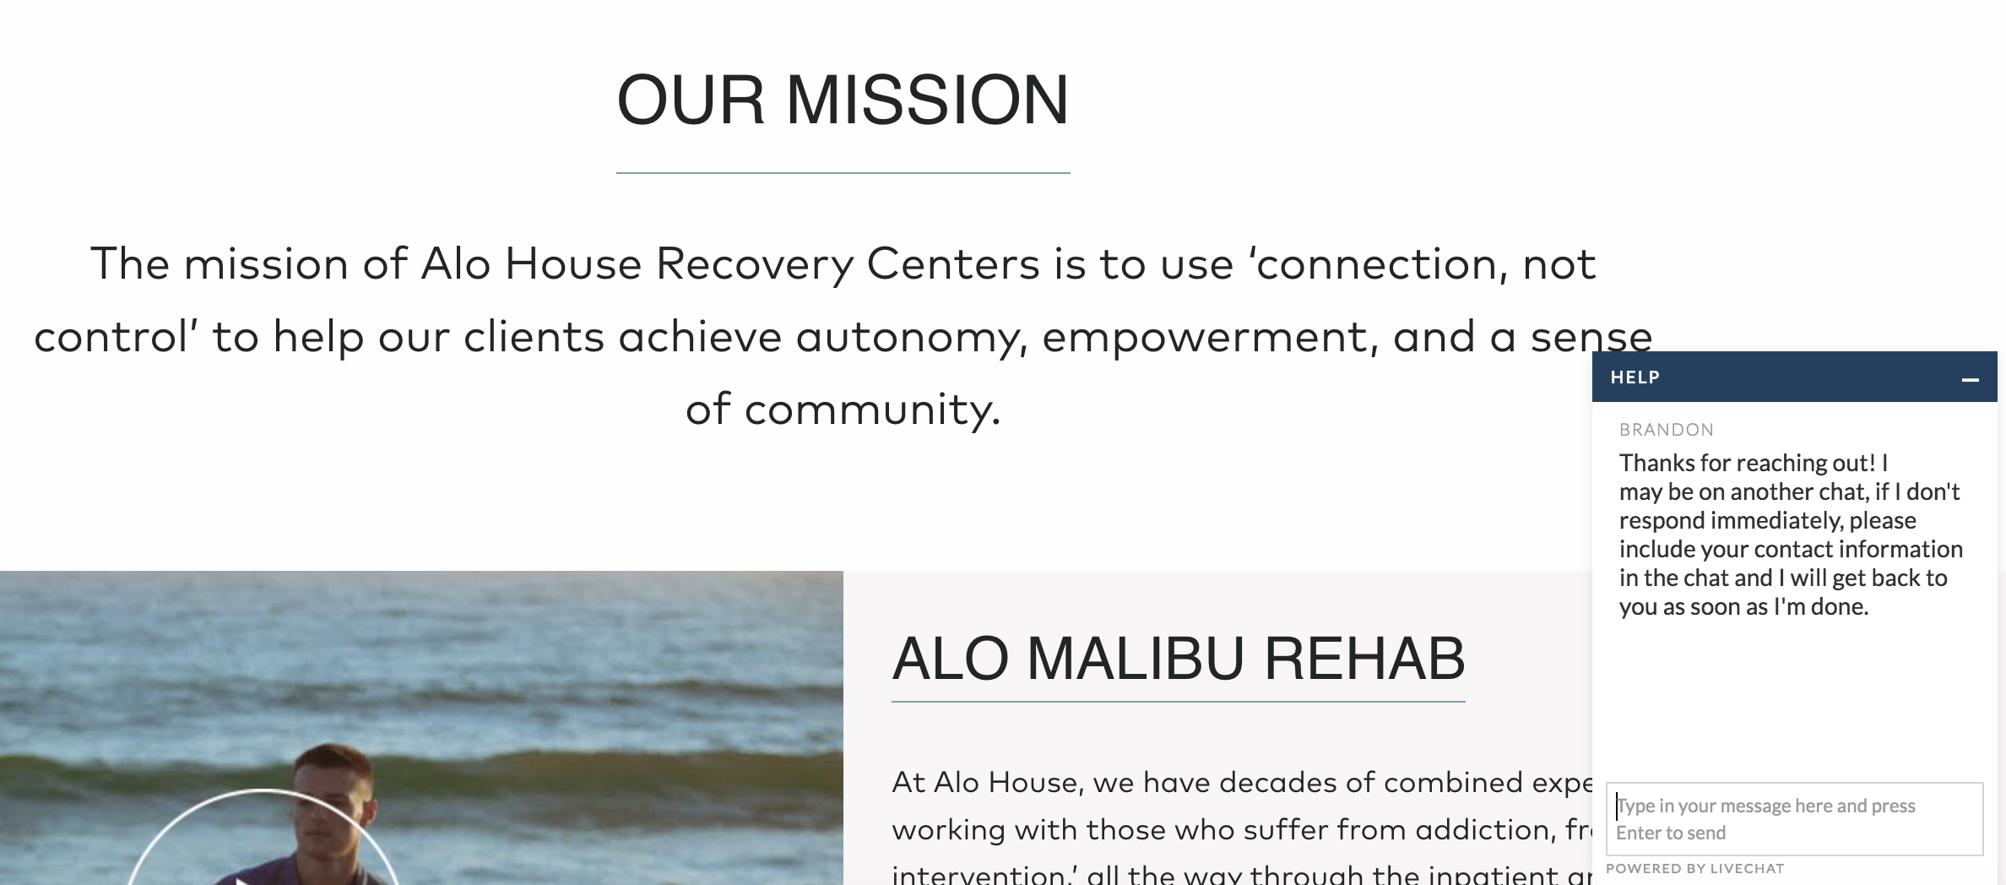
Increase Quality Leads
Marketing Automation – For Leads
Verify the insurance of incoming inquiries
Chat Widget
Notes:
Cost 2400, one time fee for set up – Hard Cost
250/month

Slide 34
New Location – Build Brand Awareness
Champaign Recommendation
Sioux City Recommendation
Marketing Objective: Build brand awareness of the new location.
Budget: $2,200
Geo-targeting: Champaign, Bloomington, Danville, Peoria, and Springfield.
Tactic/Platform: Search, FB, Yahoo
Strategy:
Push marketing through Yahoo, FB and Display Ads to create awareness.
Pull marketing through Search, and YouTube to be visibility for those with intent to find your center and/or services.
Marketing Objective: Build brand awareness of the new location.
Budget: $1,500
Geo-targeting: Sioux City, Sioux Falls,
Based on Charlie’s recommendation (Within the DMA, there are 23 counties covered 13 in Iowa, 11in Nebraska and one in South Dakota. Look at adding in Davenport, IO as well based on budget.
Tactic/Platform: Community Newspapers
O&O, Display , Facebook Ads
Strategy:
Push marketing through Newspapers, O&O, Display and FB ads. The demo here is older, lower income, less educated and therefore can benefit form a combination of local awareness.

Slide 35
Geo-fencing
A geo-fence is a virtual perimeter for a real-world geographic area. A geo-fence could be dynamically generated—as in a radius around a point location, or a geo-fence can be a predefined set of boundaries.
Geofence nearby hospitals/practices
Geofencing Competitors
Ads are displayed in app
Retargeting component after ads are served
Notes:
Conference
College Game, Basketball games
Schools, university
Competitors
Music Festivals

Slide 36
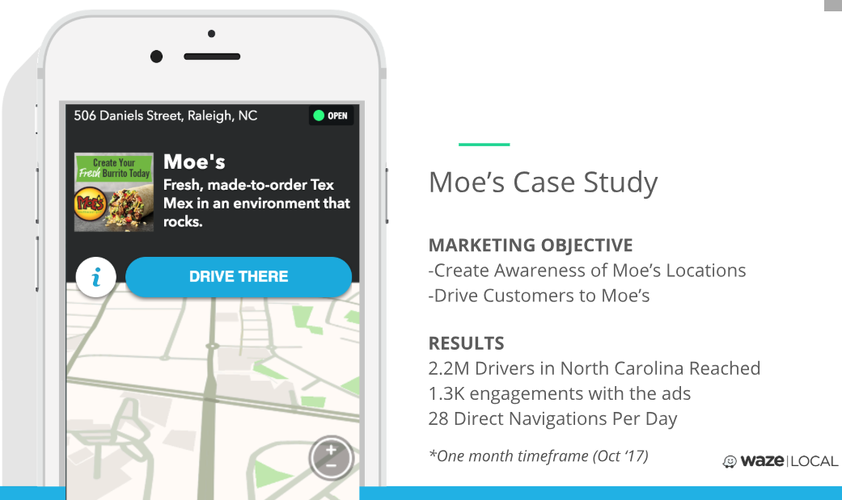

Slide 37
Traditional Media Recommendation
Marketing Objective: Increasing the pool, to reach the masses.
Tactic/Platform:
Radio
Television
Strategy:
TV Spots focused on the Rockford & Chicago areas.
Utilize the spots for online video advertising.
Possibly add NPR radio (as RHN is a non-profit). The audience is more affluent and we think it would be a good environment for them to associate with.

Slide 38
Marketing Goal: Increase overall admissions
Happiness
Healing
Hope
Health

Slide 39
Thank you!

